Slide 1
In 1948 the World Health Organization defined oral health as “a complete state of physical, mental, and social well-being, and not just the absence of infirmity.”

Slide 2
1. Physical well–being assumes the ability to function normally in activities such as speaking, eating, and moving around.
2.Mental well–being implies that there is no burden of fear, anxiety, stress, depression, or other negative emotions.
3. Social wellbeing relates to one’s ability to participate in society, fulfilling roles and duties.

Slide 3
❑ Oral health is fundamental to overall health,
wellbeing and quality of life.
A healthy mouth enables people to eat, speak, work and socialize without pain, discomfort or embarrassment.

Slide 4
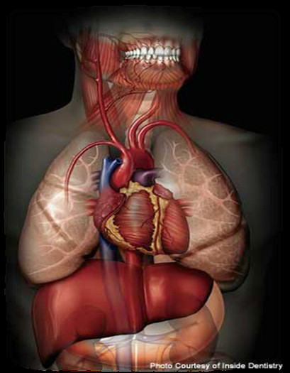
“The mouth is the gateway to the rest of the body, a mirror of our overall wellbeing.”
Along this, oral health must be perceived as a critical component of general health.

Slide 5
Dental disease negatively impacts general quality of life, affecting not only physical wellbeing but also psychological and social wellbeing.

Slide 7
➢ Further, the mouth is often an entry point for infections, which may spread to other parts of the body.
. ➢A person whose appearance and speech are impaired by dental disease can experience anxiety, depression, poor self–esteem and social stigma which in turn may inhibit lucky chance for education, employment and alter the ability to assist and build social relationships”.

Slide 8
➢Oral health problems can affect a person's ability to maintain a job or get promotions. They can also contribute to lowered academic achievement and goals.
These effects have increased when a deformity due to the oral health condition is involved

Slide 9
Children face the additional challenge of poor oral health far reaching effects into their adulthood.
Dental conditions in childhood can restrict children’s participation in schooling and education through days lost to illness.
Impaired physical appearance due to dental disease can further limit children’s ability to socialize with confidence and develop social norms and relationships.

Slide 10
Ø Tooth decay is the most common chronic childhood disease affecting 60‑90% of school children.
Ø It is over five times more prevalent than asthma among children.
Ø 7 times more common than hay fever.
Ø 52 million school hours missed annually because of oral problems

Slide 12
There are profound inequalities in caries status,
between countries, and that the distribution of
disease in a population is a changing dynamic.

Slide 13
Health inequalities are the systematic, structural
differences in health status between and within social groups within the population.
The term ‘‘health inequalities’’ is closely linked to‘‘social determinants of health’’.

Slide 14
Health inequalities can be seen as an
outcome of Social Inequalities

Slide 15
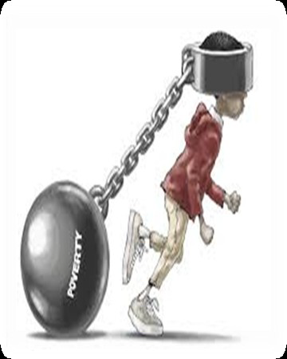
Studies showed Children from a deprived background may have five time more tooth
decay than children from more affluent backgrounds.

Slide 16
➢ The World Health Organization advocates using Health Promoting Schools programs to promote general and oral health.
➢ Oral health education is a key component in any School Oral Health Program.
“ You cannot educate a child who is not healthy, and you cannot keep a child healthy who is not educated.”

Slide 17
Health education is any combination of learning experiences designed to facilitate voluntary actions conducive to health.

Slide 18
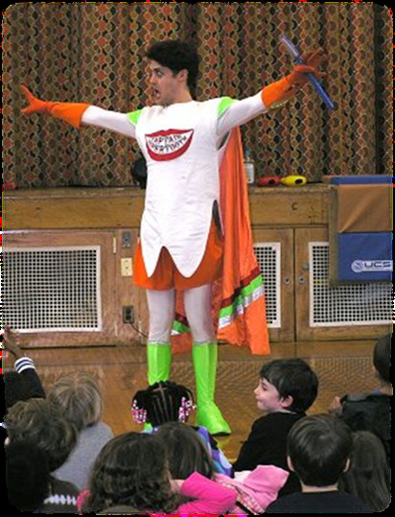
Integration of oral health into the school curriculum

Slide 19
EDUCATIONAL AIDS USEDIN HEALTH EDUCATION
○ Main constituent of the armamentarium of the health education process.
➢ Auditory aids
➢ Visual aids
➢ A combination of audio-visual aids.

Slide 20
Methods of health education
1. Individual approach
2. Group approach
3. Mass approach

Slide 21
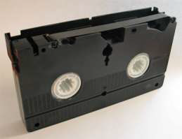
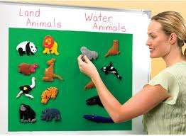
a. Projected aids:
Films or Cinemas
➢ Film Strips
➢ Slides
➢ Overhead Projectors /or Transparencies
➢ Bioscopes
➢ Video cassettes
➢ Silent films
b) Non-Projected aids:
➢ Blackboard
➢ Pictures, cartoons, photographs
➢ Charts, posters
➢ Flip charts, flashboards
➢ Flannel boards
➢ Printed materials
➢ Model, sample

Slide 22
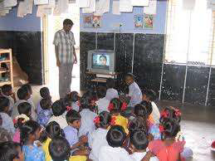
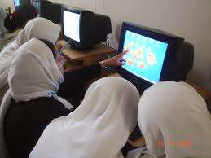
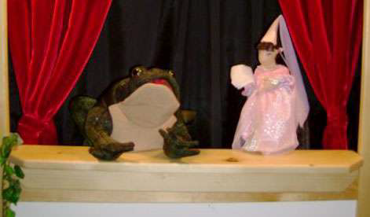
○ Creates a better presentation….
They include:
➢ Televisions
➢ Tape and slide combinations
➢ Video cassettes players
and recorders
➢ Motion pictures or cinemas
➢ Multimedia computers
○ Also include traditional media
➢ Folk dances
➢ Folk songs
➢ Puppet shows
➢ Dramas

Slide 23
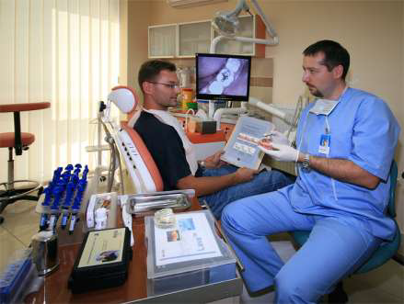
Advantages
○ Can be done in a dentist’s consultation room.
○ Discussion, argument and persuasion of an individual to change his behavior is possible.
○ There is opportunity for the individual for asking
questions and clearing doubts.
----
Disadvantages:
○ Only a small no. can benefit
○ Health education is given only to
those who come in contact with the dental
surgeon or with public health personnel

Slide 24
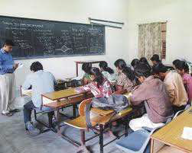
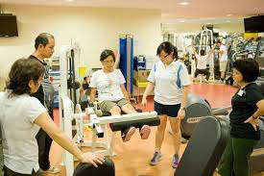
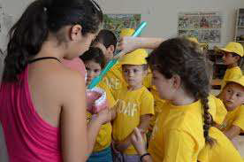
a. Chalk and talk (lectures)
b. Symposium
c. Group Discussions
d. Panel discussions
e. Workshop
f. Conferences or seminars
g. Role playing/socio dramas
h. Demonstrations

Slide 25
a) Television
b) Radio
c) Newspapers/press
d) Documentary films
e) Posters
f) Health exhibition
g) Health magazines
h) Information booklets
i) Internet

Slide 26
Health promotion
DEFINITION
“the process of enabling people to increase control over, and to improve their health”.

Slide 27
Five priority action areas for health promotion:
1. Building healthy public policy
2. Creating supporting environments for health
3. Strengthening community action for health
4. Developing personal skills
5. Re-orienting health services

Slide 28
APPROACHES TO HEALTH PROMOTION
1. Preventive
2. Behavior change
3. Educational
4. Empowerment
5. Social change

Slide 29
Individual Factors
1. Improve education and awareness
2. Reduce barriers to health care seeking
practices
Social Environment
➢Marketing healthy
behavior influencing social
and family norms that link
to oral health knowledge,
attitudes, beliefs, values.
Environmental conditions
➢Water fluoridation
➢Restricting marketing and
improving labelling of food
products

Slide 30
A number of systematic reviews have been conducted on the available evidence for the effectiveness of school-based behavioral interventions .
These have shown that oral health education can be effective in increasing knowledge in the short term and to some extent, behavior such as tooth brushing and healthy eating. However there is a limited evidence for its effectiveness on children’s oral health in terms of reducing dental plaque and dental caries.

