Slide 1
Denture cleanser

Slide 2
Saliva: Saliva is a mixture of water, proteins, electrolyte and mineral elements. Saliva has the propensity to cause extrinsic discoloration or staining of denture base materials.
Factors Affecting the Staining of Acrylic Resin

Slide 3
Beverages: The solutions that induced more staining were the concentrated coffee and tea solutions, then concentrated grape juice solution, followed by concentrated tomato grape solution and least stain induced by concentrated orange juice solution. Smoking cigarettes is considered as one of the factors that significantly affect the color of resin based restorative.

Slide 4
Denture Surface: Any dental restoration or appliance placed permanently in the oral cavity should be highly polished because the rough surface is uncomfortable, and food and other debris cling to it. The accumulation of debris on the rough surface also leads to significant discoloration and loss of glossiness of resin materials

Slide 5
Oral Hygiene and Denture Stomatitis Denture stomatitis is a commonly recurring problem of denture wearers. It is characterized by erythema and found under complete or partial denture but more frequently in the maxilla . The elderly patients should be carefully instructed on how to perform a good oral and denture hygiene through explanation and physical demonstration of how to remove the denture plaque. Edentate adults must employ oral hygiene procedure after each meal with denture cleansers and brushes to decrease the likelihood of developing oral mucosal disease and fungal infections.

Slide 6
The Ideal Properties of Denture Cleanser
1. Nontoxic and easy to remove, leaving no traces of irritant material.
2. Able to attack or dissolve both organic and inorganic portions of denture deposits.
3. Harmless to all materials used in construction of denture including denture base polymers, alloys, acrylic and porcelain teeth and resilient lining materials.
4. Not harmful to eyes, skin or clothing if accidentally spilled or splashed.
5. Stable during storage.
6. Preferably bactericidal and fungicidal.

Slide 7
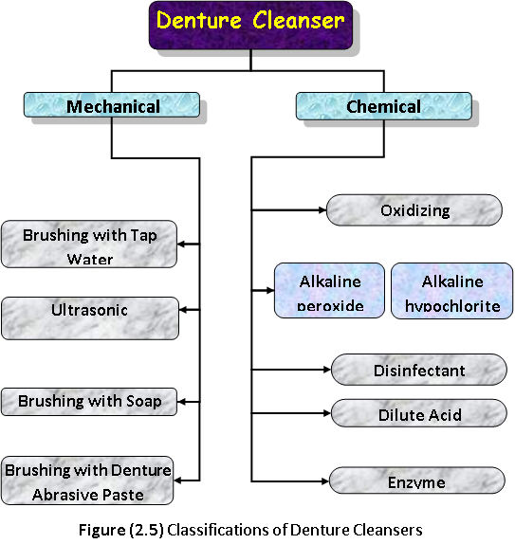

Slide 8
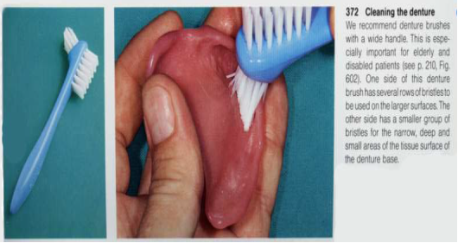

Slide 9
