Slide 1
Spinal Injuries

Slide 2
Objectives
The ability to demonstrate knowledge of the following:
Basic anatomy of the spine.
Initial assessment and treatment of spinal injuries at the field.
Principle of spinal stability.
Understanding of neurologic syndromes caused by spinal trauma.
Management of Cauda equina syndrome.

Slide 3
Epidemiology
15-20% multiple non-contiguous levels.
10% involving the cervical spine.
90% involving thoracolumbar spine.
25% have neurologic deficit.
Age: mostly between 15-24 years.
Gender: mostly males (4:1).

Slide 4
Mechanism of Injury
High energy trauma such as an MVA or fall from a height or a horse.
MVA: 40-55%
Falls: 20-30%
Sports: 6-12%
Others: 12-21%
Low energy trauma in a high risk patient (ie a patient with known spinal canal compromise such as ankylosing spondylitis, Osteoporosis or metatstatic vertebral lesions)
Penetrating trauma from gunshot or knives.

Slide 5
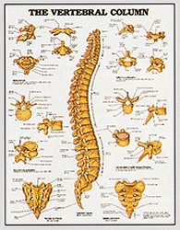
Anatomy
Spinal Column

Slide 6
Anatomy
Spinal Column

Slide 7
Anatomy
Spinal Column

Slide 8
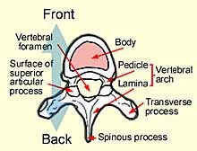
Anatomy
Spinal Column

Slide 9
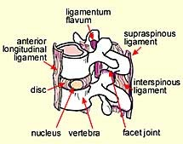
Anatomy
Spinal Column

Slide 10
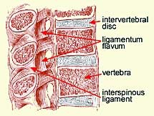
Anatomy
Spinal Column

Slide 11
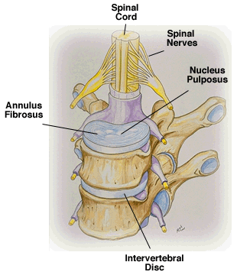
Anatomy
Spinal Column

Slide 12
Anatomy
Spinal Column

Slide 13
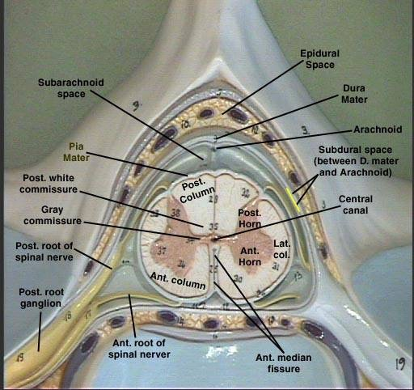
Anatomy
Spinal Cord

Slide 14
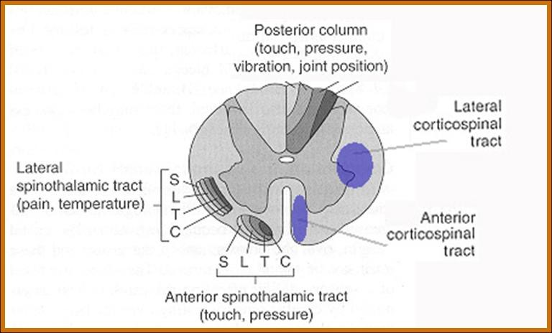
Anatomy
Spinal Cord

Slide 15
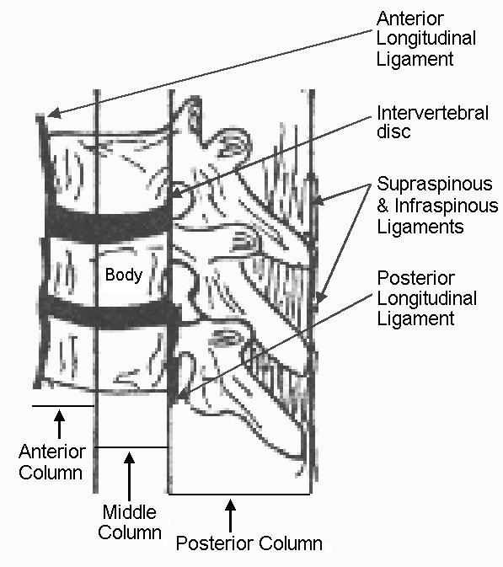
The Three columns

Slide 16
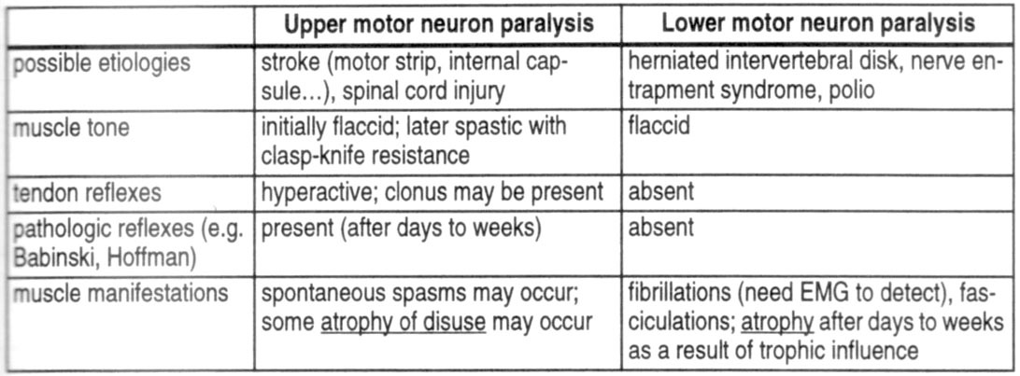
What are the differences between UMN and LMN? (e.g., cauda equina vs. myelopathy)

Slide 17
So to determine the level of injury?
Motor level = the last level with at least 3/5 (against gravity) function
NB: this is the most important for clinical purposes
Sensory level = the last level with preserved sensation
Radiographic level = the level of fracture on plain XRays / CT scan / MRI
NB: spine level does not correspond to spinal cord level below the cervical region

Slide 18
High cervical injuries (C3 and above)
Motor and sensory deficits involve the entire arms and legs
Dependent on mechanical ventilation for breathing (diaphragm is innervated by C3-C5 levels)

Slide 19
Midcervical injuries (C3-C5)
Varying degrees of diaphragm dysfunction
Usually need ventilatory assistance in the acute phase
Shock

Slide 20
What is the difference between spinal shock and neurogenic shock?
 | Neurogenic | Hypovolemic
Etiology | Loss of sympathetic outflow | Loss of blood volume
Blood pressure | Hypotension | Hypotension
Heart rate | Bradycardia | Tachycardia
Skin temperature | Warm | Cold
Urine output | Normal | Low

Slide 21
Low cervical injuries (C6-T1)
Usually able to breathe, although occasionally cord swelling can lead to temporary C3-C5 involvement (need mechanical ventilation)
The level can be determined by physical exam

Slide 22
So what do you expect with a cervical lesion?
Quadriplegia or quadriparesis
Bowel/bladder retention (spastic)
Various degrees of breathing difficulties
Neurogenic and/or spinal shock

Slide 23
Thoracic injuries (T2-L1)
Paraparesis or paraplegia
UMN (upper motor neuron) signs

Slide 24
Cauda equina injuries (L2 or below)
Paraparesis or paraplegia
LMN (lower motor neuron) signs
Thigh flexion is almost always preserved to some degree

Slide 25
Assessment
In cases of trauma, ABC….. must be assessed first and treated appropriately.
Patients should be examined with spinal collar until spinal pathology is excluded.
Careful log rolling keeping the head, neck and pelvis in line should be done to examine the spine properly.

Slide 26
Assessment
Immobilization.
History:
Mechanism of injury:
compression, flexion, extension, distraction
Other injuries.
Seat belt.
Other causalities.
Physical examination:
Inspection, palpation.
Neurologic examination.

Slide 27
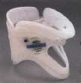
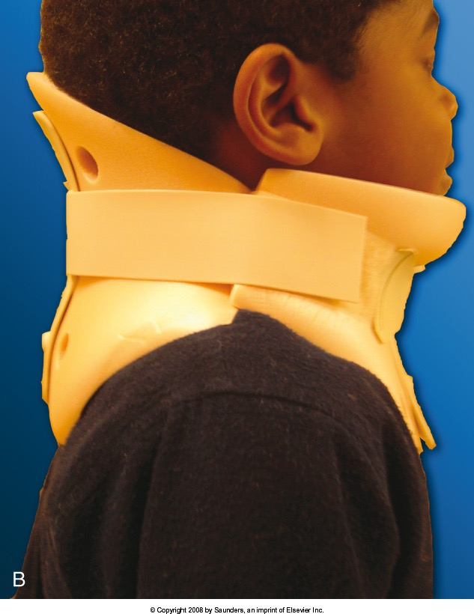
Immobilization

Slide 28
Neurologic
Muscle Test
Sensory exam
light touch, Sharp dull discrimination, Vibration sense, Proprioception and two-point discrimination
Reflexes

Slide 29
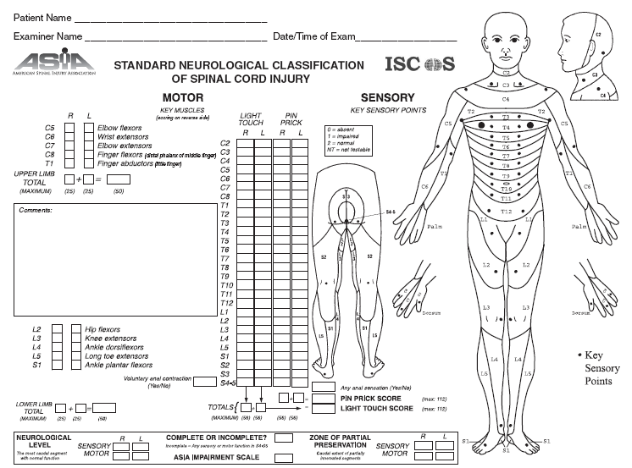
Asia Score: Brief Trauma Neurologic Survey

Slide 30
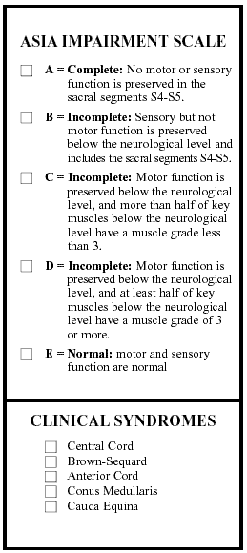
Prognosis for Recovery of spinal Cord Injury:
Level of Cord Injury determines level of function
Poor prognosis for recovery if:
-pt arrives in shock
-pt cannot breath
-pt has a complete injury

Slide 31
Assessment
Severity of neurologic deficit
Complete
Flaccid paralysis below level of injury.
May involve diaphragm if injury above C5.
Sympathetic tone lost if fracture above T6.
Incomplete
? Any sensation.
? Sacral spairing.

Slide 32
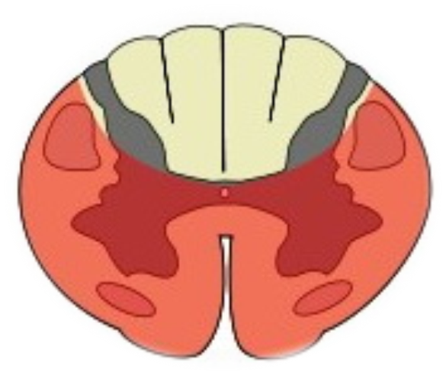
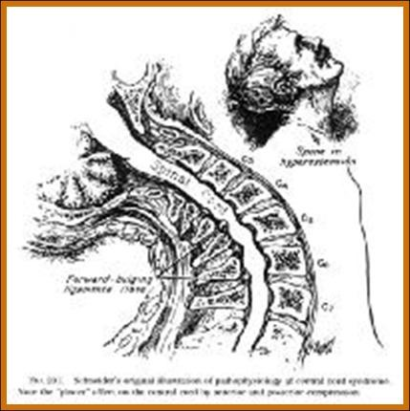
Assessment
Severity of neurologic deficit
Incomplete
Central cord syndrome:
# Characterized by disproportionally (UL>LL).
# Mechanism: hyper-extension.
# Occur with or without fractures.
# Recovery: 50% regaining function.
# Prognosis is fair.

Slide 33
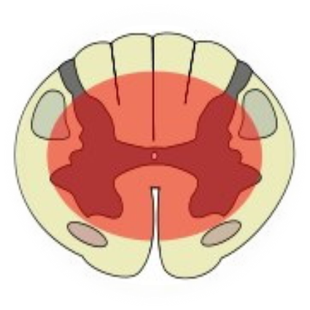
Assessment
Severity of neurologic deficit
Incomplete
Anterior cord syndrome:
# Characterized by loss of corticospinal and spinothalamic tract with preserved posterior column.
# Mechanism: ischemia or infarction to spinal cord..
# Common injury.
# Recovery: 10%.
# Prognosis is good if progressive recovery within 24hrs, absent SS after 24hrs protends a poor outcome.

Slide 34
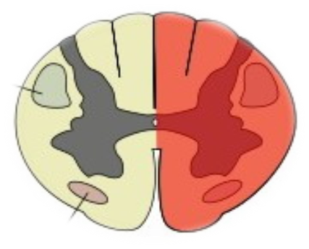
Assessment
Severity of neurologic deficit
Incomplete
Brown-Sequard syndrome:
# Characterized by hemicord injury with ipsilateral paralysis, loss of proprioception and fine touch, and contralateral temperature and pain loss.
# Prognosis is good, with over 90% regaining of bowel and bladder function and ambulatory capacity.

Slide 35
Assessment
Severity of neurologic deficit
Incomplete
Conus Medullaris syndrome:
# Seen in T12-L1 injuries.
# Loss of voluntary bowel and bladder control with preserved lumbar root function.
# Uncommon as pure lesion (mixed conus-cauda).

Slide 36
Assessment
Severity of neurologic deficit
Incomplete
Cauda Equina syndrome:
# Saddle anesthesia, urinary retention and stool incontinence.
# Usually due to large central disc herniation rather than fracture.
Nerve root deficit: LMN

Slide 37
Spinal Shock
Transient loss of spinal reflexes.
Lasts 24-72 hours.
Neurogenic shock
Reduced tissue perfusion due to loss of sympathetic outflow and un-apposed vagal tone.
Peripheral vasodilatation (hypotension and bradycardia).
Rx: fluid resuscitation and vasopressors.

Slide 38
Imaging
X-rays:
Cervical: 3 views.
AP, lateral and open mouth.
Thoraco-lumbar: 2 views.
AP & lateral.
Flexion-Extension views.
CT: best for bony anatomy.
MRI: best to evaluate soft tissue.

Slide 39
Management of Spinal Injuries
Depends on:
Level of injury.
Degree and morphology of injury: STABILITY
Presence of neurologic deficit.
Other factors.

Slide 40
Some general rules:
Stable injuries are usually treated conservatively.
Unstable injuries usually require surgery.
Neurologic compression requires decompression.

Slide 41
Specific Injuries

Slide 42
Cervical spine fractures
Descriptive: depends on mechanism of injury.
Flexion/extension.
Compression/distraction.
Shear.
Presence of subluxation/dislocation
SCI:
high fracture results in quadriplegia.
Low fracture results in paraplegia.

Slide 43
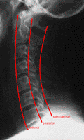
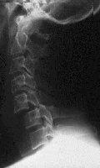
Cervical spine fractures

Slide 44
Thoraco-Lumbar fractures
Spinal cord terminates at L1/2 disc in adult
L2/3 in a child
50% of injuries occur at Thoraco-lumbar junction.
Common fractures:
Wedge fracture (flexion/compression).
Burst (compression).
Chance (flexion/distraction).

Slide 45
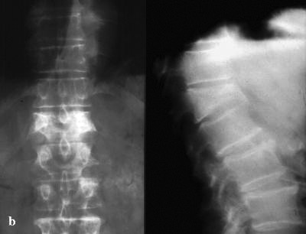
Wedge fracture

Slide 46
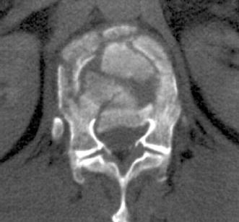
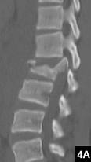
Burst fracture

Slide 47
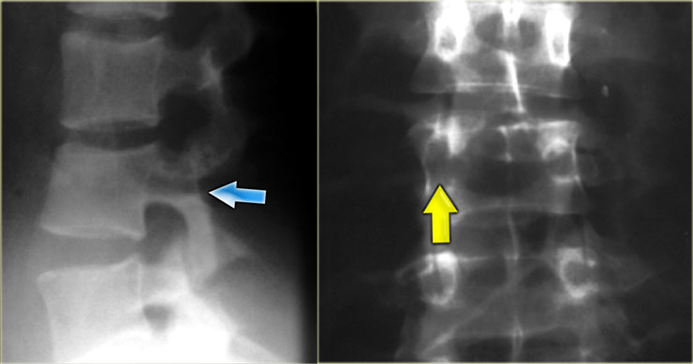
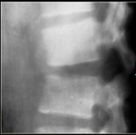
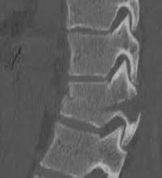
Chance fracture

Slide 48
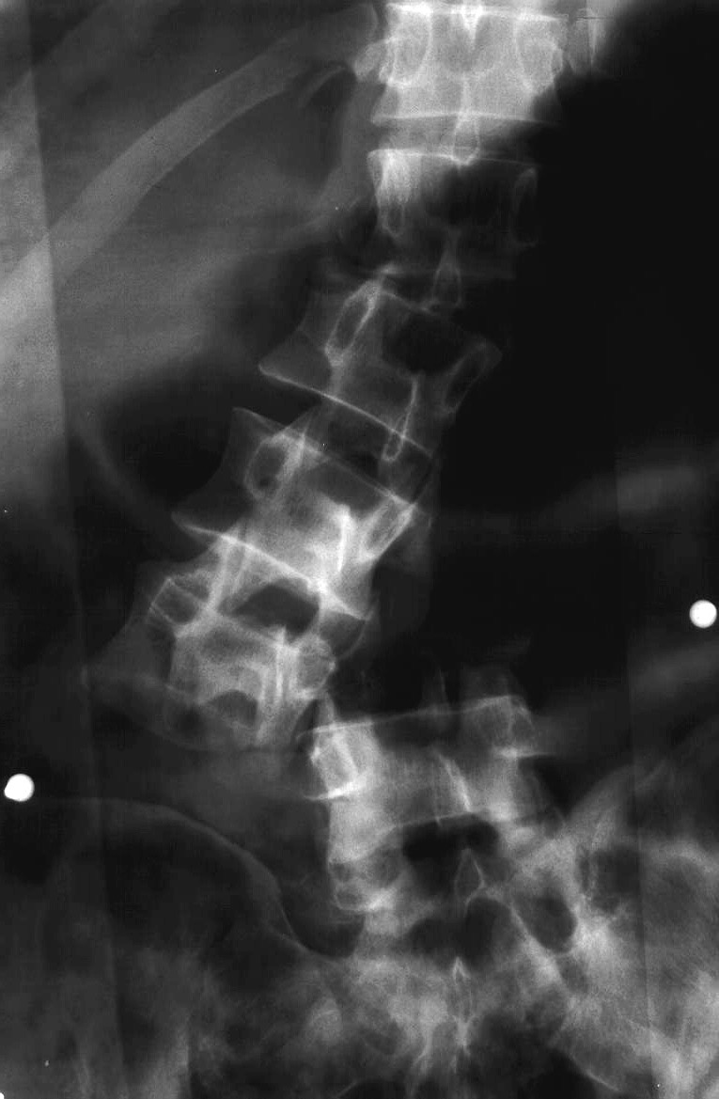
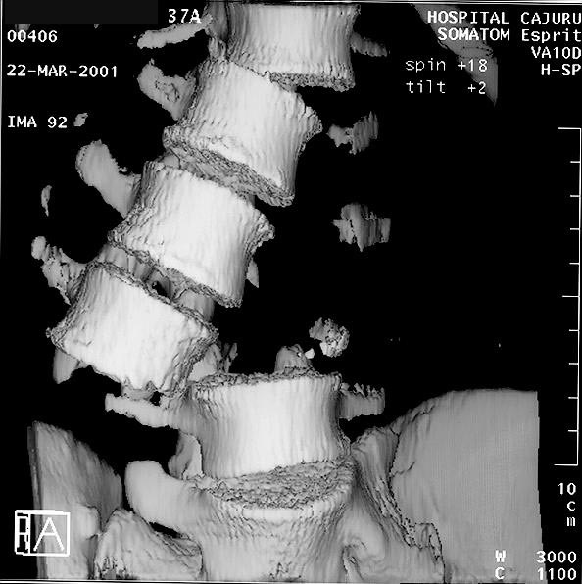
Fracture dislocation

Slide 49
Pathologic fractures
Low-energy fractures.
Osteoporotic is common.
Usually due to infection or tumor.
X-rays: “winking owl” sign.

Slide 50
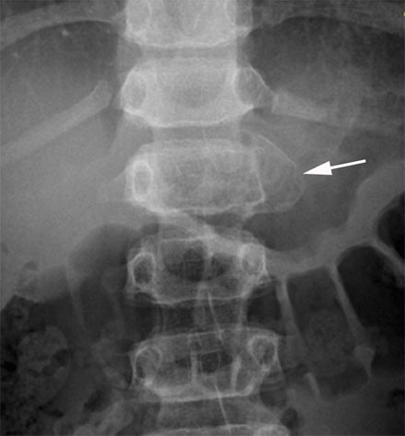
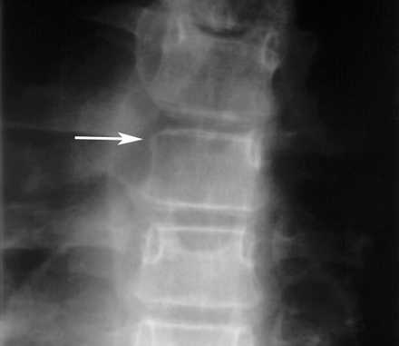
Pathologic fractures

Slide 51
Cauda Equina Syndrome
A surgical emergency.
Requires full neurologic examination including rectal examination for anal tone.
Investigations: X-rays initially, but MRI is mandatory as X-rays are usually unremarkable.
Treatment: Emergency decompression-usually discectomy and wide laminectomy within 24 hours.

Slide 52
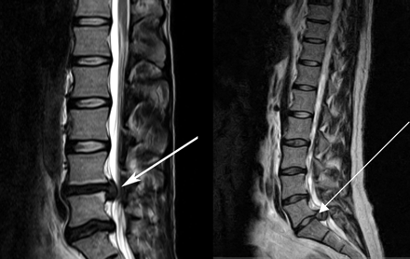
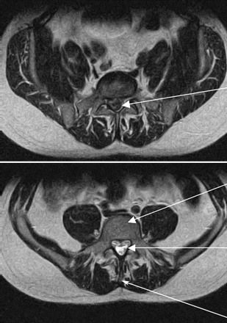
Cauda Equina Syndrome

Slide 53
Thank you

