Slide 1
Congenital Anomalies of the Central Nervous System
DR.HAYDER QATRAN
NEUROSURGERY

Slide 2
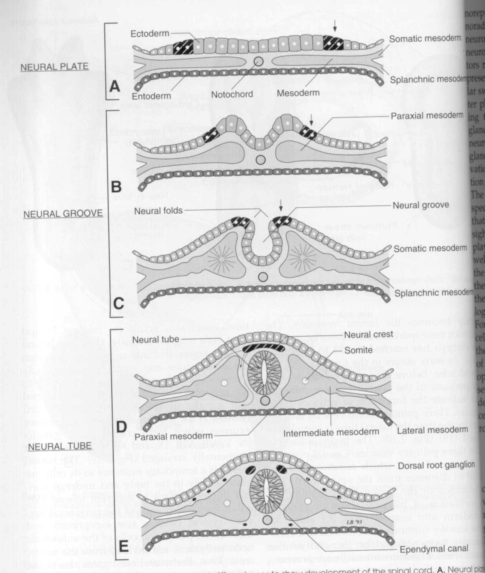
Transverse
sections of
embryos at
Different ages
to show the
Dev’t of
the spinal cord

Slide 3
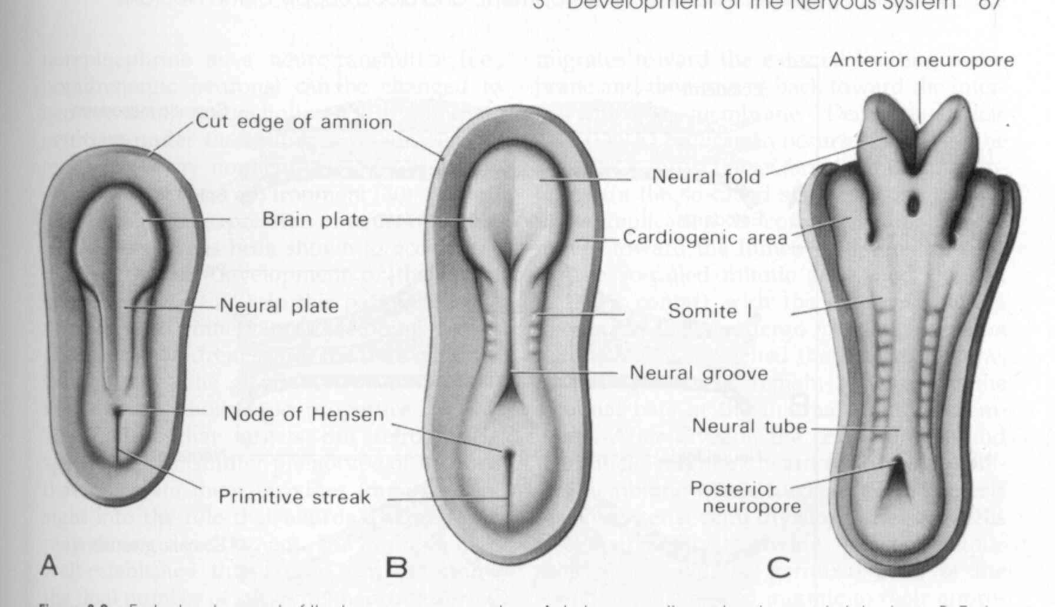
Early development of the human nervous system
late presomite and
early neural plate
stage
early somite and neural
groove stage
eight-somite and
early neural tube
stage

Slide 4
Neural Tube Defects (Posterior Midline Defects/Dysraphism)
Results from failure of the neural tube to close spontaneously between the 3rd-4th week of in utero development
Possible etiologic factors:
Radiation
Drugs
Malnutrition
Chemicals
Genetic determinants (mutations in folate-responsive and folate-dependent pathways)

Slide 5
Neural Tube Defects
Spina bifida occulta
Meningocoele/ Myelomeningocoele
Encephalocoele
Anencephaly
Dermal sinus
Tethered cord
Syringomyelia
Diastematomyelia

Slide 6
Neural Tube Defects
Diagnostic tool:
Failure of closure of the neural tube allows excretion of fetal substances (AFP, acetylcholinesterase) into the amniotic fluid
Prenatal screening of maternal serum for AFP during 16-18 week of gestation
AFP obtained between 15-20 weeks’ gestation is most specific
Rostral end of the NT closes on the 23rd day and the caudal neuropore closes by the 27th day of development

Slide 7
Neural Tube Defects and FA
Maternal periconceptional use of folic acid supplementation reduces the incidence of NT defects by at least 50%
US: recommends all women of childbearing age take 0.4 mg of folic acid daily, and women with previous pregnancy of NT defect should be treated with 4 mg of folic acid beginning one month before pregnancy is planned, until at least the 12th week of gestation when neurulation is complete

Slide 8
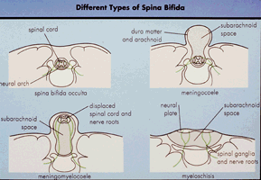

Slide 9
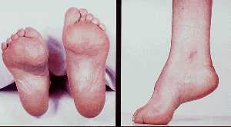

Slide 10
Spina Bifida Occulta
Midline defect of the vertebral bodies without protrusion of the SC or meninges
May be asymptomatic without neuro signs
In some, patches of hair, lipoma, discoloration of skin or dermal sinus may be present

Slide 11
Spina Bifida Occulta
Spine x-ray: defect in closure of the posterior vertebral arches and laminae, usually in L5 and S1
May be associated with syringomyelia, diastematomyelia, and tethered cord
Recurrent meningitis of occult origin should prompt careful exam for dermal sinus tract

Slide 12
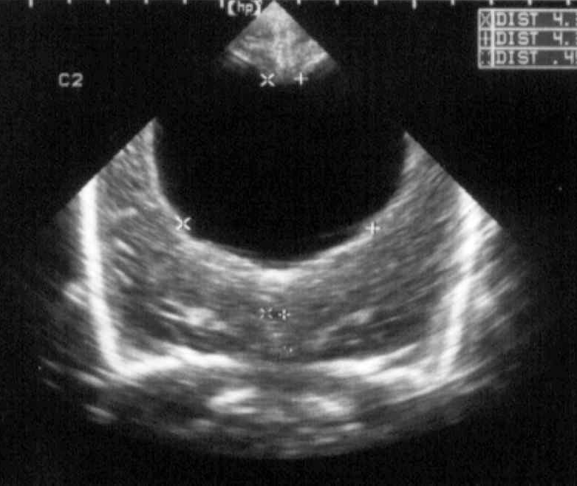
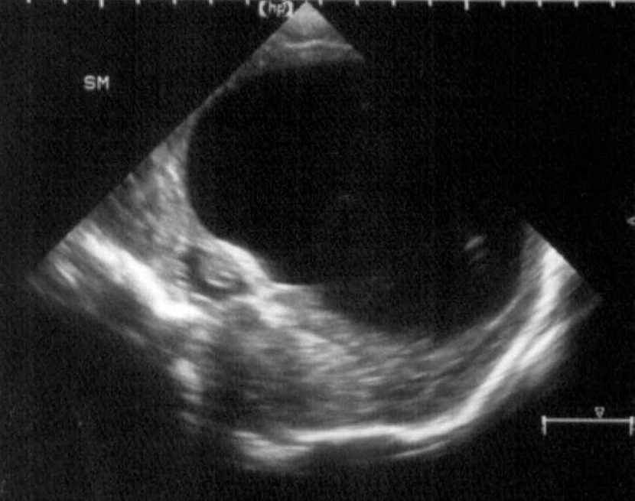
S. N., 2 mos old, female
Marked obstructive Hydrocephalus
secondary to ARNOLD CHIARI II
Neurulation Period
Gestational Age in Months
Postnatal
1
2
3
4
5
6
7
8
9

Slide 13
Meningocoele
Formed when the meninges herniate through a defect in the posterior vertebral arches
SC may be normal, or may present with tethering, syringomyelia, or diastematomyelia
A fluctuant mass that may transilluminate along the vertebral column

Slide 14
Meningocoele
Dxtic: plain x-ray, u/s, MRI for the spine, CT of the head to R/O(role out) HCP (hydrocephalous)
Txtic: Asymptomatic children with Normal neuro findings and full-thickness skin may have surgery delayed.
Patients with leaking CSF or a thin skin covering should undergo immediate repair to prevent meningitis.

Slide 15
Meningocoele
Anterior meningocoele may project into the pelvis through a defect in the sacrum causing symptoms of constipation and bladder dysfunction
Female patients may have associated anomalies of the genital tract (rectovaginal fistula, vaginal septa)
Dxtic: plain x-ray, CT, MRI

Slide 16
Myelomeningocoele
Most severe form of dysraphism involving the vertebral column with an incidence of ∼1/4000 LB
Risk of recurrence after one affected child increases to 3-4% and increases to ~10% with 2 previous abnormal pregnancies
Certain drugs that antagonize folic acid ( AEDs: tegretol, phynitoin,primidone) increase the risk of myelomeningocoele
Valproic acid(depakine) cause NT defects in ~1-2% of pregnancies

Slide 17
Myelomeningocoele
May be located anywhere along the neuraxis but the LS (lumbo-sacral) region accounts for 75% of the cases
Extent and degree of the neuro deficit depend on the location (more high up more damage)
flaccid paralysis, absent DTRs(deep tendon reflexes), sensory deficit below the affected level, postural abnormality of the LE (clubfeet, subluxation of the hips), constant urinary dribbling and a relaxed anal sphincter

Slide 18
Myelomeningocoele
HCP (hydrocephalous) in association with a type II Chiari defect develops in at least 80% with myelomeningocoele
Infants with HCP and Chiari II develop symptoms of hindbrain dysfunction: difficulty feeding, choking, stridor, apnea, VC paralysis, pooling of secretions, spasticity of UEs
Chiari crisis is due to downward herniation of the medulla and cerebellar tonsils

Slide 19
Myelomeningocoele
Requires a multidisciplinary approach: surgeon, therapist, pediatrician
Surgery: repair and shunting; orthopedic procedure, urologic evaluation
GUT: regular catheterization to prevent UTI and reflux leading to PN (pyeloniphritis) and hydronephrosis, urine cult, serum electrolytes, creatinine, renal scan, IV pyelogram, U/s
Rehab: functional ambulation (sacral or LS lesion)

Slide 20
Myelomeningocoele
Prognosis:
MR- 10-15%
Most deaths occur before age 4 years
70% have normal intelligence, but learning problems and seizure disorders are common
History of meningitis or ventriculitis adversely affect the ultimate IQ

Slide 21
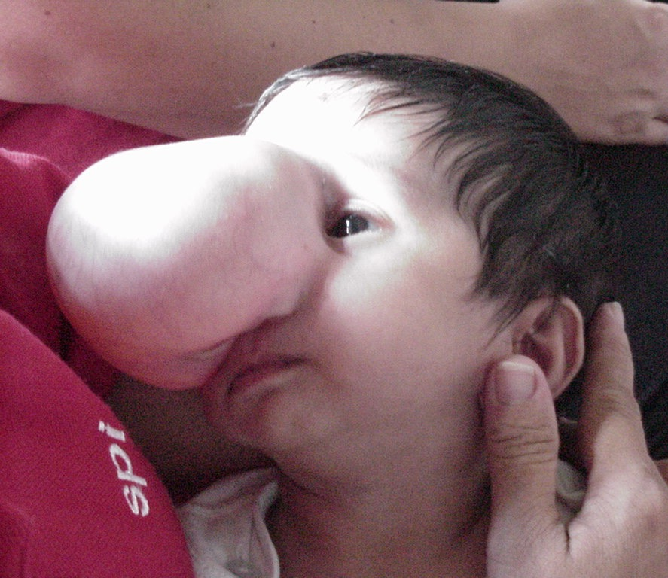
11 mos old, male
Neurulation Period
Gestational Age in Months
Postnatal
1
2
3
4
5
6
7
8
9

Slide 22
Encephalocoele
Cranium meningocoele: CSF-filled meningeal sac only
Cranial encephalocoele: contains the sac plus cerebral cortex, cerebellum or portions of the brainstem usually with abnormalities
Usually occurs in the occipital region or below the inion, although in some countries, frontal or nasofrontal encephalocoeles are more prominent

Slide 23
Encephalocoele
Dxtic:
Plain x-ray of the skull and cervical spine
Cranial u/s
In utero: AFP, biparietal diameter
Prognosis:
Encephalocoele- at risk for visual problems, microcephaly, Mental retardation, seizures
Meckel-Gruber syndrome: occipital encephalocoele, cleft lip or palate, microcephaly, microphthalmia, abnormal genitalia, polycystic kidneys, and polydactyly

Slide 24
Anencephaly
Large defect of the calvarium, meninges, and scalp associated with a rudimentary brain which results from failure of closure of the rostral neuropore
Primitive brain consists of portions of connective tissue, vessels and neuroglia
The cerebral and cerebellar hemispheres are usually absent, and only a residue of the brainstem can be identified; the pituitary gland is hypoplastic, and the SC pyramidal tracts are absent

Slide 25
Anencephaly
Associated anomalies: folding of the ears, cleft palate, congenital heart defects (10-20%)
Die within several days of birth
Frequency: 1/1000 LB
Recurrence risk: 4% and increases to 10% with 2 previously affected pregnancies
Monitoring of succeeding pregnancies: amniocentesis, AFP levels, U/s between 14-16th week of gestation

Slide 26
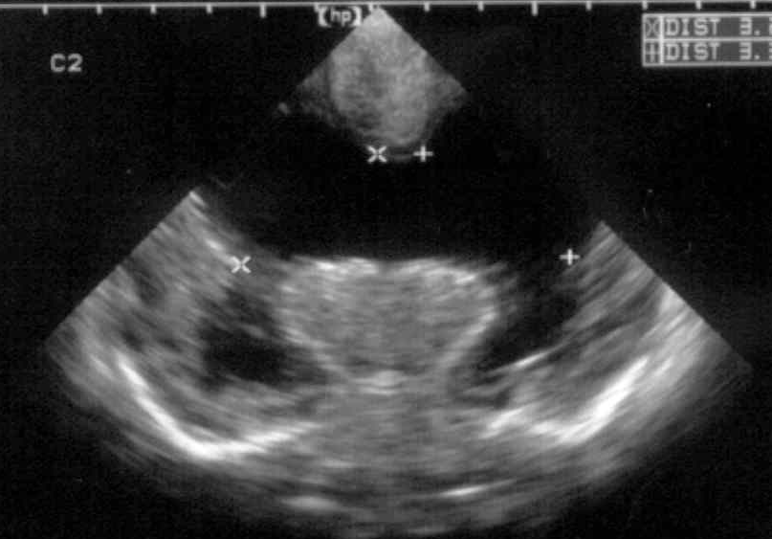
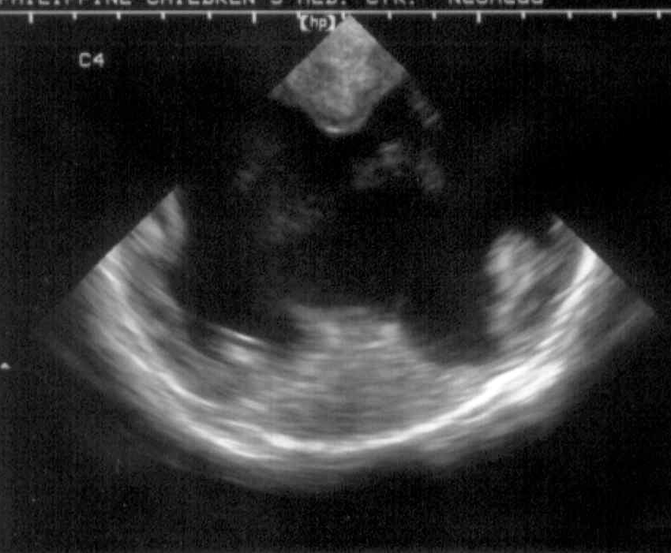
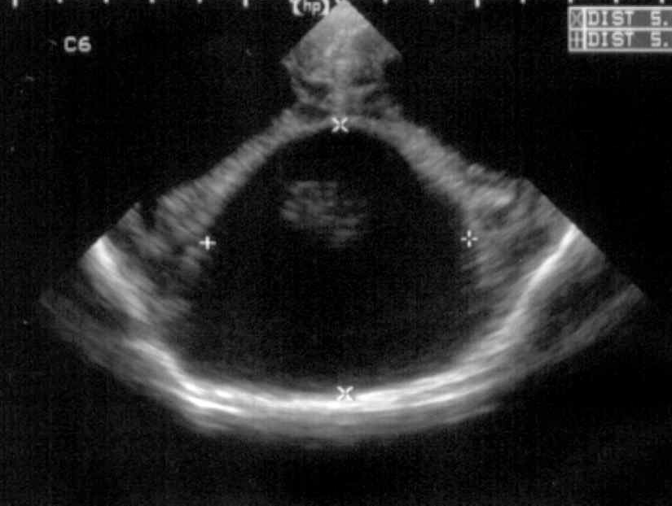
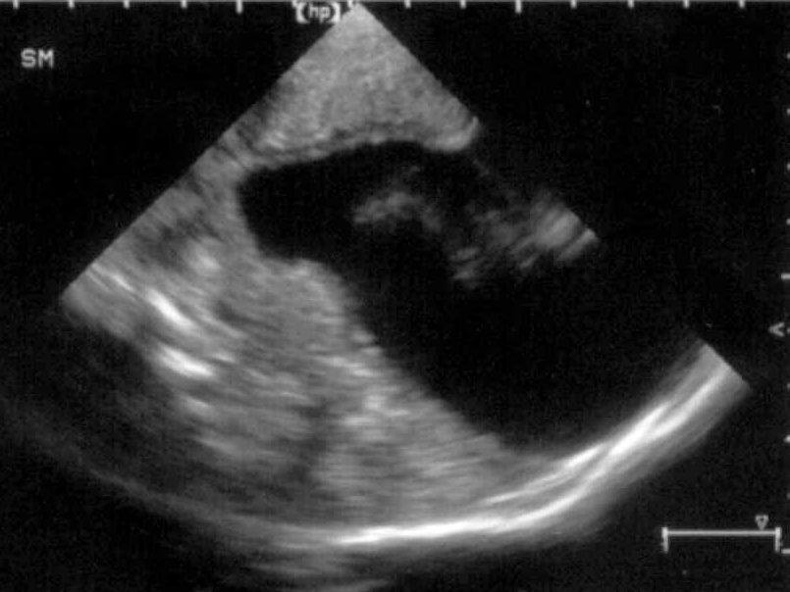
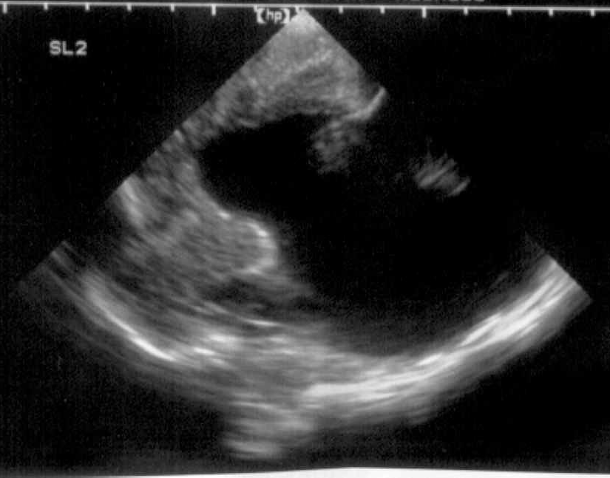
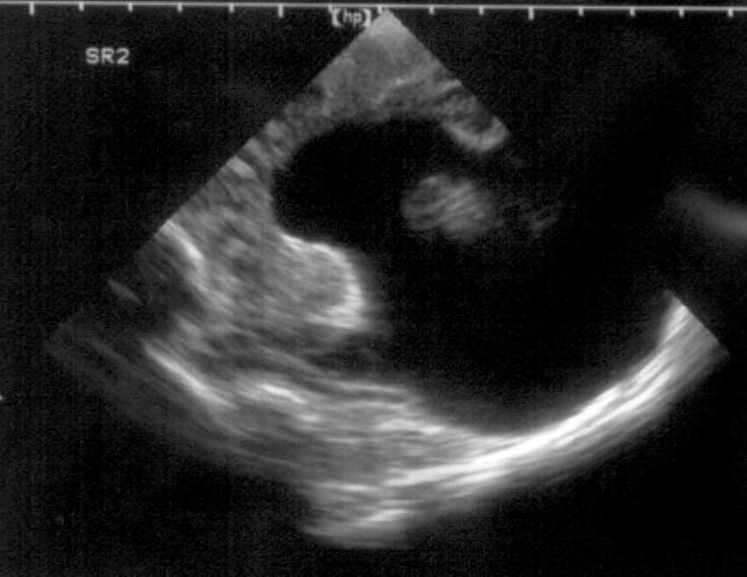
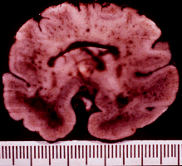
P.M, 22 days old CA 36-37 wks, with cleft lip and palate
Holoprosencephaly, semilobar
Macrogyria
Absent Septum Pellucidum
Dysgenesis of the Corpus Callosum

Slide 27
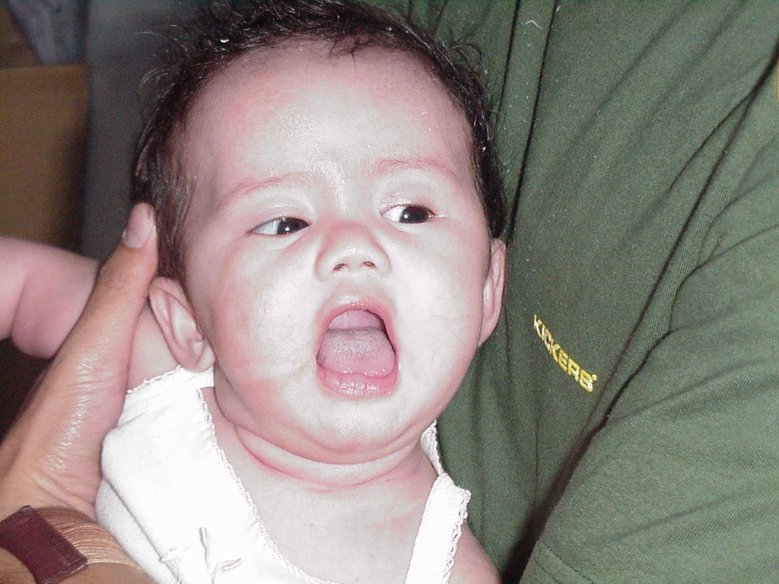
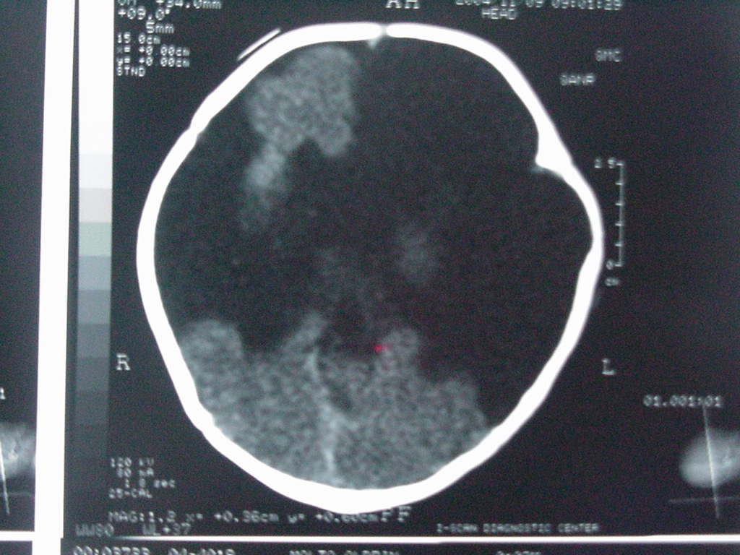
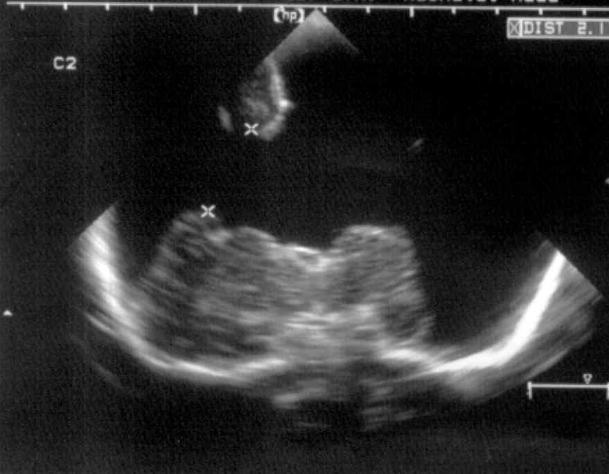
A.M., 2 months old
was noted to be microcephalic w/ sz
Porencephalic Cyst
Schizencephaly
Absent Septum Pellucidum
Dysgenetic Corpus Callosum
Aqueductal Stenosis
Neuronal Migration
Gestational Age in Months
Postnatal
1
2
3
4
5
6
7
8
9

Slide 28
Porencephaly
Cysts or cavities within the brain that may or may not communicate with the ventricular system, resulting from vascular or infectious results during late fetal or early infantile life
Usually present with hemiparesis and focal seizures during the 1st year of life

Slide 29
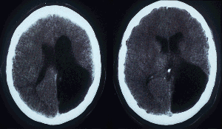
Porencephaly

Slide 30
Agenesis of the Corpus Callosum
Results from an insult to the commissural plate during embryogenesis
When it appears as an isolated phenomenon, the patient may be normal; but those with associated migration defects may present with Mental Retardation, microcephaly, hemiparesis, diplegia and seizures
CT/MRI: widely separated frontal horns with an abnormally high position of the 3rd ventricle

Slide 31
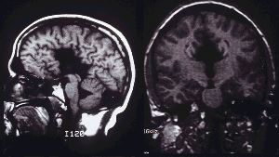
Agenesis of the Corpus Callosum

Slide 32
Agenesis of the Corpus Callosum
Aicardi Syndrome
Patients are almost all females (may be lethal in males)
Characterized by severe MR, intractable seizures with onset between birth and 4 mons of age, and chorioretinal lacunae. Hemivertebrae and costovertebral anomalies are common.
EEG: independent activity from both hemispheres as a result of the absence of the CC

Slide 33
Microcephaly
HC >3 SDs below the mean for age/sex
Primary (genetic) Microcephaly
Secondary (non-genetic) Microcephaly
Dxtic: mother’s serum phenylalanine, karyotype (abnormal facies, short stature, associated congenital abn), CT/MRI (TORCH), fasting plasma and urine amino acid analysis, serum NH_{4.}
Notes:
Primary microcephaly- due to familial and AD microcephaly, chromosomal syndromes
Secondary microcephaly- noxious agents

