Slide 1
Acute Kidney Injury
Acute kidney injury (AKI) (formerly called acute renal failure) is a clinical syndrome in which there is sudden deterioration in renal function results in inability of the kidney to maintain fluid and electrolyte homeostasis.

Slide 2
Classification:
AKI is classified by pediatric-modified RIFLE criteria according to reduction in the creatinine clearance and urine output in to:
Risk of AKI
Injury
Failure
Loss
End stage renal disease

Slide 3
CRITERIA | CREATININ CLEARANC | URINE OUTPUT
Risk | by 25% | <0.5 mL/kg/hr for 8 hr
Injury | by 50% | <0.5 mL/kg/hr for 16 hr
Failure | by 75% | <0.3 mL/kg/hr for 24 hr or anuria for 12 hr
Loss | Persistent failure >4 wk
End-stage | ESRD (persistent failure >3 mo)

Slide 4
Other classification of AKI according to rise in serum creatinine:
stage 1: S. creatinine >150% of normal
stage II: S. creatinine >200% of normal
stage III: S. creatinine >300% of normal

Slide 5
Etiology and Pathogenesis:
Prerenal AKI (prerenal azotemia)
Characterized by decreased effective circulating arterial volume, causing inadequate renal perfusion and a decreased GFR.
Absent evidence of kidney damage.

Slide 6
Causes:
Dehydration
Sepsis
Hemorrhage
Severe hypoalbuminemia
Cardiac failure.
If the underlying cause of renal hypoperfusion is reversed, renal function returns to normal.
If hypoperfusion is persist, intrinsic renal parenchymal damage will develop

Slide 7
Intrinsic (Renal) AKI
characterized by renal parenchymal damage, most commonly due to ischemic/ hypoxic injury and nephrotoxic insults.
Causes:
GN: postinfectious GN, SLE nephritis, HSP nephritis, membranoproliferative GN
Acute tubular necrosis and Cortical necrosis
Renal vein thrombosis

Slide 8
Acute interstitial nephritis (hypersensitivity to drugs or infectious agents)
Tumor infiltration
Tumor lysis syndrome.

Slide 9
Postrenal AKI:
characterized by obstruction of the urinary tract.
Obstruction must be bilateral to result in AKI.
Relief of the obstruction usually results in recovery of renal function, except in renal dysplasia or prolonged UT obstruction.

Slide 10
Causes:
posterior urethral valves
bilateral UPJ obstruction
urolithiasis (stones)
tumor (intra-abdominal or renal)
hemorrhagic cystitis
neurogenic bladder

Slide 11
CLINICAL MANIFESTATIONS:
History:
Infant with a history of vomiting and diarrhea most likely has prerenal AKI caused by dehydration, or hemolytic-uremic syndrome.
A neonate with a history of hydronephrosis on prenatal ultrasound and a palpable bladder most likely has congenital urinary tract obstruction, mostly due to posterior urethral valves.

Slide 12
child with a history of recent pharyngitis who presents with periorbital edema, hypertension, and gross hematuria most likely has intrinsic AKI due to acute postinfectious glomerulonephritis.

Slide 13
Physical examination:
Tachycardia, dry mucous membranes, and poor peripheral perfusion suggest hypovolemia and the possibility of prerenal AKI.
HT, edema, rales, and a cardiac gallop suggest volume overload and possibility of intrinsic AKI from GN or ATN
Rash and arthritis indicate SLE or HSP
Palpable flank masses may be seen with renal vein thrombosis, tumors or cystic disease

Slide 14
Investigations:
1. Urinalysis:
In prerenal azotemia, the GUE is unremarkable with a high specific gravity which indicate good renal retention of water in case of renal hypoperfusion.
The presence of hematuria, proteinuria, and RBC or granular urinary casts suggests intrinsic AKI, especially glomerular disease and ATN.

Slide 15
The presence of WBCs and WBC casts with low-grade hematuria and proteinuria suggests tubulointerstitial disease.
Urinary eosinophils may be present in drug-induced interstitial nephritis.

Slide 16
CBC: shows:
Anemia: dilutional or hemolytic, as in SLE, renal vein thrombosis, HUS
Leukopenia: in SLE, sepsis.
Thrombocytopenia: in SLE, renal vein thrombosis, sepsis, HUS

Slide 17
3. Other blood tests:
hyponatremia (dilutional)
metabolic acidosis
increased BUN, creatinine, uric acid, potassium, phosphate ( due to diminished renal function) hypocalcemia (due to hyperphosphatemia).
The serum C3 level may decreased as in postinfectious GN, SLE, or membranoproliferative GN.

Slide 18
4. Chest XR may shows cardiomegaly, pulmonary congestion or pleural effusions.
5. Renal ultrasonography can reveal hydronephrosis and/or hydroureter, which suggest urinary tract obstruction, or hydronephrosis due to intrinsic renal disease.
6. Renal biopsy indicated in patients who do not have clearly defined prerenal or postrenal AKI.

Slide 19
Lab & C\F | Prerenal | Renal | Postrenal
Urine output | Low | Low, normal, or high | Low or N
Urinalysis | Normal | RBCs, WBCs, protein, casts | Variable
Urine Na+ (mEq/L) | Child <15 Neonate <20–30 | Child >40 Neonate >50 | Variable, may be >40
FENa (fractional Na excretion | Child <1 Neonate <2.5 | Child >2 Neonate >2.5 | Variable, may be >2

Slide 20
Lab & C\F | Prerenal | Renal | Postrenal
Urine osmolality (mOsm/L) | Child >500 Neonate >350 | Child ∼300 Neonate ∼300 | Variable, may be <300
Renal U\S | Normal | Increased echogenicity, decreased corticomedullary differentiation | Hydro-nephrosis

Slide 21
Treatment of AKI:
1. Bladder catheterization for patient with U.T. obstruction to ensure urinary drainage and for accurate monitoring of UOP.
2. Fluid and diuretics therapy:
Normal saline( bolus) 20ml\kg\30 min in hypovolemic patients after exclusion of heart failure and fluid overload. It might repeated 2-3 times.
Patients usually pass urine within 2 hours after rehydration. Failure of passing urine suggest intrinsic or postrenal AKI.

Slide 22
B. Diuretic therapy (in hypervolemic patients):
Furosemide 2mg\kg with manitol 0.5g\kg as a single dose.
If the UOP not improved, continuous diuretic infusion may be indicated.
Dopamine 2-3Mg\kg\min PLUS furosemide to increase renal cortical perfusion.

Slide 23
There is little evidence that diuretics or dopamine can prevent AKI or facillate the recovery but manitol may be effective in prevention of pigment-induced AKI (myoglobin, hemoglobin)
If there is no response to diuretic therapy, it should be stopped and fluid daily intake should be limited to 400ml\m2\24 hr (insensible loss) Plus the urine output and extrarenal loss (blood and GIT).
Close monitoring of fluid intake, UOP, stool OP, B. weight, S. electrolytes.

Slide 24
3. Management of hyperkalemia:
Rapid development of hyperkalemia (S. K >6 mEq/L) can lead to cardiac arrhythmia, cardiac arrest, and death.
The earliest ECG change is peaked T waves, followed by widening of the QRS, ST segment depression, ventricular arrhythmias, and cardiac arrest.

Slide 25
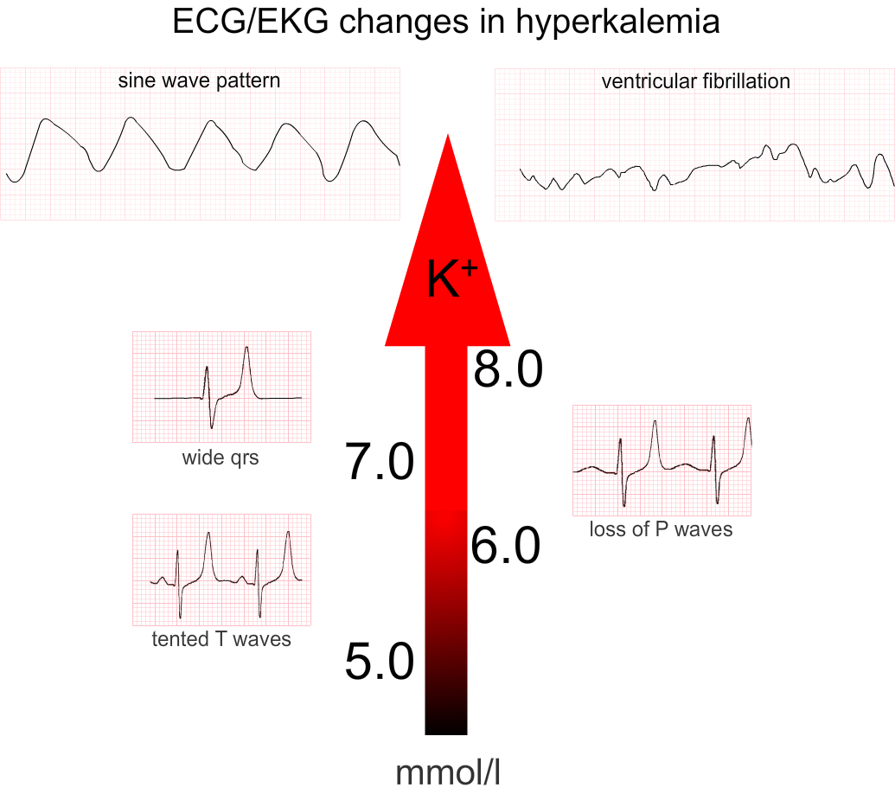

Slide 26
Treatment:
Eliminate exogenous K sources (dietary, IV fluids, total parenteral nutrition).
Sodium polystyrene sulfonate resin (Kayexalate), 1 g/kg, orally or by enema.
It exchanges Na for K in the GIT enhancing its excretion but it take several hr to take its effect.
A single dose of 1 g/kg can be lower S. K level by about 1 mEq/L. It may be repeated every 2 hr. according to the severity

Slide 27
Severe cases (S. K >7 mEq/L), especially if associated with ECG changes, require emergency treatment in addition to Kayexalate. This include:
Calcium gluconate 10% solution, 1 mL/kg IV, over 3-5 min. It counteracts the increase in myocardial irritability induced by hyperkalemia but does not lower the S. K
NaHco3 1-2 mEq/kg IV, over 5-10 min
Regular insulin, 0.1 units/kg, with glucose 50% solution, 1 mL/kg, over 1 hr

Slide 28
β-adrenergic agonists (Salbutamol) in adults, but there are no controlled data in pediatric patients.
Sodium bicarbonate, insulin, and glucose and β-adrenergic agonists lowers the S. K. level by shifting K from the extracellular to the intracellular compartment
Dialysis indicated in persistent hyperkalemia despite the previous treatments.

Slide 29
4. Treatment of severe metabolic abnormalities including metabolic acidosis, hypocalcemia, and hyponatremia.
5. Treatment of anemia: It is usually mild dilutional anemia (Hb 9-10g\dl) but severe anemia (Hb < 7g\dl) might occur with SLE, HUS, active bleeding or prolong AKI required packed RBCs transfusion 10 ml\kg over 4-6 hr to avoid hypervolemia.

Slide 30
6. Treatment of hypertension: by salt and water restriction, diuretics, Ca. channel blocker or B-blockers.
7. Nutritional therapy:
Restriction of Na, K, and Ph intake.
Protein intake moderately restricted to avoid accumulation of nitrogenous waste products.
Parenteral hyperalimenation with essential AA in critically ill patients.

Slide 31
8. Dialysis: indicated in:
Anuria/oliguria
Volume overload with HT and/or pulm. edema refractory to diuretic therapy
Persistent hyperkalemia
Severe metabolic acidosis unresponsive to medical management
Uremia (encephalopathy, pericarditis, neuropathy)
BUN >100-150 mg/dL (or rapidly rising)
Ca: Ph imbalance, with hypocalcemic tetany refractory to other treatments.

Slide 32
Thank you for your attention

