Slide 1
Practical infectious diseases

Slide 2
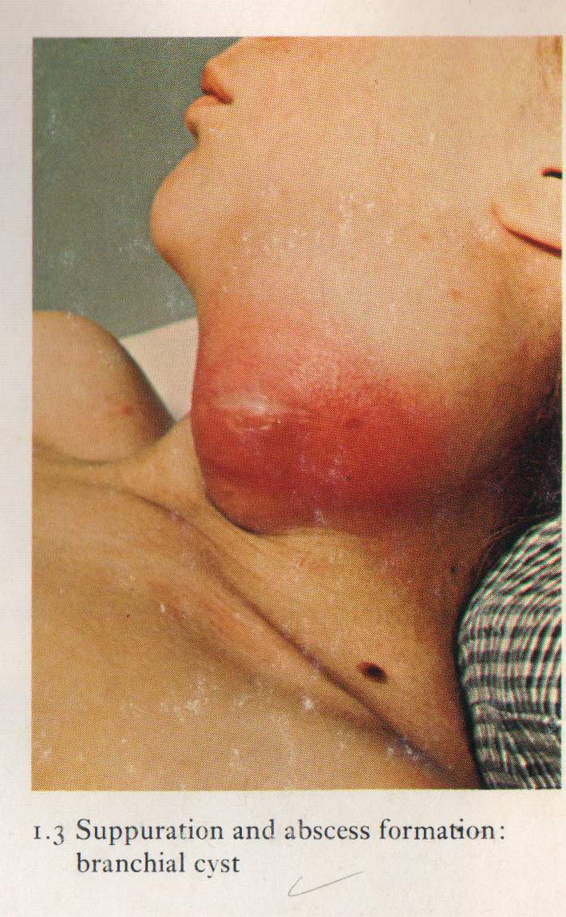
Localization of pus leads to abscess formation which appear here as red congested swelling at the side of the neck. Diagnosis: abscess

Slide 3
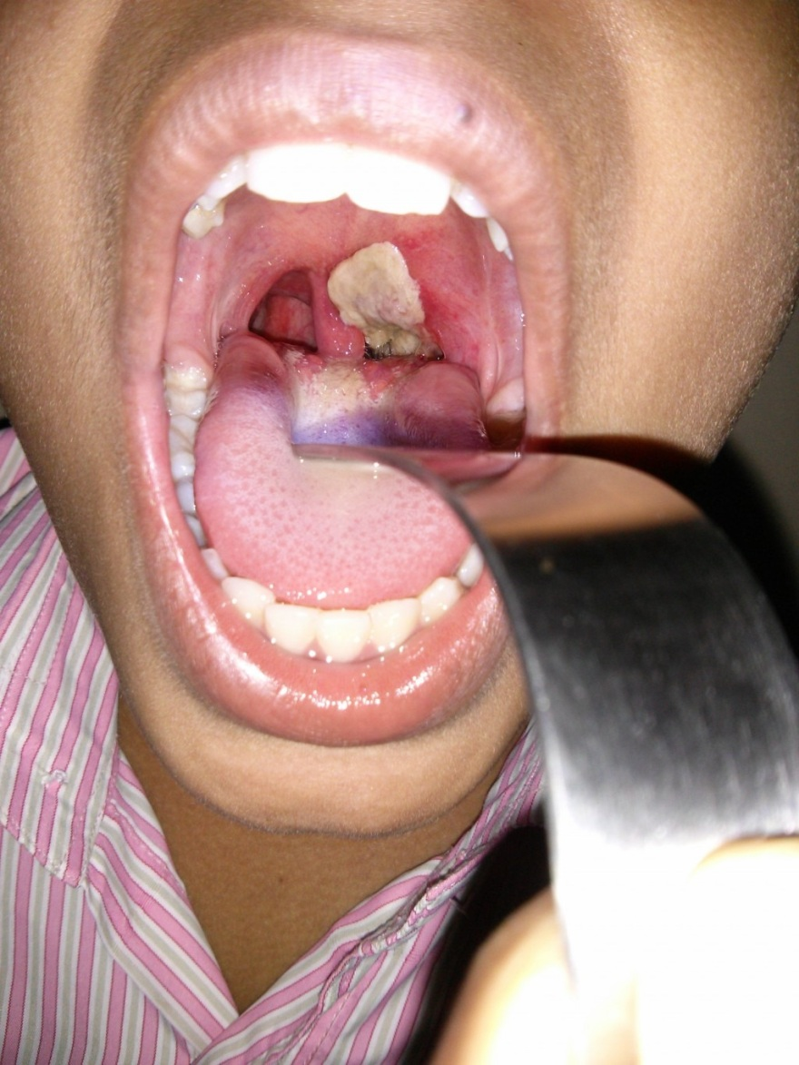
Formation of a superficial, dirty-gray pseudomembrane of diphtheria on the soft palate.

Slide 4
Pharyngeal pseudomembrane. Epithelium is absent; at one side, inflammatory exudate extends to underlying muscle Diagnosis : Diphtheria

Slide 5
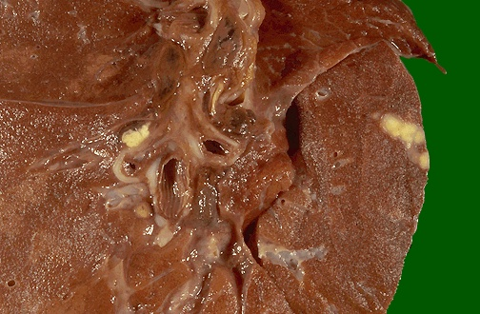
Peripheral sub pleural small whitish yellow lesion (Ghon focus) & hilar lymph node enlargement in primary T.B (cheesy like material) Diagnosis: Ghon’s complex of primary TB. .

Slide 6
Multiple irregular cavitations & extensive area of necrosis involving the upper lobe of the lung Diagnosis: secondary T.B

Slide 7
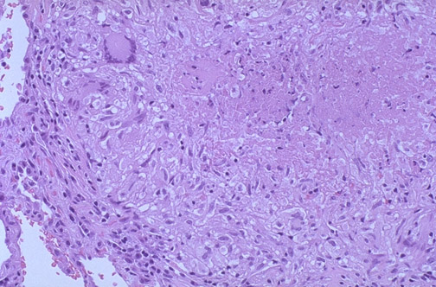
Granuloma with central caseous necrosis surrounded by epithelioid cells & Langhans giant cell (multinucleated giant cells) surrounded by a rim of lymphocytes Diagnosis: T.B lung (caseating granuloma)

Slide 8
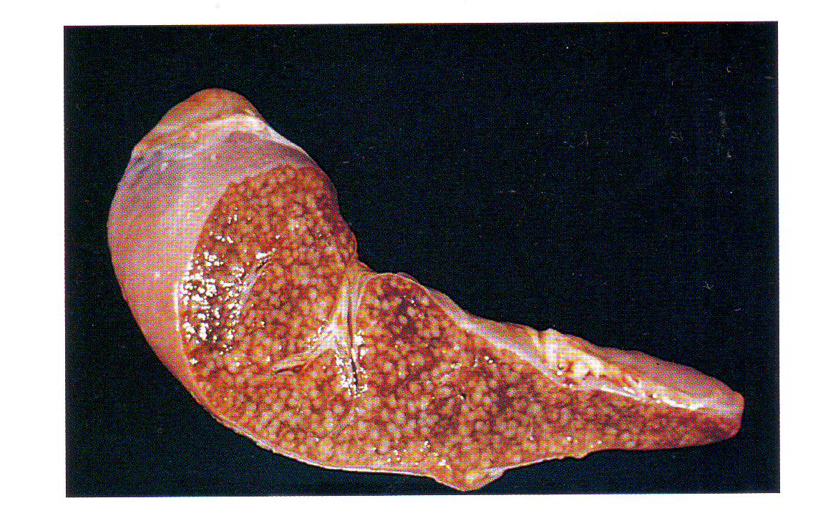
Miliary tuberculosis of the spleen,cut surface show
numerous gray-white granulomas

Slide 9
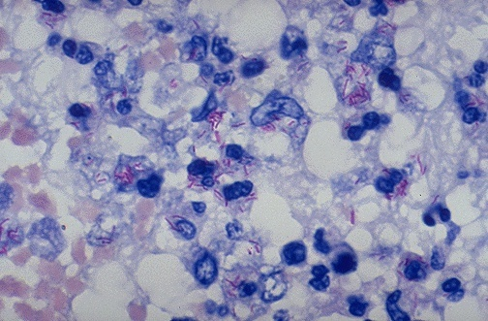
This is an acid fast stain of Mycobacterium tuberculosis Which appear as red rods.

Slide 10
The colony of actinomycosis at high magnification. The micro organism is filamentous & the filaments project as red specular at the periphery of the colony (large arrow) which is surrounded by neutrophils (mycetoma) small arrow.

Slide 11
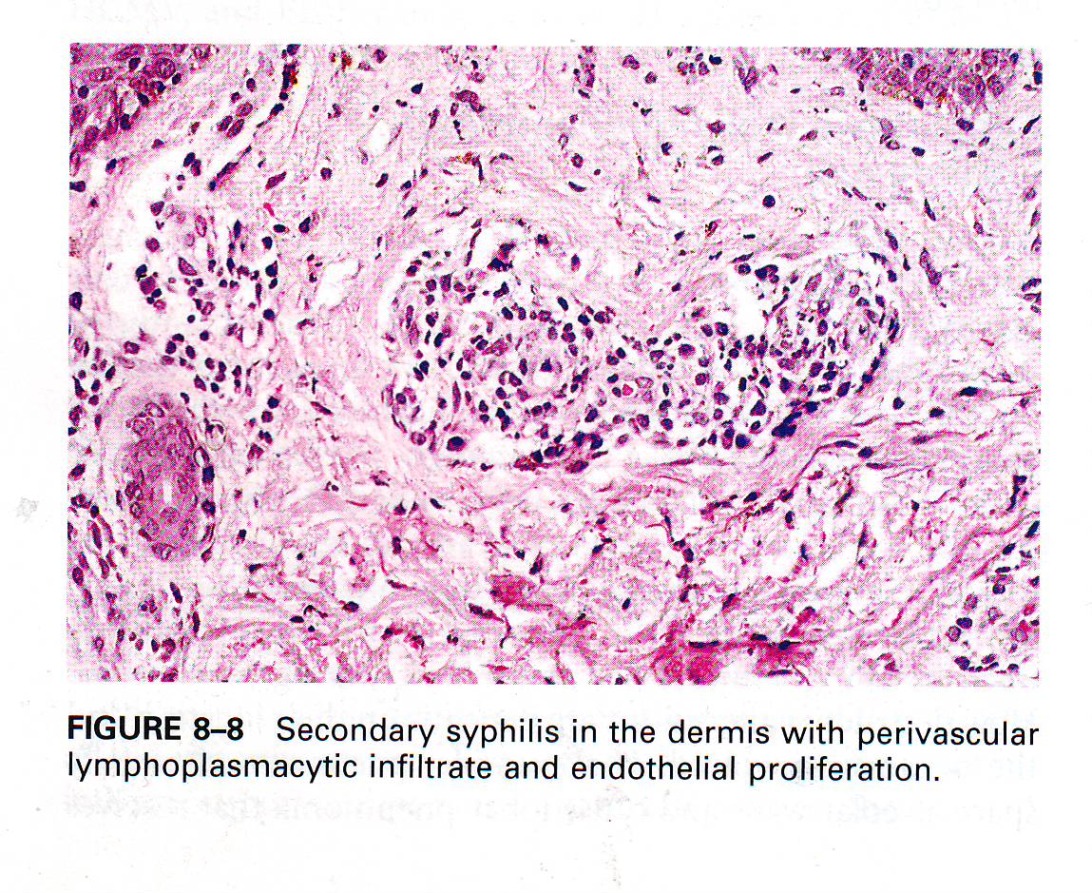
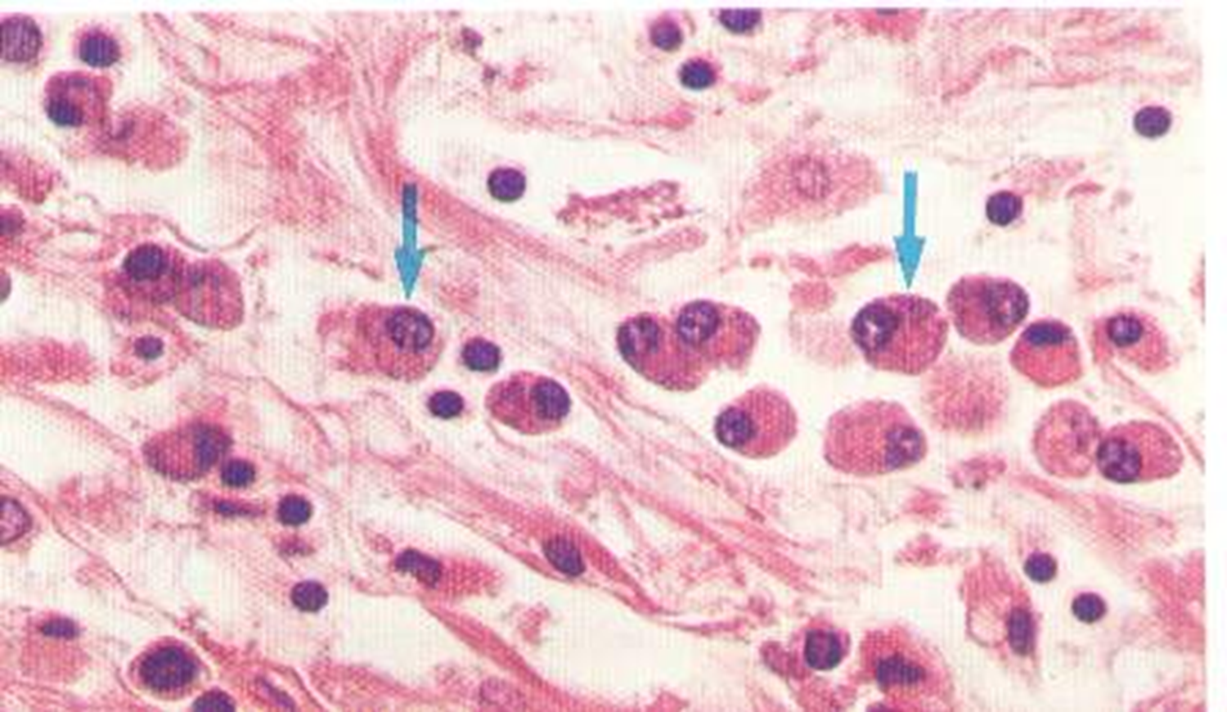
Secondary syphilis, in the dermis with perivascular lymphoplasmacytic infiltrate & endarteritis obliterance.
Plasma cells infiltration in syphilis

Slide 12
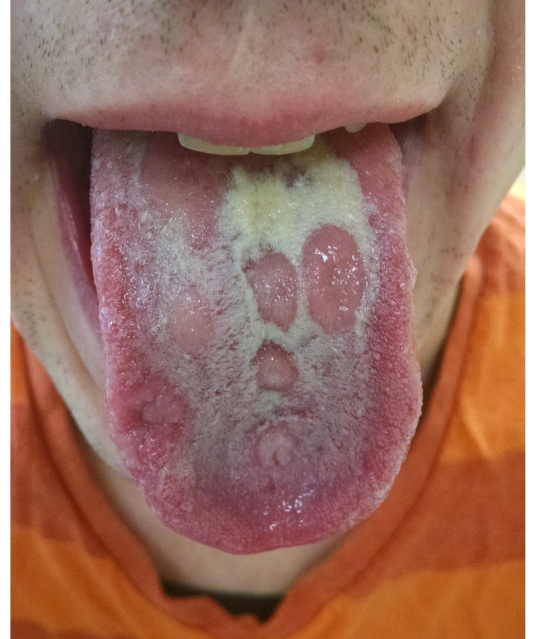
‘notched incisor Known as Hutchinson's teeth which are characteristic of congenital syphilis
Multiple shallow, lingual
ulcerations in patient with
secondary syphilis

Slide 13
Stages of Herpes Simplex infection (oral sore)

Slide 14
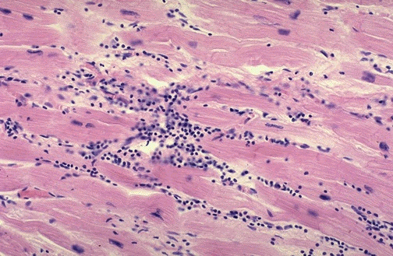
Cardiac muscle fibers show a lymphocytic infiltrate
Diagnosis: Viral myocarditis

Slide 15
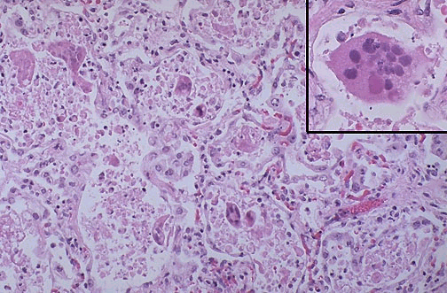
viral infection in the alveolar wall. Showing giant cell originate from epithelial cells with inclusion body of virus within the giant cells
Diagnosis: Viral pneumonia (interstitial pneumonia)

Slide 16
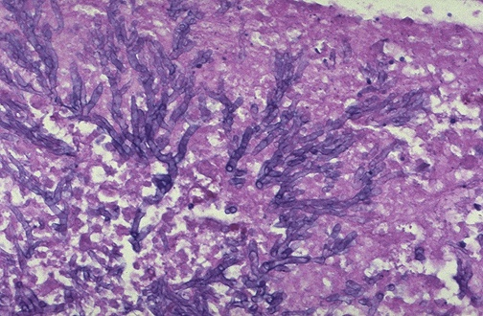
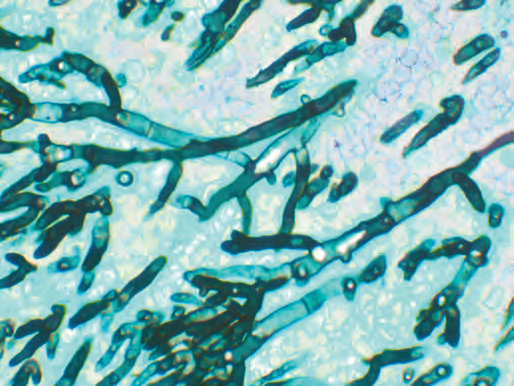
Mold ,Septate hyphae are close-packed with acute-angle branching.
Diagnosis Aspergillus infection, :

Slide 17
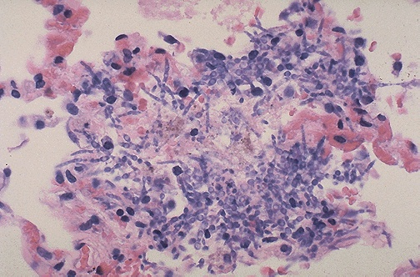
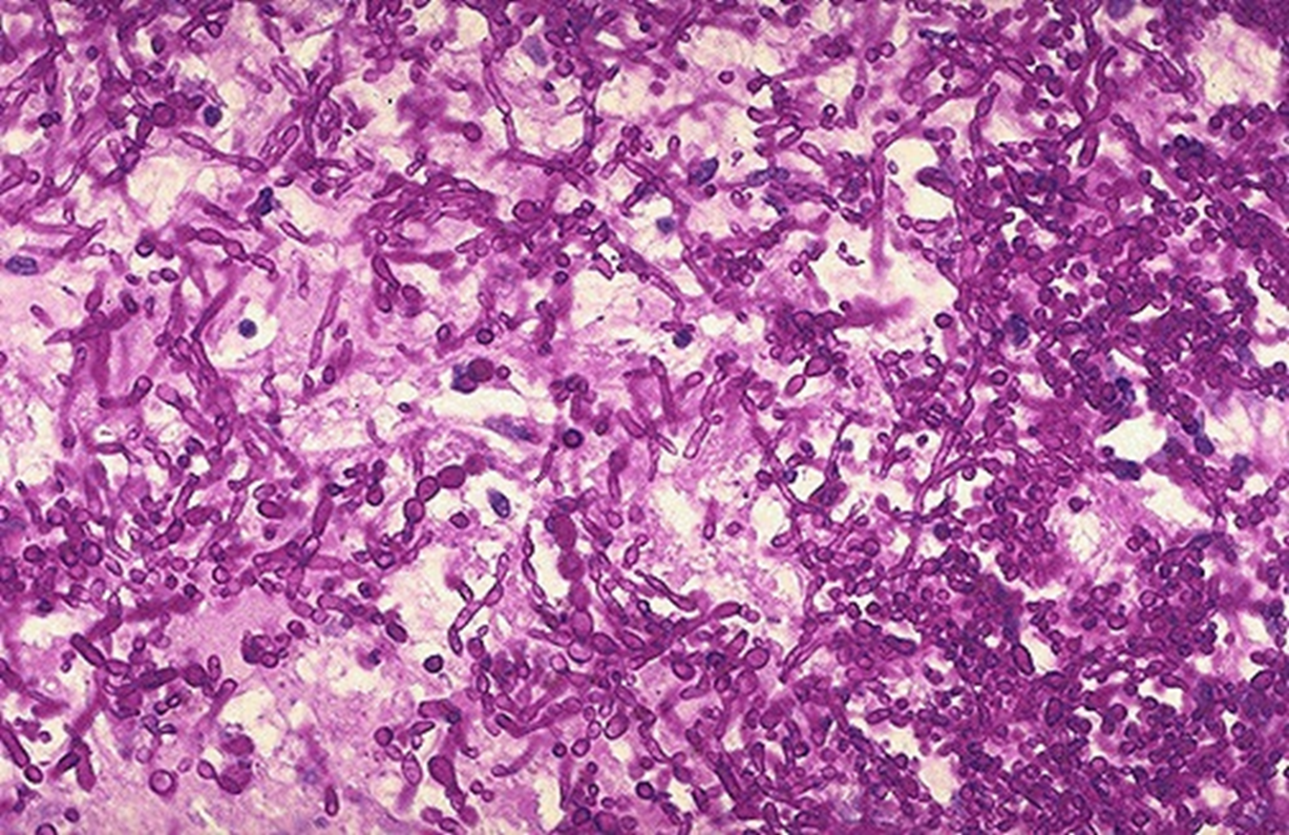
Yeast A numerous budding cells and pseudohyphae characteristic for Candida.
Diagnosis: Candidial infection (fungal infection) lung

Slide 18
Oral candidiasis (candidal stomatitis), the fungi creates gray-white, dirty-looking pseudomembranous on the tongue

