Slide 1
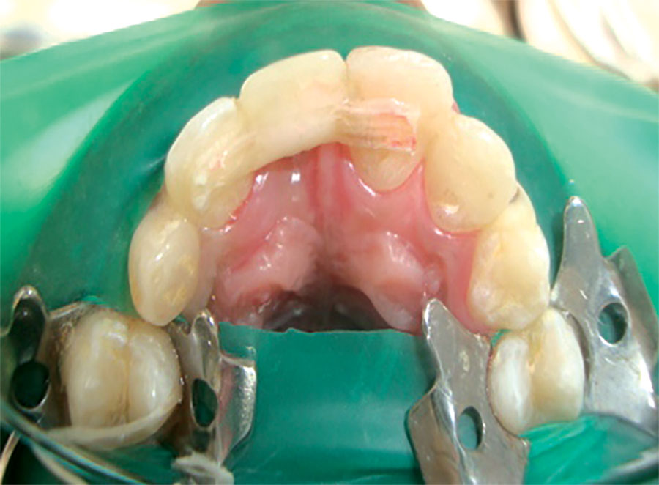
Fiber reinforced composite prosthesis
Prepared by : Mustafa moniem. Ari aso. Bahoz Himdad

Slide 2
Fiber-reinforced composite resin(FRC) prostheses offer the ad-vantages of good aesthetics, minimal invasive treatment, and an ability to bond to the abutment
teeth, thereby compensating for less-than-optimal abutment tooth retention and resistance form. These prostheses are composed of two types of composite materi-als: fiber composites to build the framework and hybrid or microfill particulate composites to create the external veneer surface

Slide 3
Traditional metal reinforced bridges are characterized by certain
disadvantages. These disadvantages culminate in the bonding and aesthetic problems of metalframeworks. Fortunately, these problems can now be overcome,
to a large extent, by the use of fiber reinforced composite (FRC). In fact, the bond strength between the prostheses and the abutment teeth obtained when using FRCmaterials is 50-100 % higher than the bond strength achieved when using metal framworke

Slide 4
In addition, in FRC restorations the glass fibers are translucent and covered with veneering composites resulting in good aesthetic restorations, which do not increase plaque accumulation.
Metal-free prostheses continue to gain interest. Although the metalalloys contribute great strengthto the prostheses, they do so at
a considerable aesthetic liability. somewhat different metal -free approaches to fixed tooth replacement continue to be developed for a variety of clinical applications.

Slide 5
The FRC material is a combination of fibers and a resinous matrix.
Different types of FRC materials exhibiting a wide varietyof mechanical flexural properties are commercially available. The mechanical properties of FRC materials are primarily dependent upon
fiber type (glass, carbon,
aramid, or polyethylene)
quantity of fibers in the matrix resin (maxi-
mum is 15x103 in a bundle)
fiber architecture (unidirectional, wo-
ven, or braided) and
quality of impregnation of fiber with resin.

Slide 6
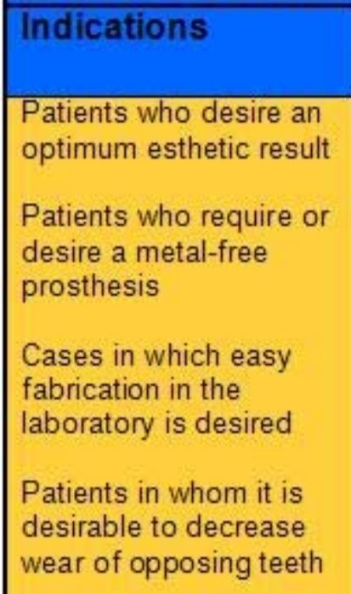

Slide 8
Clinical tooth replacement applications of FRC-reinforced pros- theses are organized into two categories: laboratory-fabricated prostheses chairside prostheses

Slide 9
Laboratory-fabricated FRC prostheses
can be retained by teeth or implants.
include a surface that does not wear opposing tooth enamel ,and the FRC framework does not require waxing, casting, or soldeing procedures during fabrication.
Supported by a strong metal-free
Metal framework

Slide 10
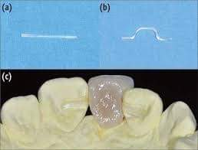

Slide 11
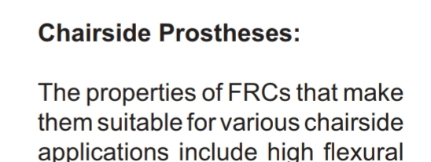
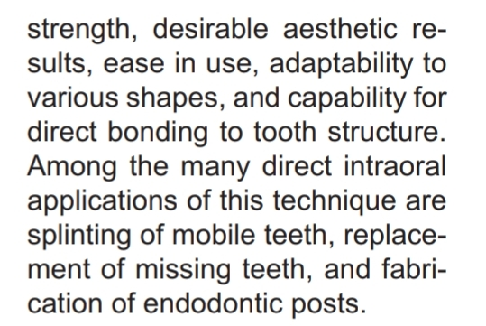

Slide 12
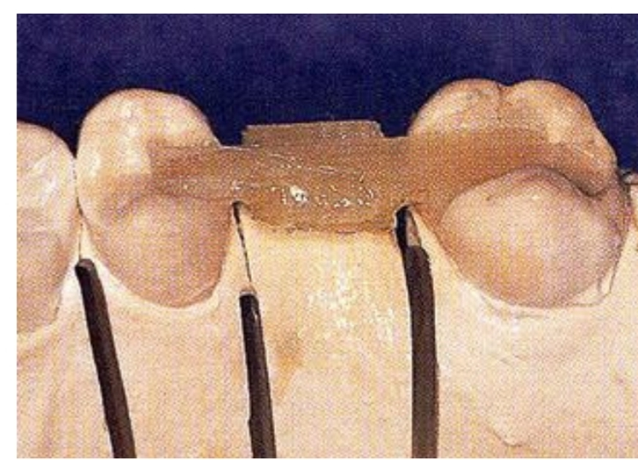

Slide 18
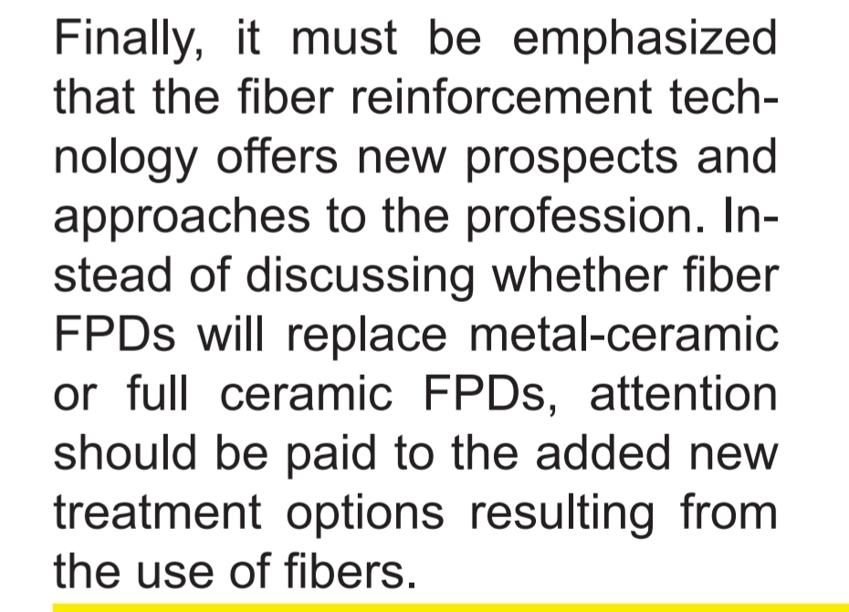

Slide 19
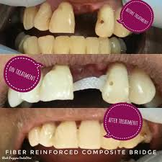

Slide 21
