Slide 1
Preparation of abutment teeth
م .احسان فارس التكاي lecture no.1

Slide 2
Preparation of abutment teeth
• After surgery, periodontal treatment, endodontic treatment, and tissue conditioning of the arch involved, the abutment teeth may be prepared to provide support, stabilization, reciprocation, and retention for the removable partial denture.
• If the prognosis of a tooth under treatment becomes unfavorable, its loss can be compensated for by a change in the removable partial denture design. •

Slide 3
CLASSIFICATION OF ABUTMENT TEETH • Abutment preparations may be grouped as follows: 1. Those abutment teeth that require only minor modifications to their coronal portions 2. Those that are to have coronal restorations other than complete coverage crowns 3. Those that are to have crowns (complete coverage)

Slide 4
SEQUENCE OF ABUTMENT PREPARATIONS ON SOUND ENAMEL OR EXISTING RESTORATIONS

Slide 5
1. Proximal surfaces parallel to the path of placement should be prepared to provide guiding planes
2. Tooth contours should be modified and lowering the height of contour so that a) Origin of circumferential claps may be placed well below the occlusal surface → junction of middle and cervical thirds b) Retentive clasp terminal placed in the gingival third of the crown c) Reciprocal clasp arms placed on and above the H.O.C

Slide 6
3.alterations of axial contours are accomplished and before rest seat preparations are instituted, an impression of the arch should be made in irreversible hydrocolloid and a cast formed in a fast-setting stone.
4. Occlusal rest areas should be prepared that will direct occlusal forces along the long axis of the abutment tooth

Slide 7
ABUTMENT PREPARATIONS USING CONSERVATIVE RESTORATIONS •
Conventional inlay preparations are permissible on the proximal surface of a tooth not to be contacted by a minor connector of the removable partial denture. • On the other hand, proximal and occlusal surfaces that support minor connectors and occlusal rests require somewhat different treatment. •

Slide 8
ABUTMENT PREPARATIONS USING CROWNS
When multiple crowns are to be restored as removable partial denture abutments, it is best that all wax patterns be made at the same time. The ideal crown restoration for a removable partial denture abutment is the complete coverage crown, which can be carved, cast, and finished to ideally satisfy all requirements for support, stabilization, and retention without compromise for cosmetic reasons.

Slide 9
SPLINTING OF ABUTMENT TEETH •
Often, a tooth is considered too weak to use alone as a removable partial denture abutment because of the short length or excessive taper of a single root, or because of bone loss resulting in an unfavorable crown-to-root ratio.
Splinting should not be used to retain a tooth that would otherwise be condemned for periodontal reasons. • The most common application of the use of multiple abutments is the splinting of two premolars or a first premolar and a canine.

Slide 10
Rest: A rigid component of a removable partial denture which rests in a recessed preparation on the occlusal, lingual or incisal surface of a tooth to provide vertical support for the denture.
Rest and Rest Seat
The prepared surface of the abutment to receive the rest called rest seat.

Slide 11
The primary purpose of the rest is to provide vertical support for the partial denture. Other purposes( functions) of the rest are the following:
1. Maintains components in their planned positions
2. Maintains established occlusal relationships by preventing settling of the denture.
3. Prevents impingement of soft tissue
4. Directs and distributes occlusal loads to abutment teeth
5. To serve as an indirect retainer by preventing rotation of the partial denture.

Slide 12
Three types of rest are
• occlusal rest
• cingulum rest
• incisal rest
A rest which is the component of direct retainer is
the primary rest.
Auxillary rest or secondary rest is the additional rest that may be used for indirect retention

Slide 13
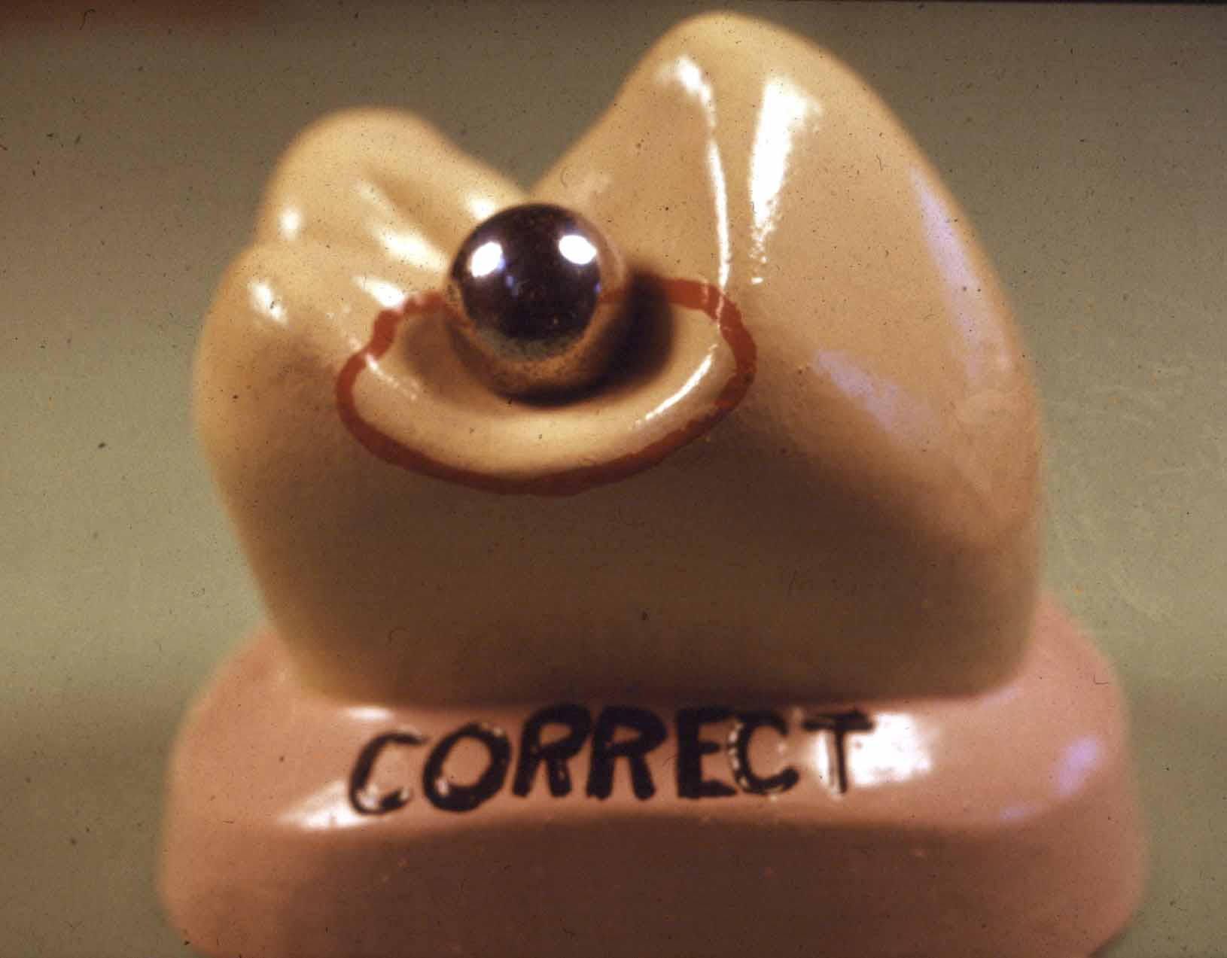
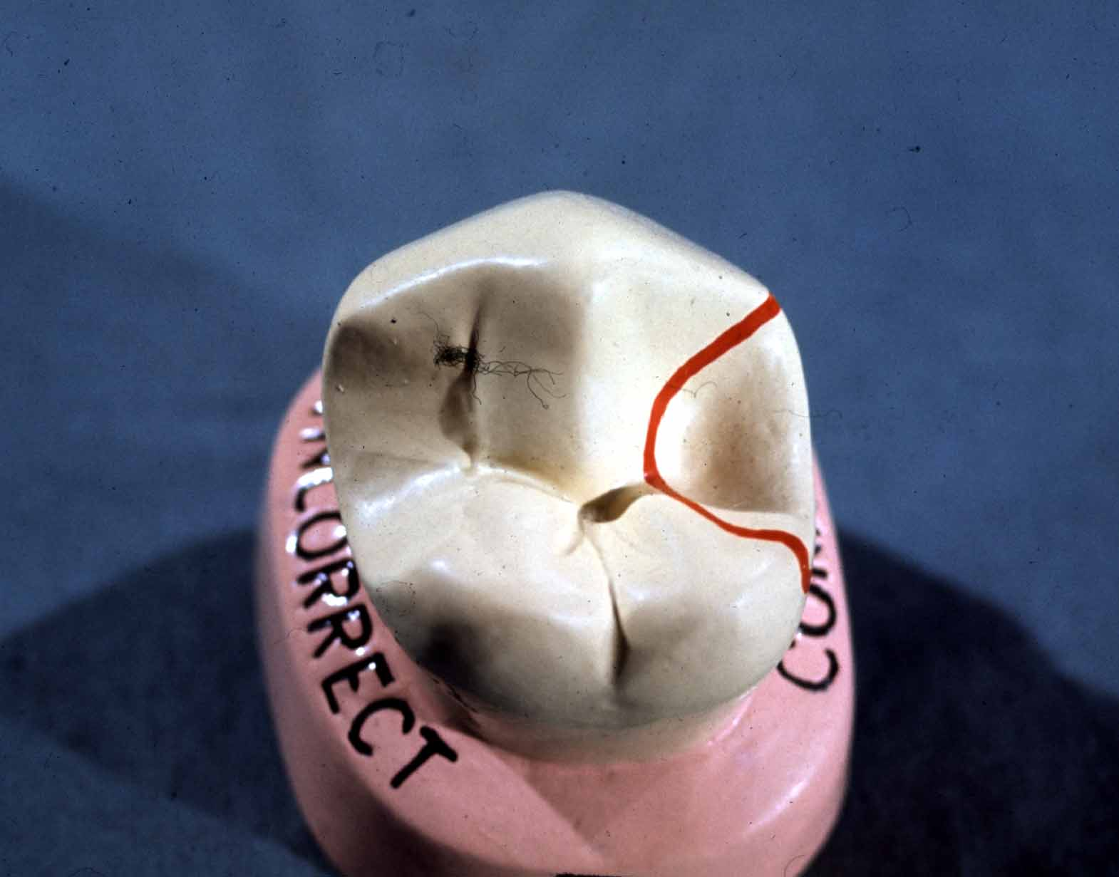
Types of rests
OCCLUSAL RESTS
Definitive rest

Slide 14

Thank you for your listening

