Slide 1
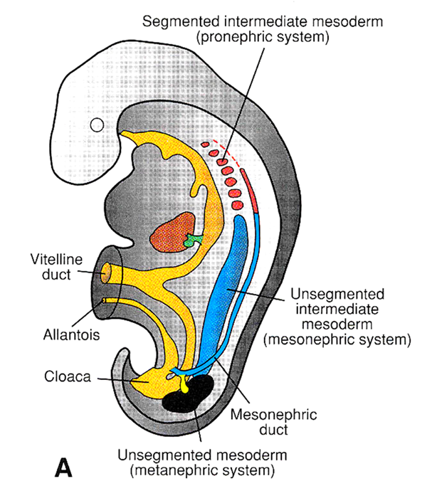
URINARY SYSTEM
Dr.Sumeya

Slide 2
Functionally, the urogenital system can bedivided into two entirely different components:
the urinary system and the genital system.
Embryologically and anatomically, however, they are intimately interwoven. Both develop from a common mesodermal ridge (intermediate mesoderm) along the posterior wall of the abdominal cavity, and initially, the excretory ducts of both systems enter a common cavity, the cloaca.

Slide 3
URINARY SYSTEM
Kidney Systems
Three slightly overlapping kidney systems are formed in a cranial-to-caudal sequence during intrauterine life in humans:
the pronephros, mesonephros, and metanephros.
The first of these systems is rudimentary and nonfunctional; the second may function for a short time during the early fetal period; the third forms the permanent kidney.

Slide 8
The development of Urinary System

Slide 11
Pronephros
At the beginning of the fourth week, the pronephros
is represented by 7 to 10 solid cell groups
in the cervical region.
These groups form vestigial excretory units,
nephrotomes, that regress before more caudal
ones are formed. By the end of the fourth week,
all indications of the pronephric system have
disappeared.

Slide 13
Mesonephros
The mesonephros and mesonephric ducts are
derived from intermediate mesoderm from
upper thoracic to upper lumbar (L3) segments.
Early in the fourth week of development,
during regression of the pronephric system,
the fi rst excretory tubules of the mesonephros
appear. They lengthen rapidly, form an S-shaped
loop, and acquire a tuft of capillaries that will
form a glomerulus at their medial extremity

Slide 14
Around the glomerulus, the tubules
form Bowman’s capsule, and together these structures constitute a renal corpuscle.
Laterally,the tubule enters the longitudinal collecting duct
known as the mesonephric or wolffi an duct .
In the middle of the second month, the mesonephros
forms a large ovoid organ on each side
of the midline . Since the developing
gonad is on its medial side, the ridge formed by
both organs is known as the urogenital ridge

Slide 15
While caudal tubules are still differentiating,
cranial tubules and glomeruli show
degenerative changes, and by the end of the second
month, the majority have disappeared. In the
male, a few of the caudal tubules and the mesonephric
duct persist and participate in formation
of the genital system, but they disappear in the
female.

Slide 19
Metanephros: The Definitive Kidney
Metanephros: The Definitive Kidney
The third urinary organ, the metanephros or
permanent kidney, appears in the fi fth week.
Its excretory units develop from metanephric
mesoderm in the same manner as in
the mesonephric system. The development of the
duct system differs from that of the other kidney
systems.

Slide 20
Collecting System
Collecting ducts of the permanent kidney develop
from the ureteric bud, an outgrowth of the
mesonephric duct close to its entrance to the
cloaca . The bud penetrates the metanephric
tissue, which is molded over its distal end
as a cap .Subsequently, the bud dilates,
forming the primitive renal pelvis, and splits
into cranial and caudal portions, the future major
calyces

Slide 21
Each calyx forms two new buds while penetrating
the metanephric tissue. These buds continue
to subdivide forming the minor calyces of the renal pelvis.

Slide 22
During further development, collecting tubules of the fi fth and successive generations elongate considerably and converge on the minor calyx, forming the renal pyramid.
The ureteric bud gives rise to the ureter, the renal pelvis, the major and minor calyces, and approximately 1 to 3 million collecting tubules.

Slide 28
Excretory System
Each newly formed collecting tubule is covered
at its distal end by a metanephric tissue
cap. Cells of the tissue cap form small
vesicles, the renal vesicles, which in turn give
rise to small S-shaped tubules.
Capillaries grow into the pocket at one end of
the S and differentiate into glomeruli.

Slide 29
These tubules, together with their glomeruli, form
nephrons, or excretory units. The proximal
end of each nephron forms Bowman’s capsule,
which is deeply indented by a glomerulus.
The distal end forms an open connection
with one of the collecting tubules, establishing
a passageway from Bowman’s capsule to
the collecting unit. Continuous lengthening of
the excretory tubule results in formation of the

Slide 30
proximal convoluted tubule, loop of Henle,
and distal convoluted tubule.
Hence, the kidney develops from two sources:
(1) metanephric mesoderm, which provides
excretory units and (2) the ureteric bud, which
gives rise to the collecting system.

Slide 31
Nephrons are formed until birth, at which
time there are approximately 1 million in each
kidney. Urine production begins early in gestation,
soon after differentiation of the glomerular
capillaries, which start to form by the 10th week.
At birth, the kidneys have a lobulated appearance,
but the lobulation disappears during infancy as a
result of further growth of the nephrons, although
there is no increase in their number.

Slide 33
POSITION OF THE KIDNEY
The kidney, initially in the pelvic region, later shifts to a more cranial position in the abdomen. This ascent of the kidney is caused by diminution of body curvature and by growth of the body in the lumbar and sacral regions.

Slide 37
BLADDER AND URETHRA
Urinary bladder and urether are derived
from the cloaca.

Slide 40
urogenital sinus
urorectal septum
cloaca
Primitive rectum
Between the two, the tip of the urorectal septum forms the perineal body.

Slide 41
Derivatives urogenital sinus
The upper and largest part urinary bladder
The pelvic (
The phallic (

Slide 42
Derivatives of parts of Primitive urogenital sinus
The upper and largest part
urinary bladder
The prostatic and membranous parts of the urethra in male
Urethra in female
The pelvic part
Penile urthra in male
The phallic part
Vestibule in female

Slide 43
The upper and largest part is the urinary bladder.Initially the bladder is continuous with the allantois, but when the lumen of the allantois is obliterated, a thick fibrous cord, the urachus, remains and
connects the apex of the bladder with the umbilicus. In the adult, it is known as the median umbilical ligament.

Slide 44
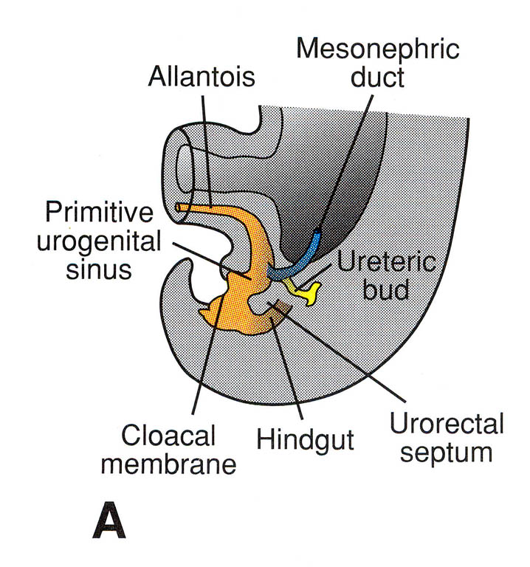

Slide 45
During differentiation of the cloaca, the caudal portions of the mesonephric
ducts are absorbed into the wall of the urinary bladder. Consequently, the ureters, initially outgrowths from the mesonephric ducts, enter the bladder separately.

Slide 46
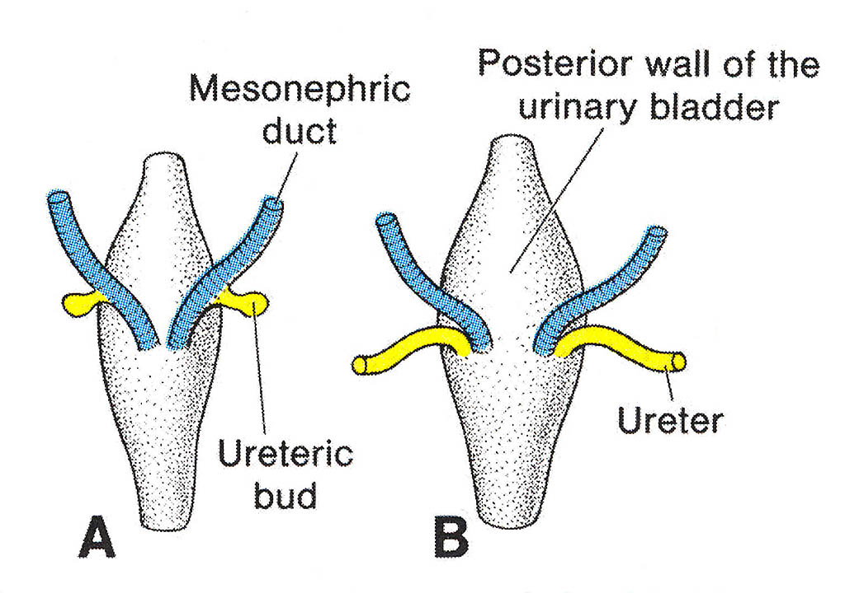

Slide 47
As a result of ascent of the kidneys, the
orifices of the ureters move farther cranially; those of the mesonephric ducts move close together to enter the prostatic urethra and in the male become the ejaculatory ducts.

Slide 48
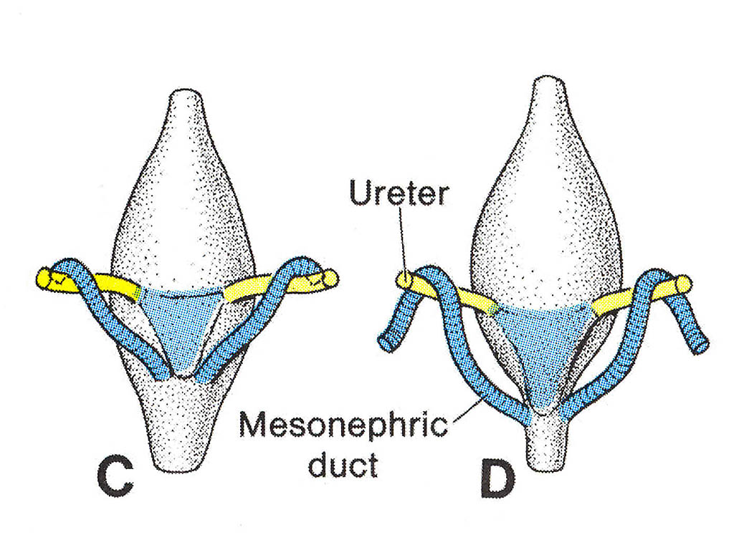

Slide 49
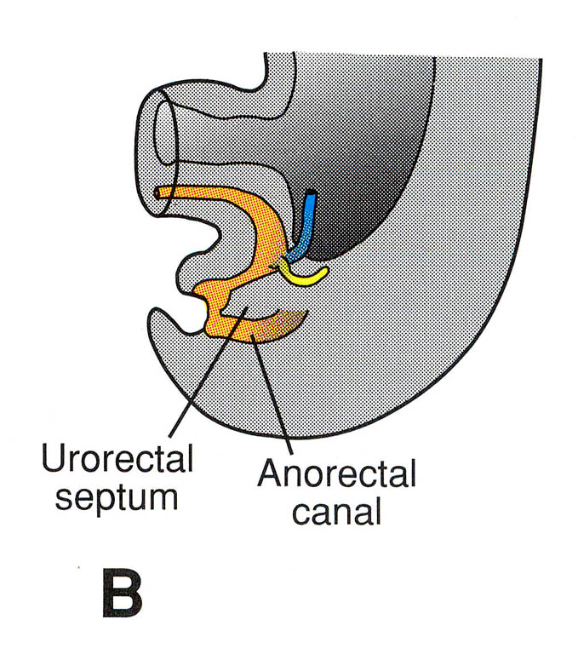

Slide 50
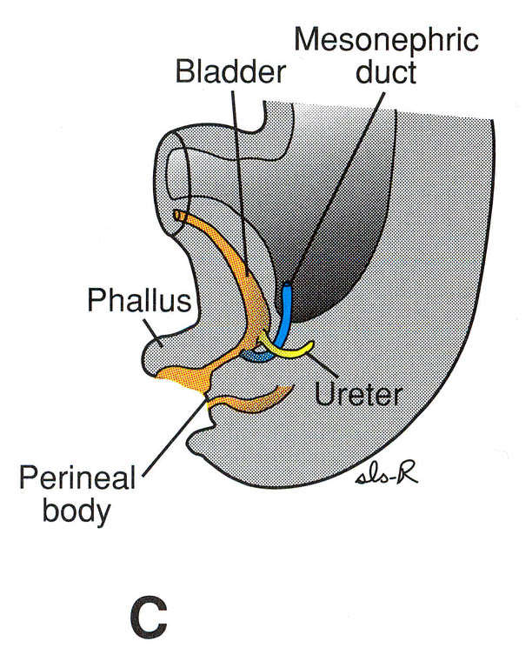

Slide 51
Anomalies of kidneys:
1. Agenesis
2. Duplication:
3. Anomalies of shape:Horseshoe kidney
4. Abnormal of position:
5. Congenital polycystic kindney:

Slide 52
Congenital polycystic kindney:
Failure of the excretory tubules of the metanephros to establish contact with the collecting tubules, leads to the formation of cysts. Isolated cysts are commonly seen, but sometimes the whole kidney is a mass of such cysts. The cysts press upon normal renal tissue and destroy it.

Slide 53
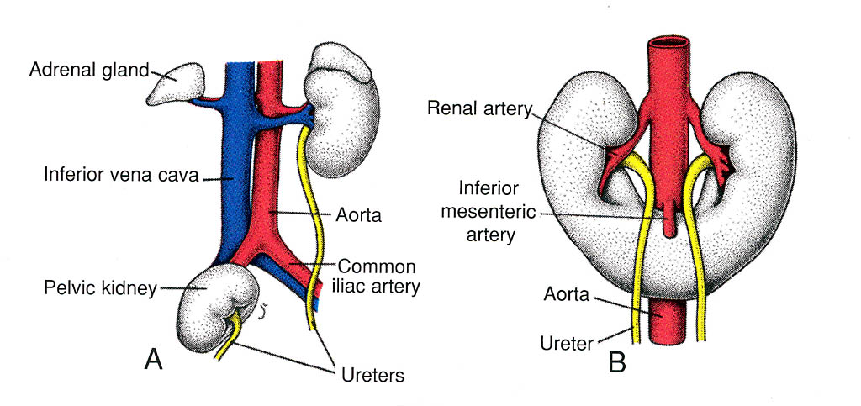
Back to 57

Slide 56
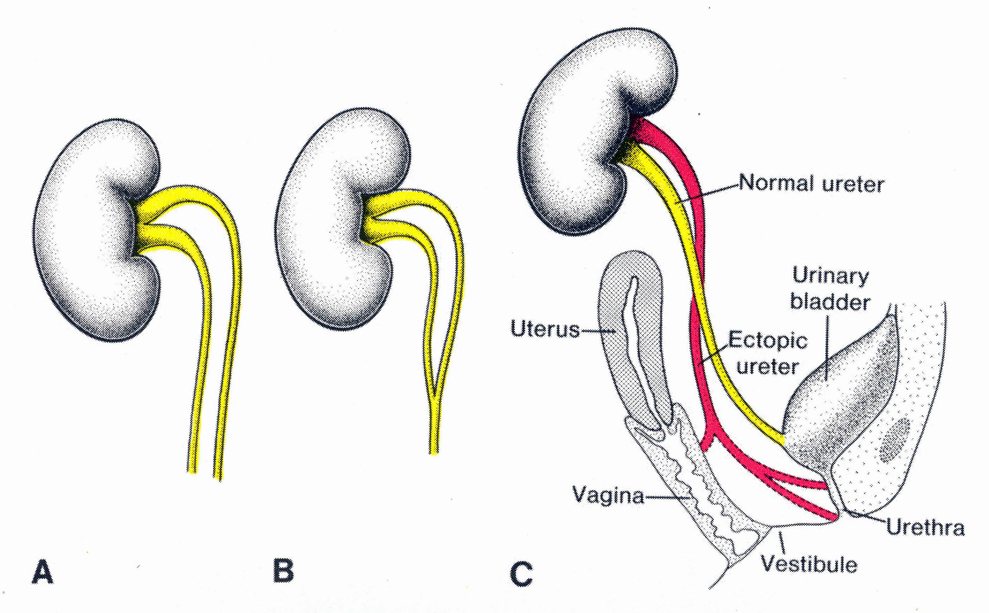
Back to 57

Slide 59
THANK YOU

