Slide 1
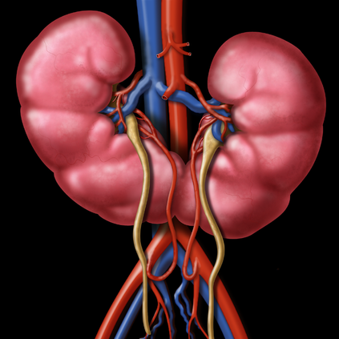
Congenital anomalies of the kidney and ureter
EMAD HASAN MAHMOOD
PROFESSOR OF UROLOGY

Slide 2
Learning objectives
1-enlist congenital abnormalities of the kidney and ureter
2-describe clinical significance of these abnormalities what are symptoms and complications
3-enlist diagnostic investigations plan
4-suggest treatment plan

Slide 3
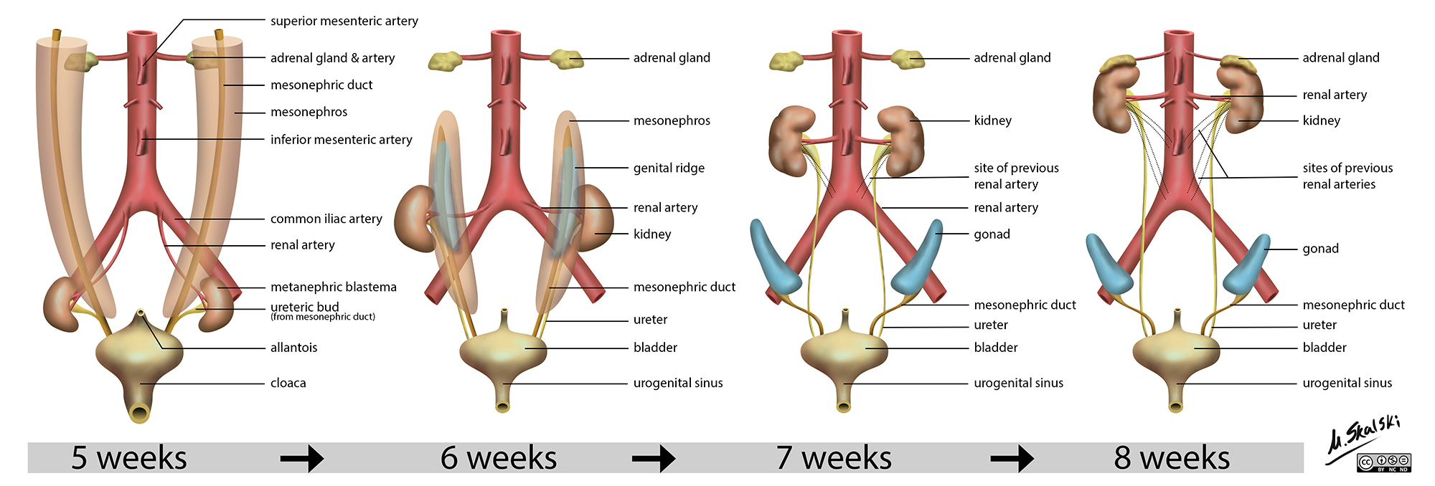

Slide 4
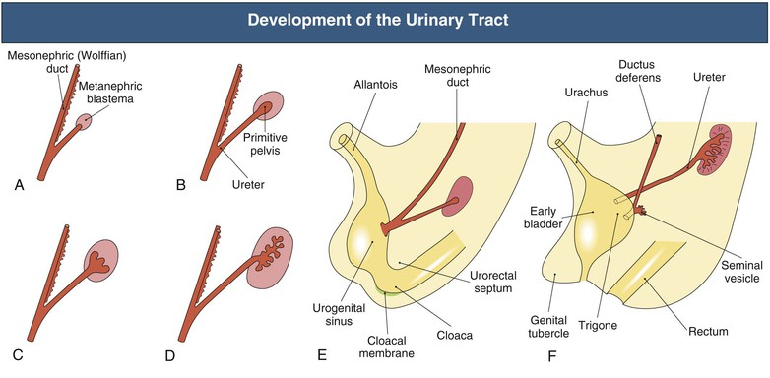

Slide 5
Types of renal abnormalities
1-number
2-size
3-position
4-rotation
5-fusion

Slide 6
Congenital abnormalities of renal pelvis and ureter
1-pelviureteric junction obstruction
2-ureteric duplications
3-ureterocele
4-congenital vesicoureteric reflux
5-megaureter
6-retrocaval ureter
7-ectopic ureter

Slide 7
diagnosis
A-antenatal U/S ( 18-20 )include following severity , unilateral versus bilateral , renal parenchyma thin, bladder abnormalities , amniotic fluid
B-postnatal physical examination , palpable bladder
USG , IVU , MCU , DIURETIC ISOTOPES

Slide 8
hydronephrosis
Aseptic dilatation of renal pelvis and collecting system
0.6-4.5% antenatal U/S
Several grading system (renal pelvic diameter)
Antenatal U/S
Causes
Transient , physiological , PUJ Ob. , VUR , Megaureter , Ureterocele , PUV

Slide 10
CONGENITAL PUJ OB
Etiology
Aperistaltic segment of ureter due to absent muscle
Crossing vessel over PUJ
Valve
High insertion of ureter
Stenosis
stricture

Slide 11
INCIDENCE MOST COMMON KIDNEY OBSTRUCTION IN CHILDREN OCCUR IN 1 IN 500 TO 1 IN 1250

Slide 12
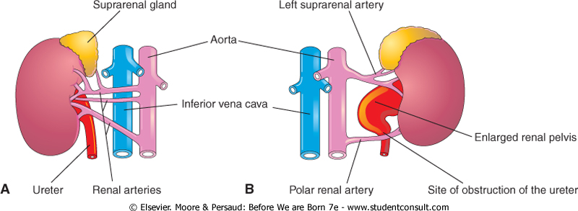

Slide 13
Management of UPJ obstruction
Radiological Diagnosis
Abdominal U/S show various degree of hydronephrosis and ureter not dilated and evaluate parenchymal thickness
IVU same finding of U/S in addition evaluate function of the kidney
Abdominal CT with contrast same finding of IVU in addition if kidney not visualized by IVU can bee seen by CT
Radioisotopes scan ( MAG 3 ) evaluate the degree of obstruction in addition the split functio of the kidney

Slide 14
Urinanalysis may show RBC, WBC
Serum urea and creatinine to evaluate renal function especially in bilateral obstruction
Treatment is surgical PYELOPLASTY either dimembered example (Anderson-Hynes ) OR non dismembered example vertical flap (Culp- Scardino ) OR spiral flap

Slide 15
DUPLICATIONS
Renal pelvis
Common usually unilateral
Upper pelvis is small drain upper calyx
Treatment if Asymptomatic no treatment if one severe damage is partial nephrectomy

Slide 16
DUPLICATIONS
URETER
Often join together before reaching bladder or may be complete and open independently in the bladder the ureter of upper moiety opens
distal and medial to its fellow and suffer ureterocele or VUR OR ECTOPIC
COMPLICATIONS REPEATED UTI OR STONE FORMATION
TREATMENT
Asymptomatic no treatment if complications treaTment is accordingly

Slide 18
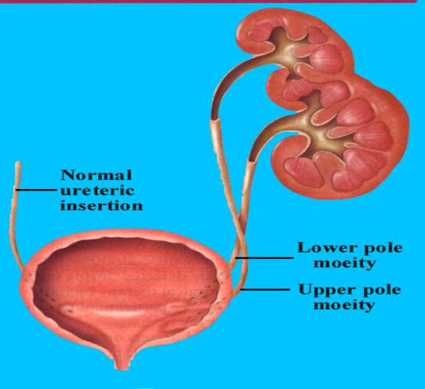

Slide 29
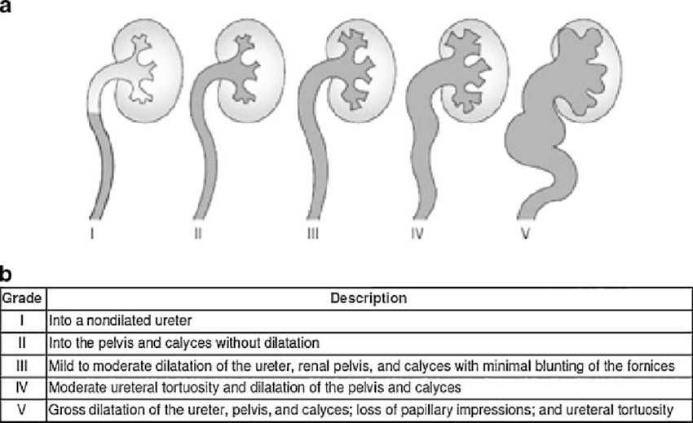
VESICOURETERIC JUNCTION OBSTRUCTION ( VUR )

Slide 32
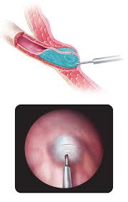
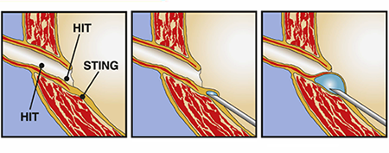
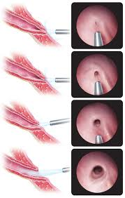
DEFLUX INJECTION THERAPY

Slide 34
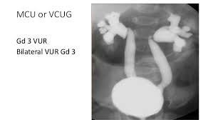
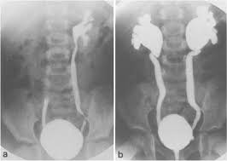

Slide 36
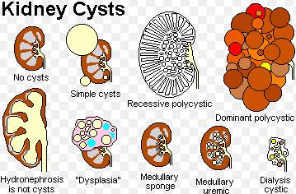

Slide 37
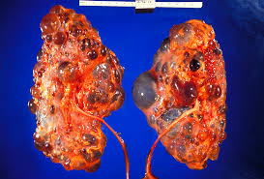
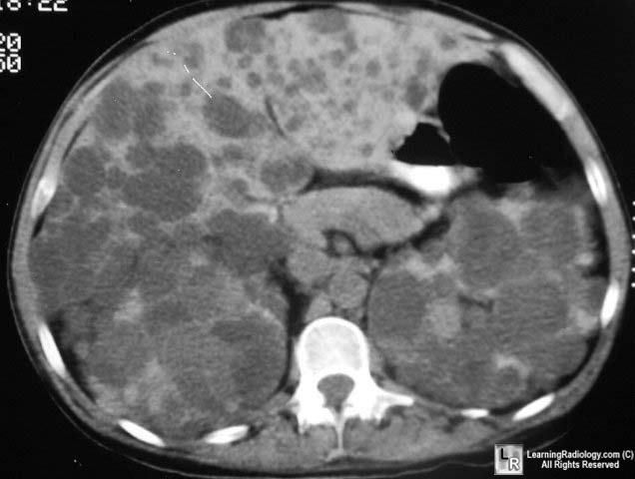

Slide 40
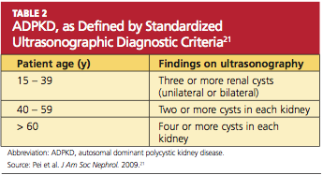

Slide 41
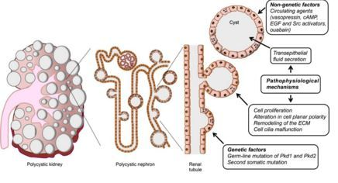

Slide 46
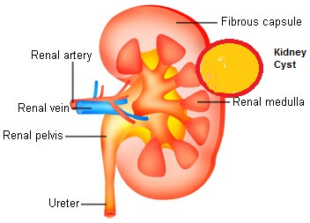

Slide 47
RETROCAVAL URETER

Slide 50
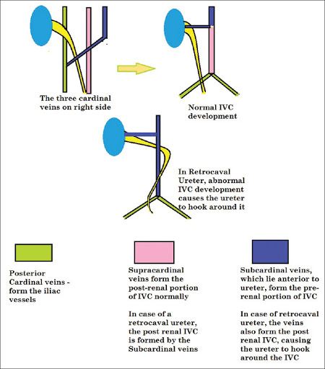

Slide 52
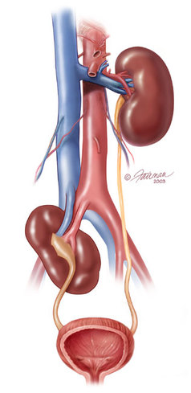

Slide 53
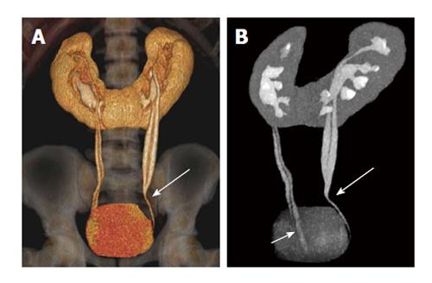

Slide 54
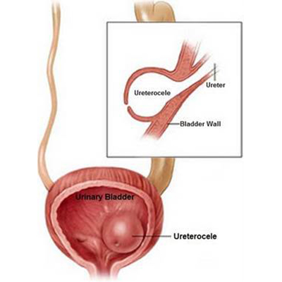

Slide 55
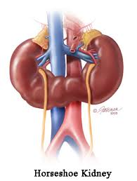

Slide 56
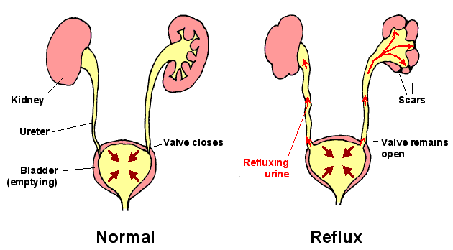

Slide 57
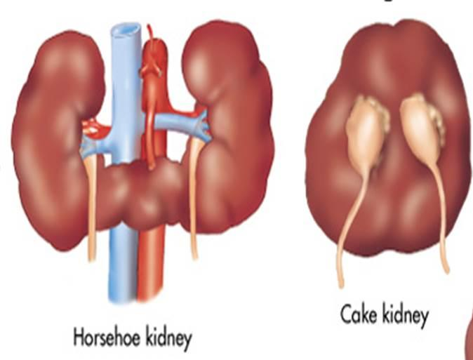

Slide 58
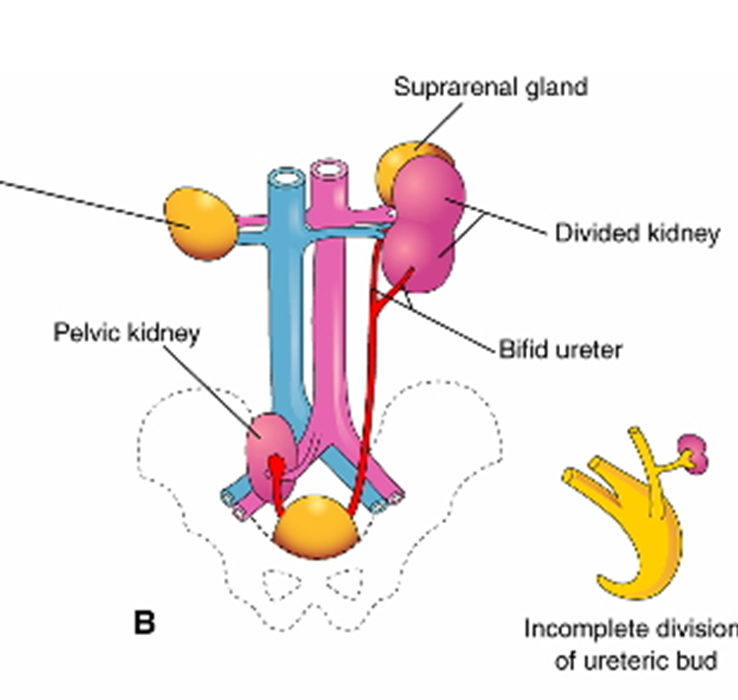

Slide 59
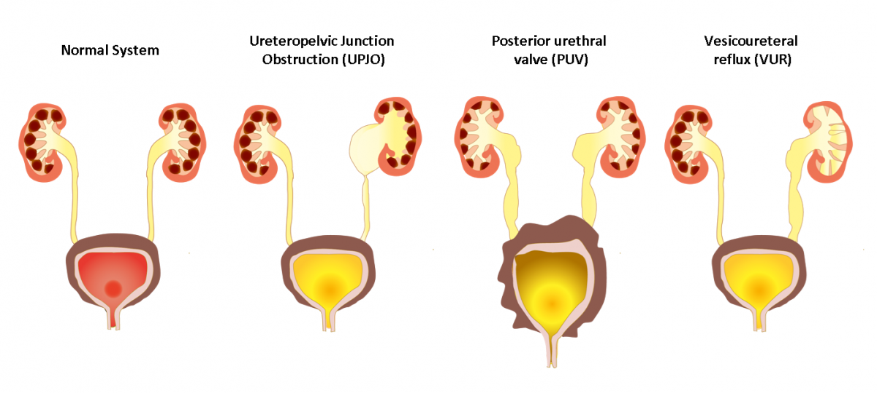

Slide 60
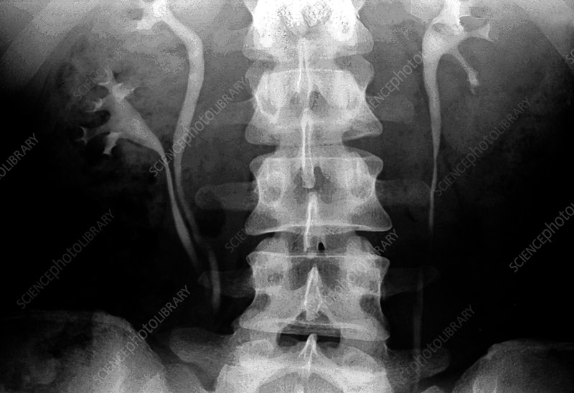

Slide 61
THANK YOU

