Slide 1
HERNIA
Lecture 2
Professor
Dr. Mohanned Alshalah

Slide 2
LEARNING OBJECTIVES
To know and understand:
Applied anatomy of the most common groin hernia
Pathophysiology, clinical features, Investigations and principles of management of groin Hernias

Slide 3
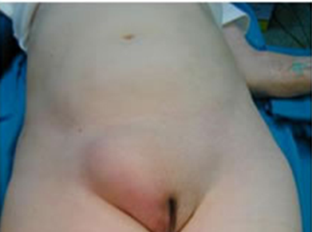
Femoral Hernia

Slide 4
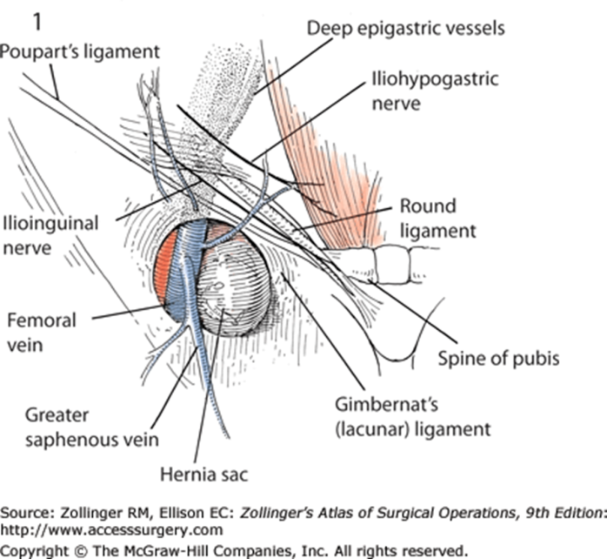
Femoral Canal Anatomy

Slide 5
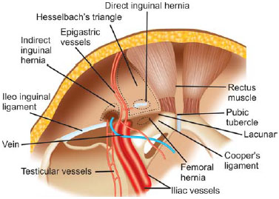

Slide 6
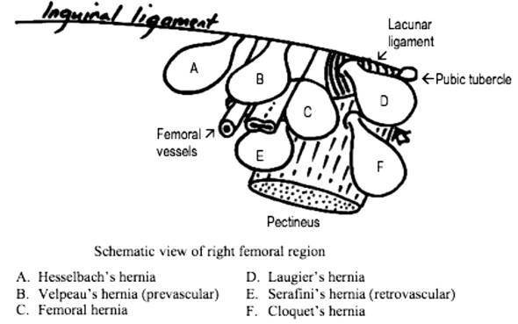
Subtypes of Femoral Hernia

Slide 7
Watchful Wait vs Repair
Cumulative risk of strangulation over 2 years 476 patients (439 Inguinal, 37 Femoral)
34 strangulations (22 Inguinal, 12 Femoral)
Cumulative Probability of Strangulation
 | 3 months | 2 years
Inguinal | 2.8% | 4.5%
Femoral | 22.0% | 45.0%

Slide 8
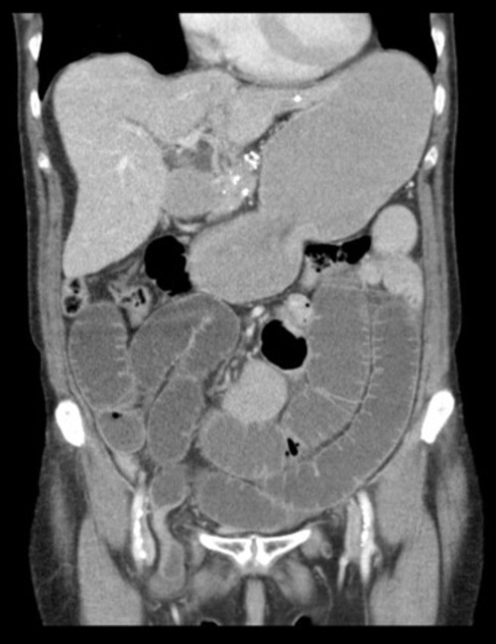
Strangulation

Slide 9
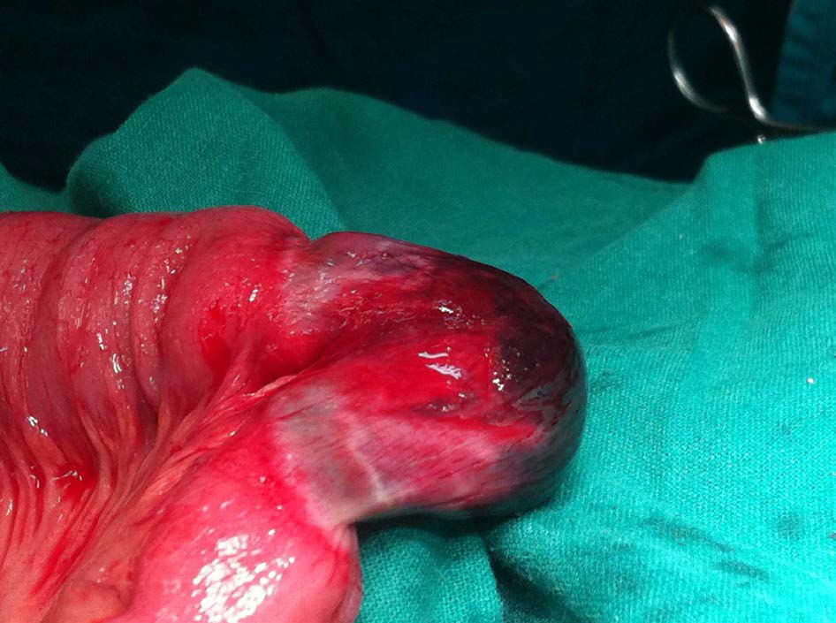

Slide 10
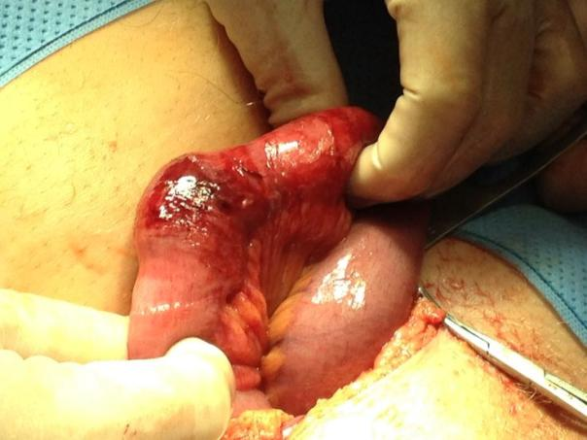
Richters Hernia

Slide 11
Femoral Hernia Repair
Mortality risk (Inguinal and Femoral)
0.1% < 60 years
0.2% 60 – 69
1.6% 70 – 79
3.3% > 80 years
Emergency repair for strangulation x 10 mortality risk – overall 10%

Slide 12
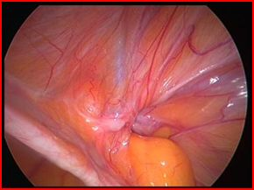
Groin Hernia Guidelines ASGBI 2013

Slide 13
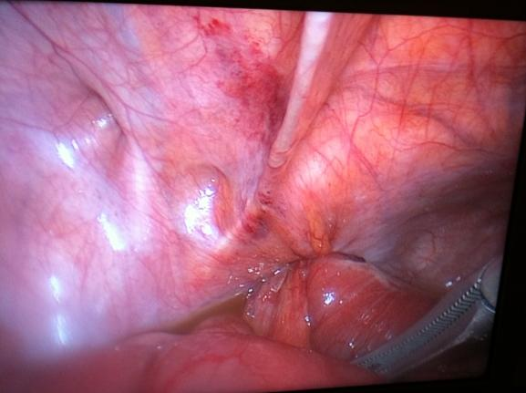

Slide 14
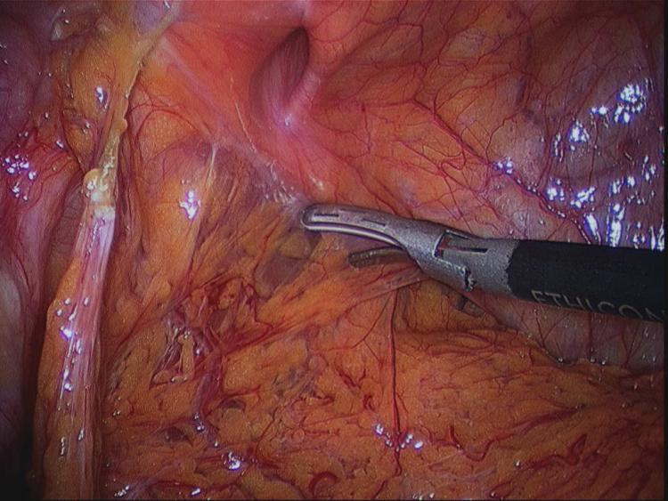
Laparoscopic Femoral Hernia Repair

Slide 15
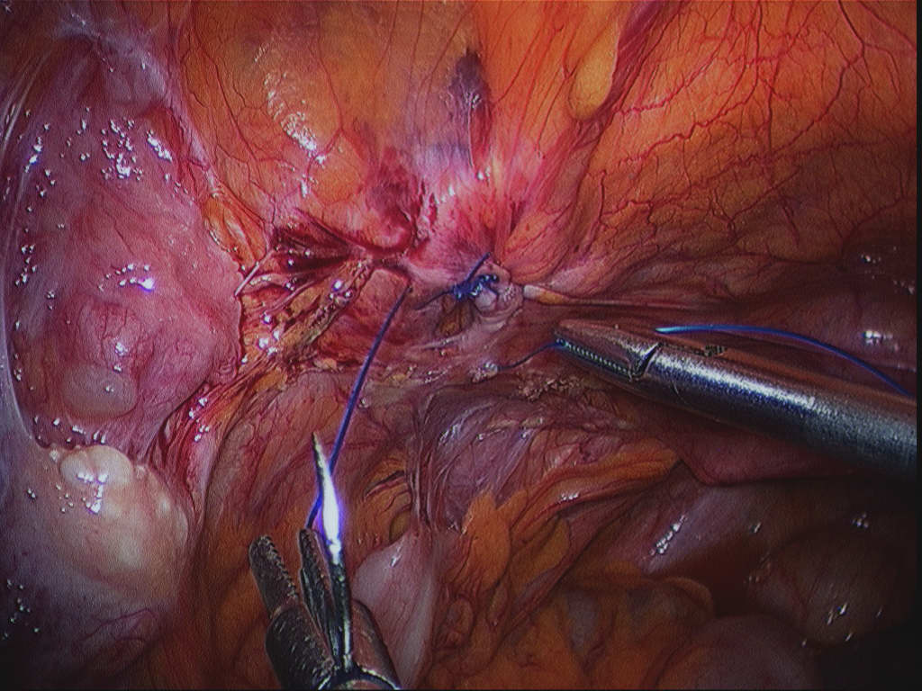
Laparoscopic Femoral Hernia Repair

Slide 16
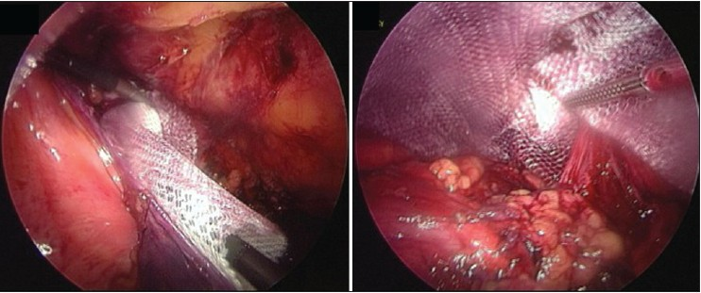
Laparoscopic Femoral Hernia Repair

Slide 17
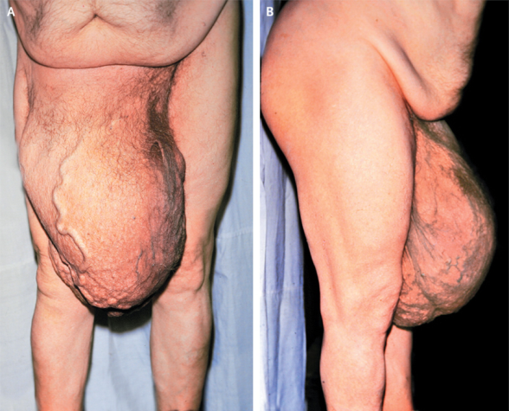
Inguinal Hernia

Slide 18
Nyhus Classification of Groin Hernias
Type I--indirect inguinal hernia Internal inguinal ring normal (i.e., paediatric hernia) Type II--indirect inguinal hernia Dilated internal inguinal ring with posterior inguinal wall intact Type III--posterior wall defects Direct inguinal hernia Indirect inguinal hernia: dilated internal ring with large medial encroachment on the transversalis fascia of the Hesselbach's triangle (i.e., massive scrotal, sliding hernia) Femoral hernia Type IV--recurrent hernia
Notes:
Classification is an attempt to give physicians a common language when it comes to hernias. To allow appropriate comparisons of therapeutic options. Most surgeons continue to describe hernias by their type, location, and volume of the hernia sac

Slide 19
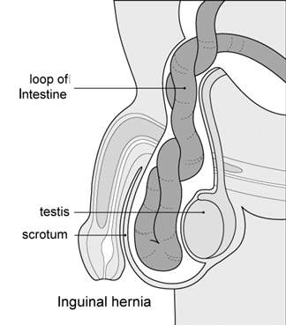
Inguinal hernia
Epidemiology:
Male : Female
by 9 to 1 ratio
Lifetime risk Male 27%, Female 3%
young adults mostly have indirect inguinal hernia
As age of patient increases, the incidence of direct hernias increases
10% emergency surgery

Slide 20
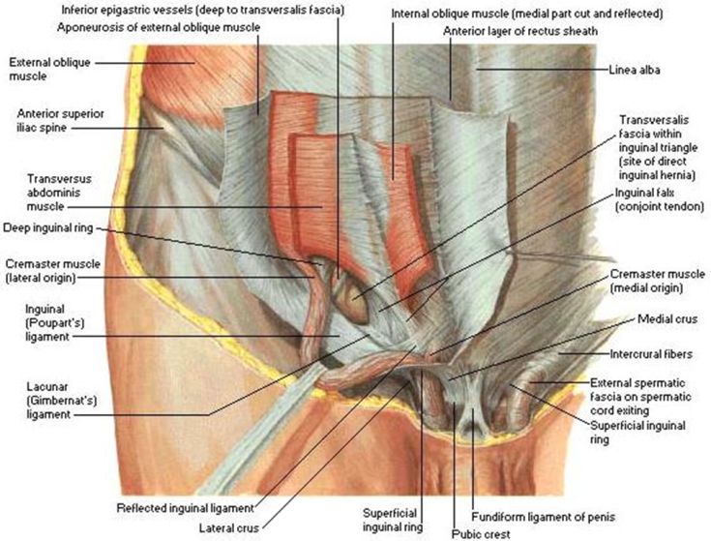
Inguinal Anatomy

Slide 21
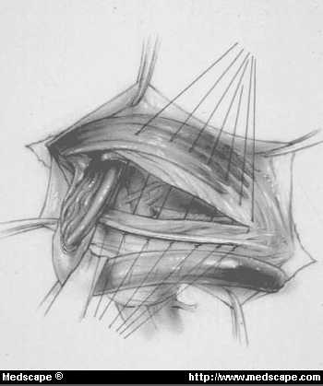
Inguinal Hernia Surgery
Bassini
Shouldice
McVay
Lichtenstein
Preperitoneal
Laparoscopic

Slide 22
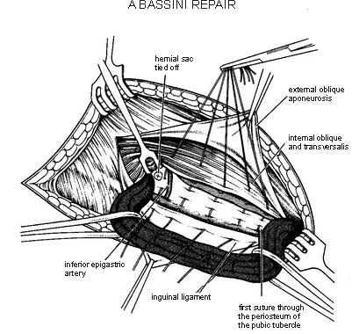
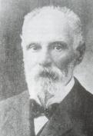
Bassini Repair (1884)
Conjoined tendon to the inguinal ligament.

Slide 23
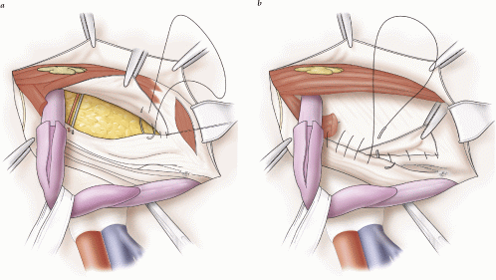
Shouldice Repair (1930s)
Multilayer repair of the posterior wall of the inguinal canal
Double breasting of transversalis fascia
Transverse abdominis aponeurotic arch to the iliopubic tract and Conjoined tendon to the inguinal ligament

Slide 24
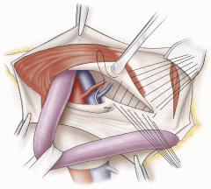
McVay Repair (1948)
Transverse abdominis aponeurosis to Cooper's ligament and iliopubic tract

Slide 25
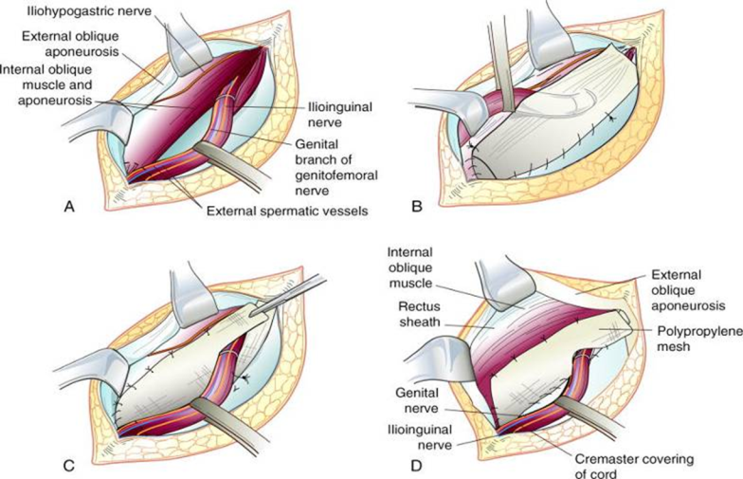
Lichtenstein (1989)
First pure prosthetic, tension-free repair to achieve low recurrence rates

Slide 26
Prosthetic Repair
Allows for a fibrotic reaction to occur between the inguinal floor and the posterior surface of the mesh, thereby forming scar and strengthening the closure of the hernia defect
Notes:
The most popular are polypropylene, either monofilament (Marlex, Prolene) or polyfilament (Surgipro), Dacron (Mersilene) and expanded polytetrafluoroethylene(e-PTFE) (Gore-Tex). Polypropylene and Dacron are supplied in the form of meshes, which promote fibroblast in-growth and collagen deposition, which are important in long-term fixation. Proponents of the monofilament meshes argue that these are more resistant to infection. e-PTFE is not supplied as a mesh but rather as an extruded sheet which has characteristics that are more like a membrane than a mesh. It is porous with nodes of solid PTFE (Teflon) connected by fibrils of the same material. Because e-PTFE is not a mesh, it does not promote as significant of a fibrous response as do the mesh materials and it is not so solidly incorporated into the abdominal wall.

Slide 27
Laparoscopic Inguinal Hernia Repair
TAPP - transabdominal preperitoneal repair was reported in 1992, Arregui et al. (Surg Laparosc Endosc 2:53-58, 1992) and Dion and Morin (Can J Surg 35:209-212, 1992)
TEP – totally extraperitoneal approach reported by Dulucq (Cahiers Chir 79:15-16, 1991)

Slide 28
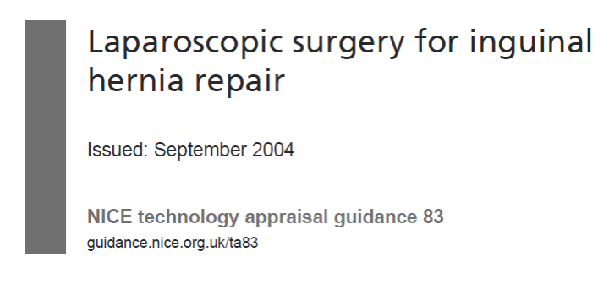
NICE guidelines on Laparoscopic Hernia – 2004
37 RCTs were examined – Lap v open
Lap longer operating time (13.3 min)
Quicker return to work/ activities (3 days)
Reduced rate of numbness (TAPP & TEP)
NICE TA083 guidance DOH 2004

Slide 29
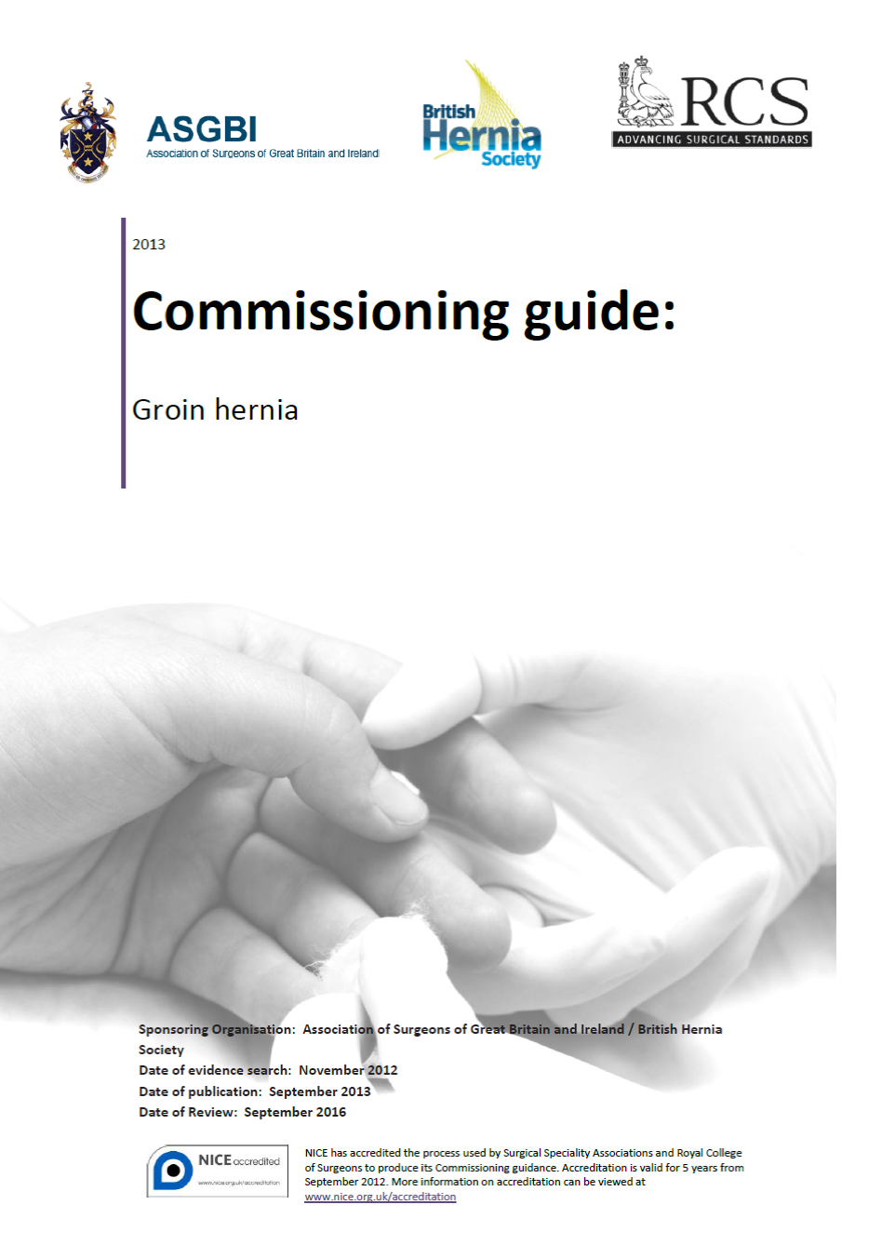

Slide 30
Laparoscopic Inguinal Hernia Repair

Slide 31
Complications of Inguinal Hernia Repair
Seroma/haematoma
Testicular Ischaemia
Visceral injury
Nerve injury
Numbness
Chronic pain - up to 40%
Foreign body feeling
Recurrence 1%
Mesh infection 0.2%
Mortality ‹ 1%

Slide 32
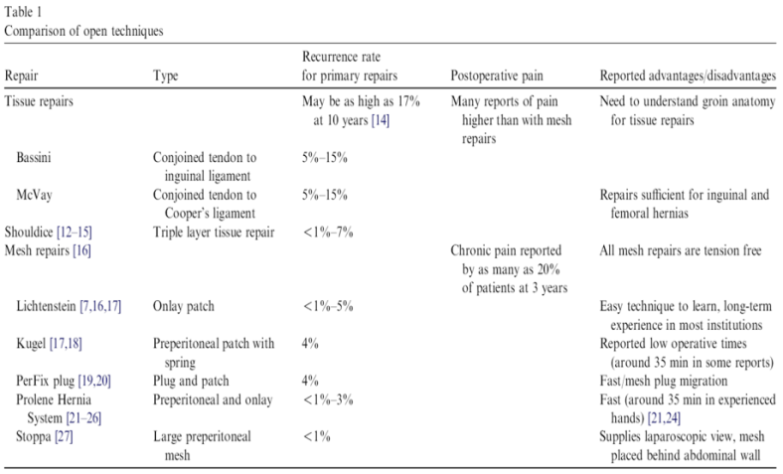
Comparison of open approaches Recurrence

Slide 33
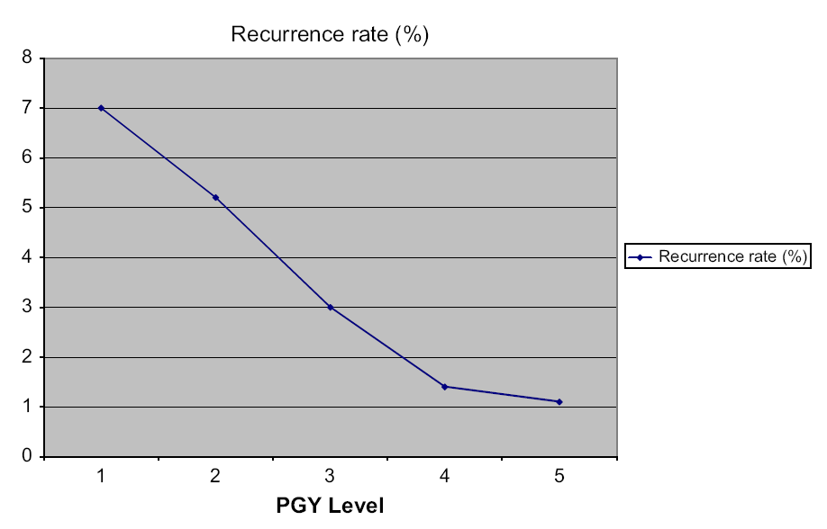
Recurrence rate Surgical Trainees

Slide 34
Watchful Wait vs Repair
Cumulative risk of strangulation over 2 years
476 patients (439 Inguinal, 37 Femoral)
34 strangulations (22 Inguinal, 12 Femoral)
Cumulative Probability of Strangulation
 | 3 months | 2 years
Inguinal | 2.8% | 4.5%
Femoral | 22.0% | 45.0%

Slide 35
Watchful Wait vs Repair
Two independent systematic reviews both concluded that watchful waiting is safe, but most patients will develop symptoms (mainly pain) over time and will require an operation

Slide 36
Inguinal Hernia Repair Mortality
ELECTIVE
All series < 1%
Swedish Registry – not raised above that of background population
Danish study - 26,304 patients
0.02% <60 years, 0.48% >60 years
EMERGENCY
7% in Danish Study
Swedish Registry – x7 emergency surgery
x20 bowel resection

Slide 37
Mortality and Groin Hernias
Women have a higher mortality risk than men, due to a greater risk for emergency procedure irrespective of hernia anatomy and a greater proportion of femoral hernias
After a femoral hernia operation, the mortality risk was increased seven-fold for both men and women

Slide 38
Groin Hernia Guidelines ASGBI 2013 Speed of Referral
Men, reducible, symptomatic – ROUTINE
Men, irreducible – URGENT
Women – URGENT
Strangulated/obstructed - EMERGENCY

Slide 39
Groin Hernia Guidelines ASGBI 2013 Imaging
Diagnostic uncertainty
To exclude other pathology
USS – first line
MRI – if USS neg, and groin pain persists

Slide 40
Groin Hernia Guidelines ASGBI 2013 Indications for Surgery
Symptomatic Inguinal
All Femoral hernias
Asymptomatic Inguinal – can be managed conservatively – but likely to require surgery in the future

Slide 41
Inguinal Hernia Repair Perioperative Antibiotics
Controversial
Surgical Site Infection (SSI) rates 0 -14%
antibiotics may reduce wound infection rate
Mesh infection – 0.3 – 2%
Meta analysis/ Cochrane Reviews –
antibiotics vs controls – no significant difference in SSI or mesh infections
Routine use of prophylactic antibiotics – not recommended, except in high risk patients - >75yrs, Obesity, urinary catheter, Diabetes

Slide 42
Groin Hernia Guidelines ASGBI 2013 Laparoscopic or Open Repair
Laparoscopic
Younger patients
Females
Groin pain with small hernias
Bilateral hernias
Recurrent (index op – Open)
Femoral - elective
Open
Elderly (LA)
Comorbidity (LA)
Anticoagulants
Large inguino-scrotal
Hostile Abdomen
Recurrent (index op – Lap)

Slide 43
Groin Hernia Guidelines ASGBI 2013 Post Op Activity
“Do what you feel you can” – heavy weight lifting 2-3 weeks.
Return to work – median 7 days (open and lap)
Driving – 7 days

Slide 44
Obturator Hernia
9 : 1 female to male ratio
Typical patient is > 70 yrs of age
Multiparous women
Up to 20% bilateral
Concurrent Femoral hernias common
Notes:
Female predominance likely a result of multiparity, wider pelvis, larger obturator rings.
High mortality rate is a reflection of the typical patient- frail, emaciated, with multiple comorbidities

Slide 45
CLINICAL PRESENTATION
Intestinal obstruction
most common presentation (80%)
Up to 70% mortality with strangulation
Overall mortality 25%
Correct preoperative diagnosis in 20% to 38% of patients

Slide 46
ANATOMY
Formed by rami of the ischium and pubis
Bilaterally in anterolateral pelvic wall
Medial to the acetabulum

Slide 47
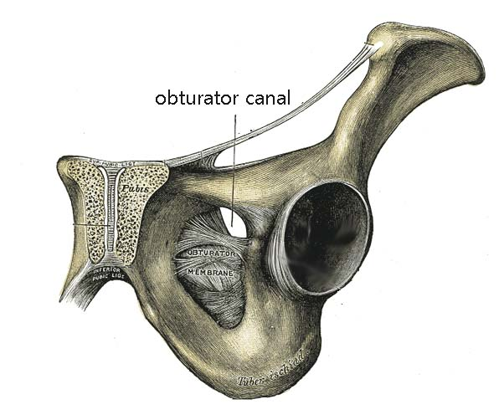

Slide 48
Obturator Foramen
Covered by obturator membrane
Internal orifice closed by preperitoneal fat
Contains obturator nerve and vessels

Slide 49
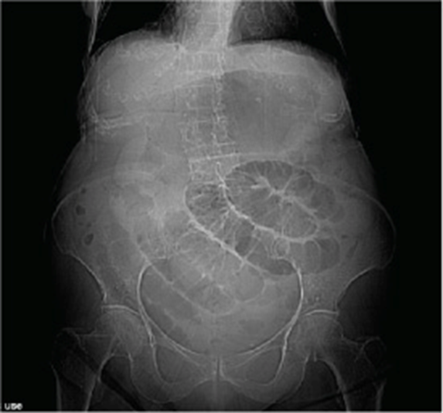

Slide 50
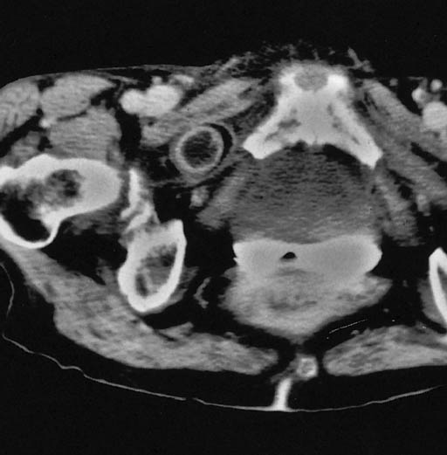
MRI

Slide 51
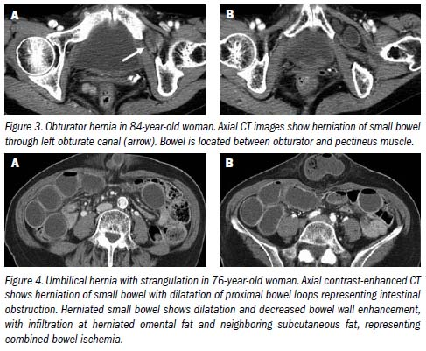
CT

Slide 52
Obturator Hernia Operative Approach
REPAIR
Simple closure of the hernial defect with one or more interrupted sutures
Plugging the canal with cartilage, free omentum ,obturator fascia, polypropylene mesh, teflonpatch, or bladder wall.
Recurrence – 10% for simple closure

Slide 54
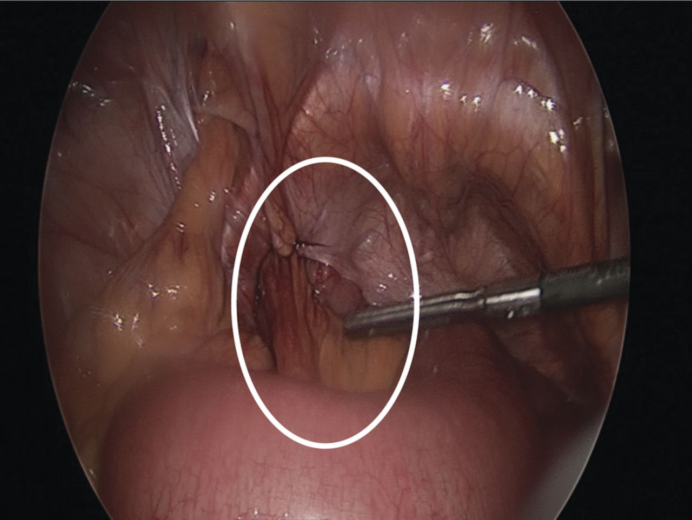
Intraoperative image showing left sided obturator hernia within white outline and incidental femoral hernia at 11’o clock position.
Noel P. Lynch et al. J. surg. case rep. 2013;2013:rjt050
Published by Oxford University Press and JSCR Publishing Ltd. All rights reserved. © The Author 2013.
Notes:
Intraoperative image showing left sided obturator hernia within white outline and incidental femoral hernia at 11’o clock position.

Slide 55
Write a report to Identify, discuss and defend the medico-legal, socio-cultural and ethical issues when pertaining informed consent to patient presented with elective inguinal hernia.

Slide 56
In the link below you find lecture in YouTube application
https://youtu.be/YzMT7y545Zk

