Slide 1
Blood Physiology Immunity Lecture 7 Dr. Suroor

Slide 2
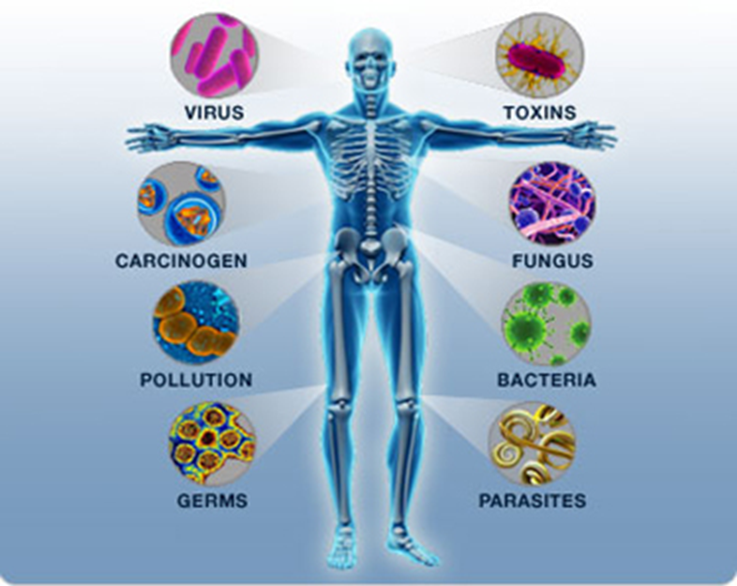
Immunity is body's ability to resist or eliminate potentially harmful foreign materials or abnormal cells like bacteria, virus, toxic substances. Immunity is of two types:
I. Innate immunity.
II. Acquired immunity.

Slide 3
Consists of following activities:
Defense against invading pathogens (viruses & bacteria)
Removal of 'worn-out' cells (e.g., old RBCs) & tissue debris (e.g., from injury or disease)
Identification & destruction of abnormal or mutant cells (primary defense against cancer)
Rejection of 'foreign' cells (e.g., organ transplant)
Inappropriate responses:
Allergies - response to normally harmless substances
Autoimmune diseases
The immunity of 2 main types : Innate (natural)& Acquired

Slide 4
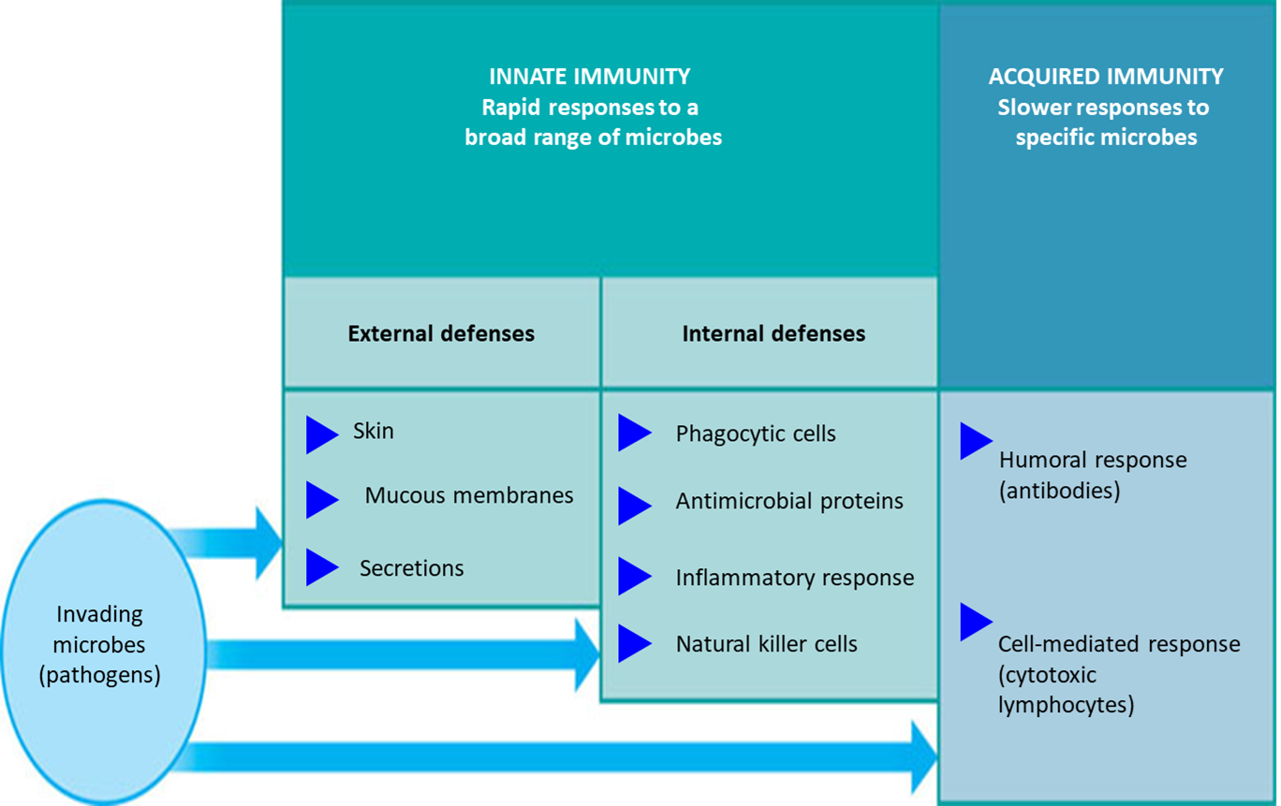

Slide 5
Innate immunity is the inborn capacity of the body to resist pathogens. if the organisms enter the body, innate immunity eliminates them before the development of any disease.
It is called the natural or non-specific immunity, represents the first line of defense against any type of pathogens
Innate or natural immunity involving:
Phagocytosis of bacteria and other invaders by white blood cells and cells of the tissue macrophage system
2. Destruction of swallowed organisms by the acid secretions of the stomach and the digestive enzymes.
3. Resistance of the skin to invasion by organisms.
4. Presence in the blood of certain chemicals and cells that attach to foreign organisms or toxins and destroy them.
Innate immunity
relies on mechanisms already existing before microbe infects host
is the first line of defense
has no memory for subsequent exposure
relies on non specific mechanisms

Slide 6
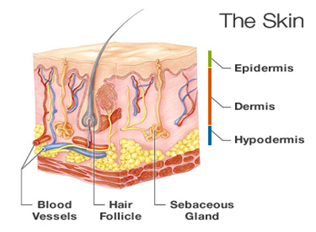
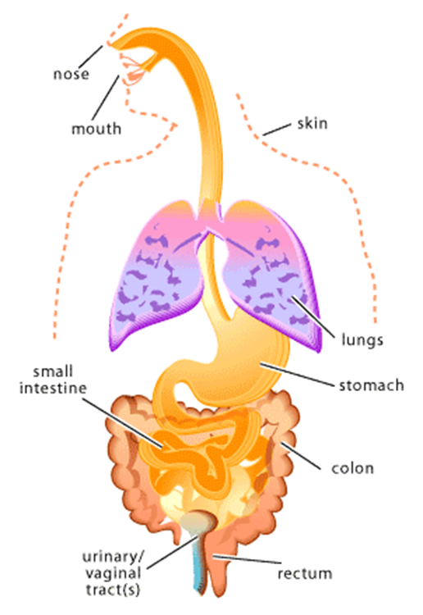
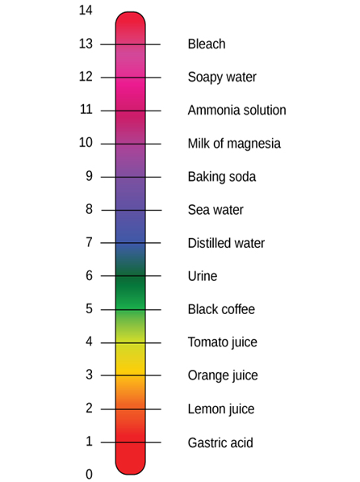
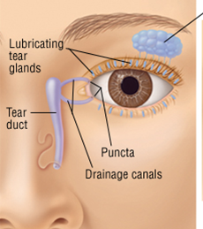
The cells that mediate innate immunity include neutrophils, macrophages, and natural killer (NK) cells, large lymphocytes cytotoxic one . All these cells respond to lipid and carbohydrate sequences unique to bacterial cell walls and to other substances characteristic of tumor and transplant cells.

Slide 7
 ACQUIRED IMMUNITY OR SPECIFIC IMMUNITY
Acquired immunity is the resistance developed in the body against any specific foreign body like bacteria, viruses, toxins, vaccines or transplanted tissues , known as specific immunity.
It is the most powerful immune mechanism that protects the body from the invading organisms or toxic substances. Lymphocytes are responsible for acquired immunity
Two types of acquired immunity develop in the body:
Cellular immunity
2. Humoral immunity
Adaptive immunity
develops following entry of microbe into the host
comes into action after innate immunity fails to get rid of microbe
has memory to deal with subsequent exposure
happens through specific cells
T cells (cell mediated)
B cells (antibody mediated

Slide 8
Humoral immunity is mediated by circulating immunoglobulin antibodies in the γ-globulin fraction of the plasma proteins. Humoral immunity is a major defense against bacterial infections.
Immunoglobulins are produced by B lymphocytes, and they activate the complement system and attack and neutralize antigens.
Cellular immunity is mediated by T lymphocytes. It is responsible for delayed allergic reactions and rejection of transplants of foreign tissue.
Cytotoxic T cells attack and destroy cells that have the antigen which activated them. Cellular immunity constitutes a major defense against infections due to viruses, fungi, and a few bacteria such as the tubercle bacillus. It also helps defend against tumors.

Slide 9
Development of the Immune System
During fetal development, lymphocyte precursors come from the bone marrow. Those that populate the thymus become transformed by the environment in this organ into the lymphocytes responsible for cellular immunity (T lymphocytes).
humoral immunity (B lymphocytes the transformation to B lymphocytes occurs in bursal equivalents, ie, the fetal liver and, after birth, the bone marrow. After residence in the thymus or liver, many of the T and B lymphocytes migrate to the lymph nodes and bone marrow. Most of the processing occurs during fetal and neonatal life. However, there is also a slow, continuous production of new lymphocytes from stem cells in adults.

Slide 10
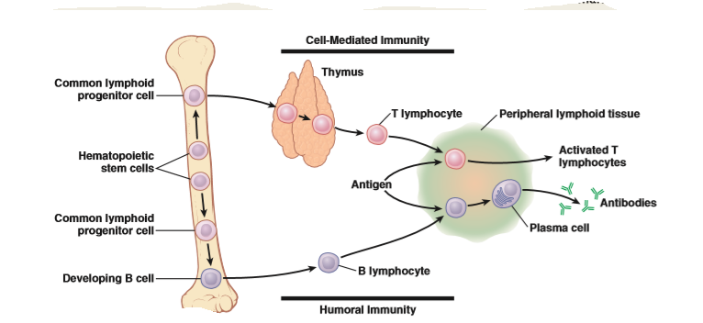

Slide 11
B cells differentiate into plasma cells and memory B cells.
Memory B cells “remember” specific antigens and can launch fast immune response if antigen is encountered again.
three major types of T cells: cytotoxic T cells, helper T cells, and memory T cells.
There are two subtypes of helper T cells:
T helper 1 (TH1) cells secrete IL-2 and γ-interferon and are concerned primarily with cellular immunity;
T helper 2 (TH2) cells secrete IL-4 and IL-5 and interact primarily with B cells in relation to humoral immunity.
Cytotoxic T cells destroy transplanted and other foreign cells, with their development aided and directed by helper T cells.

Slide 12
Markers on the surface of lymphocytes are assigned CD (clusters of differentiation) numbers on the basis of their reactions to a panel of monoclonal antibodies. Most cytotoxic T cells display the glycoprotein CD8, CD8+ T cells destroy infected cells containing microbes or microbial proteins and helper T cells display the glycoprotein CD4. CD4+ T cells activate phagocytes to kill microbes
These proteins are closely associated with the T cell receptors and may function as coreceptors.
Natural killer cells are also cytotoxic lymphocytes, though they are not T cells. limits the spread of tumors and microbial infections by inducing apoptosis in cells, limiting tissue damage
Memory B Cells & T Cells
After exposure to a given antigen, a small number of activated B and T cells persist as memory B and T cells. These cells are readily converted to effector cells by a later encounter with the same antigen. This ability to produce an accelerated response to a second exposure to an antigen is a key characteristic of acquired immunity. The ability persists for long periods of time, and in some instances (eg, immunity to measles) it can be lifelong.
It had been argued that the long life of memory cells involves their repeated exposure to small amounts of antigen.

Slide 13
Role of the T Cells in Activation of the B Lymphocytes.
Most antigens activate both T lymphocytes and B lymphocytes at the same time , some of the T-cells that are formed, called T-helper cells, secrete specific substances (collectively called lymphokines) that activate the specific B lymphocytes. Indeed, without the aid of these T-helper cells, the quantity of antibodies formed by the B lymphocytes is usually slight.
Formation of Antibodies by Plasma Cells.
Before exposure to a specific antigen, the clones of B lymphocytes remain dormant in the lymphoid tissue. Upon entry of a foreign antigen, macrophages in lymphoid tissue phagocytize the antigen and then present it to adjacent B lymphocytes.
the antigen is presented to T cells at the same time, and activated T-helper cells are formed. These helper cells also contribute to extreme activation of the B lymphocytes. The B lymphocytes specific for the antigen immediately enlarge and take on the appearance of lymphoblasts
The mature plasma cell then produces gamma globulin antibodies at an extremely rapid rate—about 2000 molecules per second for each plasma cell. the antibodies are secreted into the lymph and carried to the circulating blood. This process continues for several days or weeks until finally exhaustion and death of the plasma cells occur.

Slide 14
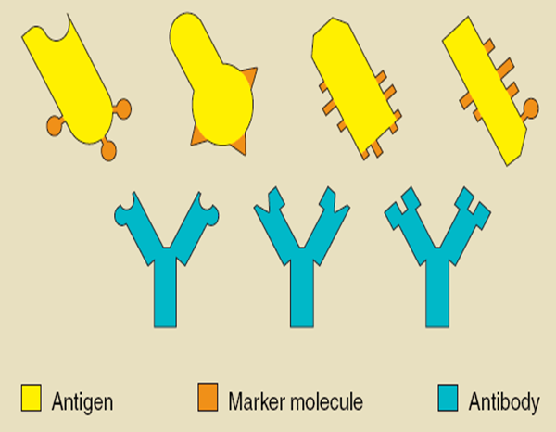
Antigen (Ag): are the substances which induce specific immune reactions
in the body.
▪ It is foreign substance (organism, toxin, vaccine, or any substance) that is recognized by one or more of its chemical compound mainly surface protein or polysaccharides.
Each Ag has multiple Ag determinants (epitopes) which are the part of an antigen that is actually bound by an Ab or lymphocyte Ag receptor.

Slide 15
Antibodies are gamma globulins called immunoglobulins (Ig) that have molecular weights between 160,000 and 970,000 and constitute about 20 percent of all the plasma proteins.
All the immunoglobulins are composed of combinations of light and heavy polypeptide chains. Most are a combination of two light and two heavy chains, some of the immunoglobulins have combinations of as many as 10 heavy and 10 light chains, which give rise to high-molecular-weight immunoglobulins. in all immunoglobulins, each heavy chain is paralleled by a light chain at one of its ends, thus forming a heavy-light pair, and there are always at least 2 and as many as 10 such pairs in each immunoglobulin molecule
.
Ig as designated end of each light and heavy chain, called the variable portion; the remainder of each chain is called the constant portion. The variable portion is different for each specific antibody, and it is this portion that attaches specifically to a particular type of antigen. The constant portion of the antibody determines other properties of the antibody. A combination of noncovalent and covalent bonds (disulfide) holds the light and heavy chains together.

Slide 16
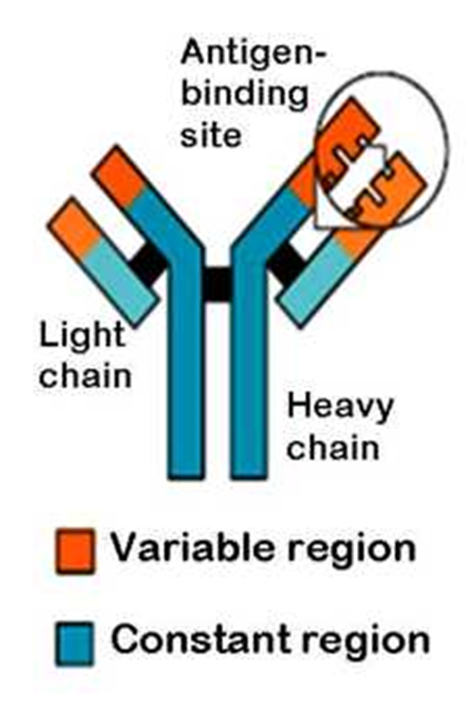
Belong to the gamma-globulin fraction of serum proteins :
Y-shaped 2 identical heavy chains 2 identical light chains
All immunoglobulins are not antibodies

Slide 17
Five kinds of antibodies IgG, IgM, IgA, IgD, IgE
these classes of antibodies are from B- cells :-
1. IgG :- it has high Ag affinity and can cross the placenta barrier and
protect the new born for a several months .
2. IgM :- its responsible the primary immune response and this type can not
cross the placenta barrier .
3. IgA :- this type are present in equal a mounts in secretion such as saliva ,
gastric juice , pancreatic and intestinal juice . it protect mucosal surface in
the guts respiratory and urinary tracts .
4. IgE :- it mainly bound to basophiles and mast cells and involved in the
pathogenesis of allergic disease .
5.IgD:- act as receptor for B lymphocyte and participate in their activation
IgG which is a bivalent antibody and constitutes about 75 percent of the antibodies of the normal person, provides natural passive immunity to the developing fetus by crossing the placenta from mother to baby.
IgE, which constitutes only a small percentage of the antibodies but is especially involved in allergy. The IgM class is a large share of the antibodies formed during the primary response are of this type. These antibodies have 10 binding sites that make them exceedingly effective in protecting the body against invaders, even though there are not many IgM antibodies

Slide 18
Mechanisms of Action of Antibodies
Antibodies act mainly in two ways to protect the body against invading agents: (1) by direct attack on the invader and (2) by activation of the “complement system” that then has multiple means of its own for destroying the invader.
Because of the bivalent nature of the antibodies and the multiple antigen sites on most invading agents, the antibodies can inactivate the invading agent in one of several ways, as follows:
Agglutination, in which multiple large particles with antigens on their surfaces, such as bacteria or red cells, are bound together into a clump
. Precipitation, in which the molecular complex of soluble antigen (such as tetanus toxin) and antibody becomes so large that it is rendered insoluble and precipitates
Neutralization, in which the antibodies cover the toxic sites of the antigenic agent
4. Lysis, in which some potent antibodies are occasionally capable of directly attacking membranes of cellular agents and thereby cause rupture of the agent
.

Slide 19
The Complement System for Antibody Action
"Complement" is a collective term to describe a system of about 20 different proteins, many of which are enzyme precursors. The principal actors in this system are 11 proteins designated C1 through C9, B, and D. All these are present normally among the plasma proteins and also among the plasma proteins that leak out of the capillaries into the tissue spaces. The enzyme precursors are normally inactive, but Complement can be activated by two pathways: classical and alternative
1- The Classical Pathway
Classical pathway is linked to the immune system , depends on the binding of antibodies to invading organisms , Subsequent binding of C1 to the antigen-antibody complexes (complement fixation) The classical pathway is activated by an antigen-antibody reaction. , when an antibody binds with an antigen, a specific reactive site on the "constant" portion of the antibody becomes uncovered, or activated, and this in turn binds directly with the C1 molecule of the complement system, setting into motion a "cascade" of sequential reactions.
2- The Alternate Pathway
Alternative pathway is triggered by interaction among factors B, D, and P, and polysaccharide molecules present on microorganisms , complement system sometimes is activated without the intermediation of an antigen-antibody reaction. This occurs especially in response to large polysaccharide molecules in the cell membranes of some invading microorganisms
C3a , C4a & C5a release histamine from these cells to help in immobilization of Ag from site of invasion & stimulate allergy & local inflammation.
Chemotaxis: C5a is chemotactic substance to neutrophils & monocytes.

Slide 20
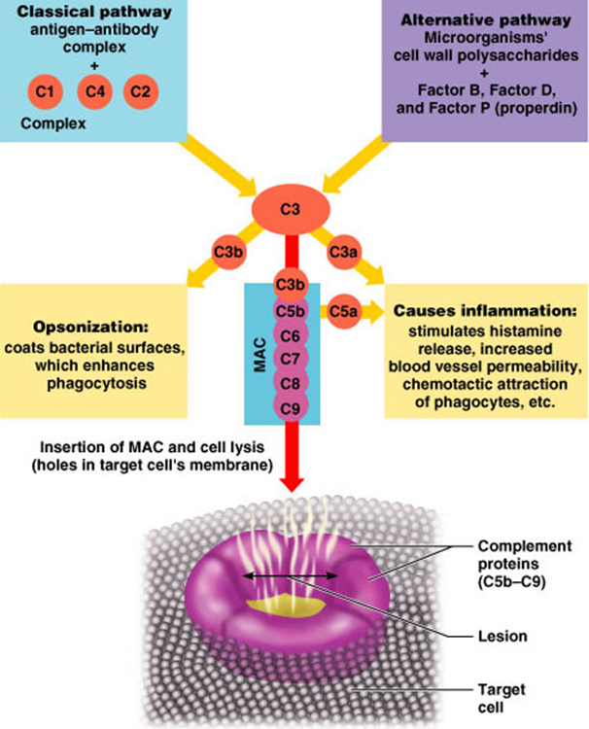

Slide 21
