Slide 1
Chronic complication of DM
Adel Gassab Mohammed
MD. CABMS. MSc , Specialist Endocrinologist,
College of medicine
ORCID iD: https://orcid.org/0000-0001-9084-1038.
Email: adelgassab@utq.edu.iq

Slide 2
Chronic complication of DM
Microvascular
Retinopathy
Nephropathy
Neuropathy
Foot disease
Macro vascular
Coronary circulation
Cerebral circulation
Peripheral circulation

Slide 3
Diabetic retinopathy
One of the common causes of blindness in adults between 30-65 years of age
Prevalence increases with duration of diabetes
Almost all individual with type 1 diabetes
Type 2 will have some degree after 20 years.
Risk factors: long duration, poor glycemic control, hypertension, hyperlipidemia, pregnancy, renal disease, obesity, smoking

Slide 4
Diabetic retinopathy
Pathogenesis
Hyperglycemia→ increase retinal blood flow
→ disrupt intracelllular metabolism in retinaendothelial cells & pericytes→ impaired vascular autoregulation, → capillary hypoperfusion & closure→ chronic retina ischemia→ stimulates production of growth factor (Vascular endothelial growth factor (VEGF)→further stimulates deleterious endothelial cell growth& increase vascular permeability

Slide 5
Diabetic retinopathy
Risk Factors
Long duration of diabetes
Poor glycemic control
Hypertension
Hyperlipidemia
Pregnancy
Nephropathy/renal disease
obesity,
smoking

Slide 6
Diabetic retinopathy
Clinical features
Proliferative-
growth of new blood
Non proliferative
Microaneurysm- dot
vessels on retina→ vitrous hemorrhage→fibrosis &scarring→tractional retina detachment
Retinal hemorrhage- blot
Capillary hypoperfusion
Cotton wool spots
Venous beading
Intra-retinal microvascular abnormalities ( pre- proliferatives)

Slide 7
Diabetic retinopathy
Cystoid macular edema→increase vascular permeability& deposition of hard exudates in central retina→ loss of vision
Proliferative→stimulates new vessels to grow on the ant. Surface of the iris (rubeosis iridis)→secondory glaucoma

Slide 8
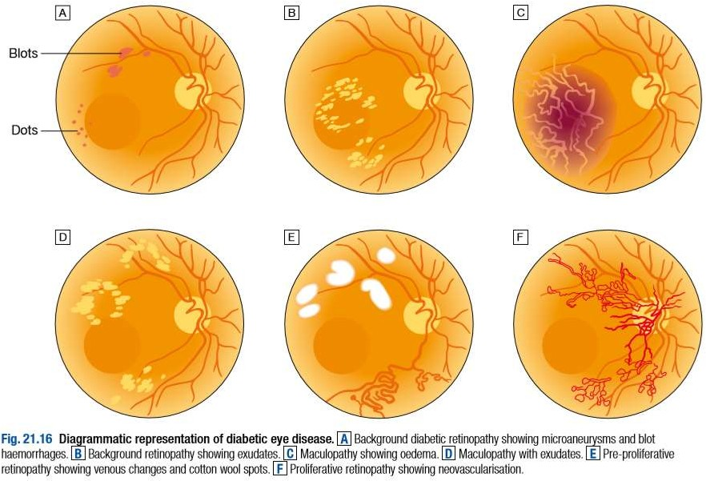

Slide 9
Diabetic retinopathy
Prevention
Glycemic, blood pressure, lipid profile control→reduce incidence & progression of DR
Screening→ annual screening retinopathy (those with risk factor)

Slide 10
Diabetic retinopathy
Management
Good glycemic & BP control
HbA1c – 53mmol/mol (7%)
– BP- <130/80 mmHg
Ranibizumab- diabetic macula edema
Retinal photocoagulation
Severe proliferative
Severe non-proliferative retinopathy
New vessels+ vitreous hemorrhage
New vessels- vitreous hemorrhage
CSMO
F(x): treat leaking microaneurysm & areas of retinal thickening in macular area & reduce macular edema

Slide 11
Destroy areas of retinal ischemia
Reduce risk of recurrent hemorrhage
Patients should reviewed regularly
Vitrectomy→ advanced diabetic eye due to type 1

Slide 12
Other causes of visual loss in people with diabetes
Cataract
Age related macular degeneration
Retinal vein occlusion
Retinal arterial occlusion
Non arteritic ischemic optic neuropathy
glaucoma

Slide 13
Diabetic nephropathy
Cause of morbidity & mortality
Most common causes of end-stage renal failure
About 30% patients with type 1 diabetes developed nephropathy after 20 years diagnosis
From the outset, the risk is not equal in all patients

Slide 14
Diabetic nephropathy
Risk factors
Poor glycemic control
Long duration of diabetes
Presence of other microvascular complication
Ethnicity (Asians, Pima Indians)
Pre-existing hypertension
Family h/o diabetic nephropathy
Family h/o hypertension

Slide 15
Diabetic nephropathy
Pathogenesis
mesangial expansion is directly induced by hyperglycemia, perhaps via increased matrix production or glycosylation of matrix proteins.
→thickening of the glomerular basement
membrane (GBM) occurs→glomerular sclerosis is caused by intraglomerular hypertension (induced by dilatation of the afferent renal artery or from ischemic injury induced by hyaline narrowing of the vessels supplying the glomeruli).

Slide 16
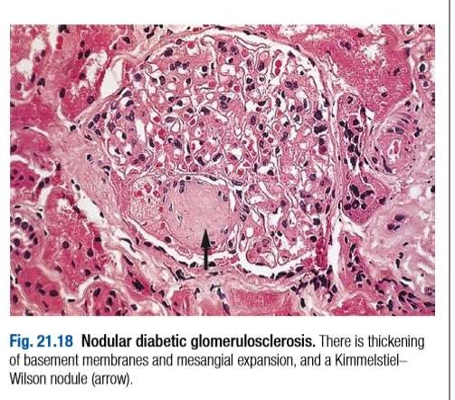

Slide 17
Diabetic nephropathy
Diagnosis & screening
Microalbuminuria
marcoalbuminuria
Who to screen
Patients with type 1 diabetes annually from 5 years after diagnosis
Patients with type 2 diabetes anually from time of diagnosis
Early morning urine measured for albumin:creatinine ratio, Microalbuminuria present if
Male ACR 2.5-30 mg/mmol creatinine
Female ACR 3.5-30mg/mmol creatinine
Elevated ACR followed by repeat test
Microalbuminura establish if 2 out of 3 tests positive

Slide 18
Diabetic nephropathy
Management
Reduce risk of progression of nephropathy & CVS disease
Aggressive reduction of BP
Aggressive CVS risk factor reduction
Type 1-ACEI-reduction of BP
Type 2-ARB
Blockade of renin angiotensin 2 mediated vasoconstriction of efferent arterioles in glomeruli→ dilatation of these vessels decrease glomeruli filtration pressure → decrease hyperfiltration & protein leak
CI : renal artery stenosis
Electrolyte & renal f(x) should be check
Alternatives: diltiazem, verapamil
Renal replacement therapy
Renal transplantation
Pancreatic transplantation

Slide 19
Diabetic neuropathy
Mainly manifest in the peripheral nervous system.
Causes substantial morbidity & mortality
Diagnosed base on clinical sign & symptoms after the exclusion of all causes neuropathy.
Affect 50-90% of patients with diabetes, of those 15-30% having painful diabetic neuropathy.
Prevalence –duration of diabetes & degree of metabolic control.

Slide 20
Diabetic neuropathy
Pathogenesis
Occurs secondary to metabolic disturbance.
Pathological features:
Axonal degeneration of both myelinated+unmyelinated fibres
thickening of schwann cell basal lamina
pacthy segmental demyelination
abnormal intraneural capillaries

Slide 21
Diabetic neuropathy
Classification
somatic
Polyneuropathy Symmetrical- mainly sensory & distal Asymmetrical-mainly motor& proximal (amyotrophy) Mononeuropathy ( mononeuritis multiplex)
visceral
Cardiovascular sudomotor Gastrointestinal vasomotor Genitourinary pupillary

Slide 22
Diabetic neuropathy
Clinical features
Symmetrical sensory
polyneuropathy
Asymtomatic
Mc signs :
diminished perception of vibration sensation distally
Gloves & stocking impairment
Loss of tendon reflexes in LL
A diffuse small fibre neuropathy altered perception of pain & temperature, a/w symptomatic autonomic neuropathy→foot ulcers & Charcot neuroarthropathy
Symtomatic
Sensory abnormalities
predominant
Paraesthesiae in the feet
Pain the LL
Burning sensation in the soles of
feet
Cutaneous hyperaesthesiae
Abnormal gait- wide based
a/w numbness in the feet
Callus skin at pressure point
Electrophysiological test-slow conduction both motor & sensory
Test vibration & thermal
thresholds- abnormal

Slide 23
Daibetic neuropathy
Asymmetrical motor diabetic neuropathy
Called as diabetic amyothrophy
Progressive weakness & wasting of proximal muscles of LL
Severe pain –ant. Aspect of legs (hyperaesthesiae & paraaesthesiae)
Loss of weight ( neuropathic cachexia)
Tendon reflexes –absent
Extensor plantar responses +++
CSF protein –raised
Management-mainly supportive
Recovery within 12 month, some deficit may permanent

Slide 24
Diabetic neuropathy
Mononeuropathy
Motor or sensory function affected within a single peripheral or cranial nerve
Severe & rapid in onset, but eventually recover
Most common CN affected : 3rd& 6th (diplopia)
Nerves compression palsies most commonly occur→ median nerve (carpal tunnel syndrome), less common→ ulnar nerves
Lateral popliteal nerves compression→ foot drop

Slide 25
Diabetic neuropathy
Autonomic neuropathy
Not necessarily associated with peripheral somatic neuropathy.
Parasympathetic / sympathetic nerves may be predominantly affected in one/ more visceral system.

Slide 26
Postural hypotension
Resting tachycardia
Fixed heart rate
Cardiovascular
Dysphagia
Abdominal fullness, nausea , vomiting
Nocturnal diarrhea + fecal incontinence
constipation
Gastrointestinal
Difficulty in micturition, urinary incontinence, recurrent infection
Erectile dysfunction & retrograde ejaculation
Genitourinary
Nocturnal sweat w/o hypoglycemia
Gustatory sweating
anhydrosis
sudomotor
Feet feel cold
Dependent edema
Bullous formation
vasomotor
Decreased pupil size
Resistance to mydriatics
Delayed/ absent reflexes to light
Pupillary

Slide 27
Diabetic neuropathy
Management Postural hypotension
Pain &paraesthesia from peripheral
somatic neuropathies
Support stockings
Fludrocortison
NSAIDS
α-adrenoceptor agonist (midodrine)
Intensive insulin therapy
Anticonvulsants (gabapentin, pregabalin, carbamazepin, phenytoin)
Tricyclic antidepressants
(amytriptyline, imipramine)
Other antidepressant(duloxetine)
Opiates ( tramadol, oxycodone)
Membrane stabilisers (
mexiletine, IV lidocaine)
Antioxidant (α-lipoic acid)
Diarrhea
Loperamide
Broad spectrum antibiotiics
Clonidine
octreotide

Slide 28
Diabetic neuropathy
Gastroparesis
Dopamine antagonist ( metoclopromide, domperidone)
Erythmycin
Gastric pacemaker, percutaneus enteral feeding
Constipation
Stimulant laxatives
Erectile dysfuction
Phosphodiesterase type 5 inhibitors (sildenafil, vardenafil, tadalafil)
Dopamine agonist (apomorphine)
Prostalglandin E1 ( alprostadil)
Vacuum tumescence devices
Psychological counselling
Atonic bladder
Intermittent self catheterization
Excessive sweating
Anticholinergic drugs ( propantheline, poldine,oxybutinin)
Clonidine
Topical antimuscurinic agents (glycopyrrolate cream)

Slide 29
Macrovascular Disease Due to Diabetes
greater risk for heart attacks, strokes and poor circulation to the legs.
People with diabetes can have problems with their blood vessels. It is common for the arteries to get narrow. This can lead to disorders all through the body.
The Metabolic Syndrome
This is a group of problems:
too much belly fat
high blood pressure
high blood fats (“triglycerides”)
low HDL (“good”) cholesterol
high blood sugar

Slide 30
Each of the problems listed above raises the risk of CHD (coronary heart disease). And they may play roles in strokes and PAD (peripheral artery disease). High insulin levels and a large waist boost the risk of death from CHD.

Slide 31
Coronary Heart Disease
Some arteries carry blood to the heart. In CHD, these arteries get narrow. People who have diabetes are at risk for CHD. Women who have diabetes are at high risk for heart attacks.
The arteries to the heart tend to get wider when you exercise. This increases blood flow to the heart. But in people with diabetes, these arteries do not get as wide. So, such people are at risk
for chest pain (”angina”). And they are at risk for heart attacks. Diabetes is just one risk factor for CHD. There are other risk factors:
smoking
high blood pressure
high LDL (“bad”) cholesterol
low HDL (“good”) cholesterol

Slide 32
people with type 2 diabetes and no history of CHD
people without diabetes who had already suffered a heart attack
Both groups had the same risk of a heart attack. People with diabetes should deal with any risk factors for CHD.
Stroke
People who have diabetes are at risk for stroke.
Stroke risk factors that are related to diabetes include:
high A1C levels (high blood sugar)
long history of diabetes
High blood sugar may raise stroke risk in different ways. It may:
allow cholesterol to build up faster along arteries to the brain
promote blood clots
Another risk factor for stroke is high blood pressure. Many people with diabetes have high blood pressure.

Slide 33
Peripheral Artery Disease
Some arteries carry blood to the legs. In PAD, these arteries get narrow. It’s marked by leg pain with exercise that stops quickly with rest. This is a sign of poor circulation. Poor circulation can slow the healing of injuries to the skin. This may lead to sores on feet and legs.
Diabetes and smoking each raise the risk of PAD. A person with diabetes who smokes has an even greater risk. People with PAD should deal with the same risk factors noted for CHD. These are:
smoking
high blood pressure
high LDL (“bad”) cholesterol
low HDL (“good”) cholesterol
If you have very bad PAD you may need surgery. This will bypass the blocked blood vessels. Or you can have a surgery called angioplasty to treat PAD. A small balloon is used to open up the narrowed artery.

Slide 34
Diabetic foot
Aetiology
Foot ulceration
Trauma in the presence of neuropathy/ peripheral vascular disease + infection 2’ to disruption of protective epidermis
Ulcer develops at site of plaque of callus skin beneth tissue necrosis→breaks through to surface
Charcot neuroarthropathy
Progressive condition affecting joints & bones of foot
Earlt inflammation→joint dislocation→subluxation→pathological fracture of foot→ debilitating deformity

Slide 35
Diabetic foot
Pathophysiology
Unperceived trauma→ progressive destruction & increased blood flow→ mismatch of bone destruction & synthesis

Slide 36
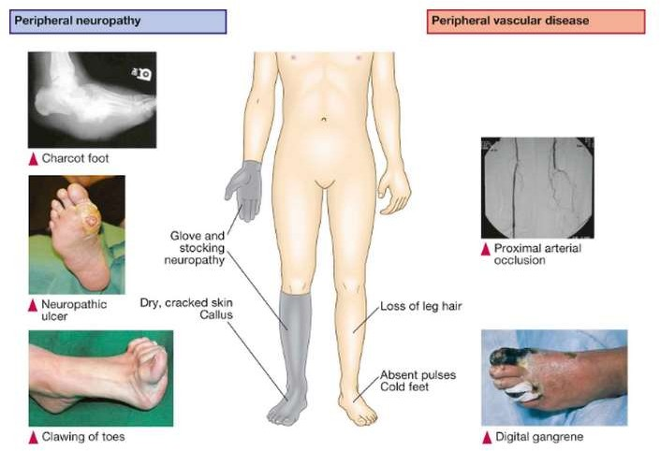
Diabetic foot
Clinical features

Slide 37
Diabetic foot
Managements
Foot ulcer
Referred to multidiciplinary foot team
Treatment:
debridement of dead
tissue
Prompt treatment with antibiotics, pressure relief using dressing
Neurosichemic –vascular assessment often carried out→ultrasound/angiograp hy
Gangrene-→ amputation
Charcot foot
Investigation:MRI
Treatment:
Immobilisation
Avoid weight bearing on
affected foot

Slide 38
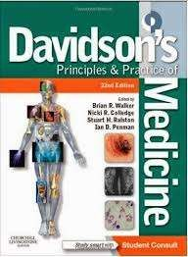
References
http://emedicine.medsc ape.com/article/238946
-overview#a0104
http://emedicine.medsc ape.com/article/237378
-overview#a0104

Slide 39
Thank you ☺

