Slide 1
URINARY INCONTENENCE

Slide 2
DIFENITION

Slide 5
Types of urinary incontinence

Slide 26
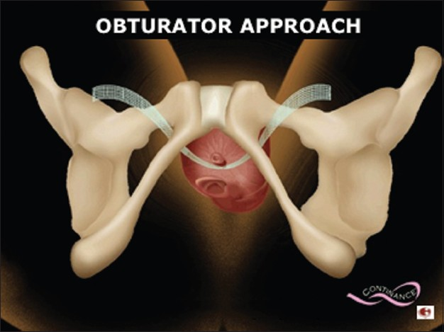

Slide 27
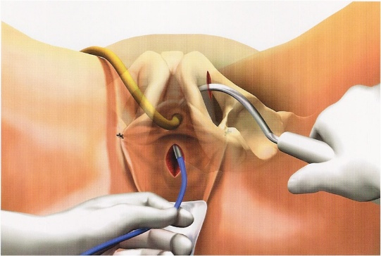

Slide 28
